Slide 1



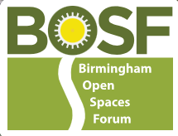
Urban Nature Development for a City of Nature
End of FPA Project Report
Midland Art Centre | Thursday, Mar 27, 2025, | 10:00 am - 2pm
Presented by: The City of Nature Team

Slide 2

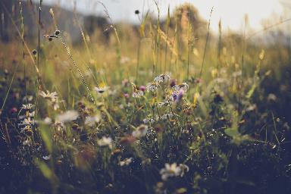
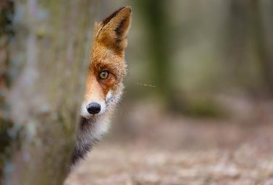
Meeting Overview
I want to start by thanking you for being here today, and for everything that you have done to contribute to delivering the aims of the City of Nature Plan – so far.
We are between the end of the Future Parks Accelerator project and the start button being pressed on the mechanism that will deliver the plan over the next 23 years.
Notes:
Wildflowers and Fox looking round a tree.

Slide 3

How did we get here?
Notes:
A Reminder of the Journey to Urban Nature Development through FPA (30 mins)
Reflecting on the progress made so far, this session will revisit key milestones in the journey from the Future Parks Accelerator (FPA) to the Urban Nature Development Project.
We’ll celebrate achievements and set the context for today’s discussions.

Slide 4
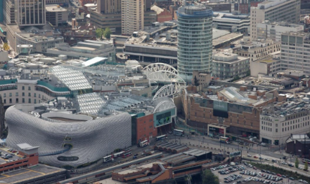
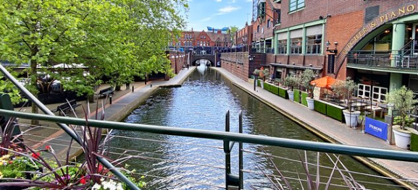
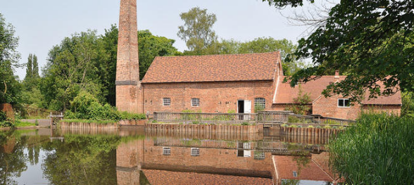
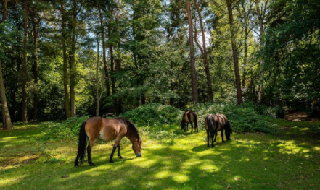
Where are we? What does birmingham mean to you?
When we think about Birmingham what comes into our minds?
Notes:
When we think about Birmingham what images come into our minds?
All these images are in Birmingham. The city centre (very grey, not much green just one tree if you look closely), Brindley Place canals, Sarehole Mill Museum and ponies in Sutton Park LNR.

Slide 5
How Green is our City?
Birmingham is one of the greenest cities in Europe - with over 600 publicly accessible parks and green spaces across the city.
These spaces cover over 4,700 hectares (47 Km2) - for comparison, this is three times the size of the city of Lichfield (14.02 Km2) or 1.5x the city of Worcester (33.3 Km2).
We have Local Nature Reserves, a National Nature Reserve which is also a SSSI, Sites of importance to Nature Conservation and sites of local importance to nature conservation.
Fifteen of our city’s parks, commons and country parks have previously held the Green Flag Award, the national quality award for parks and green spaces, making them among the best in the country.
There are over 1 million trees across the city - to recognize this, Birmingham has earned the prestigious ‘Tree Cities of the World’ status. In 2021 Birmingham was the first UK city to adopt an Urban Forest Master Plan.
Running through and connecting these green spaces are 32 miles (51km) of canals, 3 rivers and 250miles (400km) of urban brook courses; sometimes referred to as our blue infrastructure.

Slide 6
Some of your green spaces
National Nature Reserve
Sutton Park
Country Parks
Lickey Hills Country Park
New Hall Valley Country Park
Sheldon Country Park
Woodgate Valley Country Park
Kingfisher Country Park
The Shire Country Park
Local Nature Reserves including:
Edgbaston Reservoir
Plantsbrook
Quinton Meadows
The largest urban park we have is:
Perry Hall Playing Field which is
638,749 SQM
The smallest urban park we have is:
The Pines Public Open Space which is only
485 SQM and most of it is a play area.
Premier Parks:
Cannon Hill
Handsworth Park
Kings Heath Park
39 of our parks have pools
221 have play areas
We also have 68 green areas that are part of the leisure portfolio but aren’t classified as parks or public open spaces
There are also golf courses, allotments and cemeteries.
In addition, we have Housing green spaces, Education Playing Fields and Highways verges and roundabouts.
We even have rooftop gardens on buildings

Slide 7
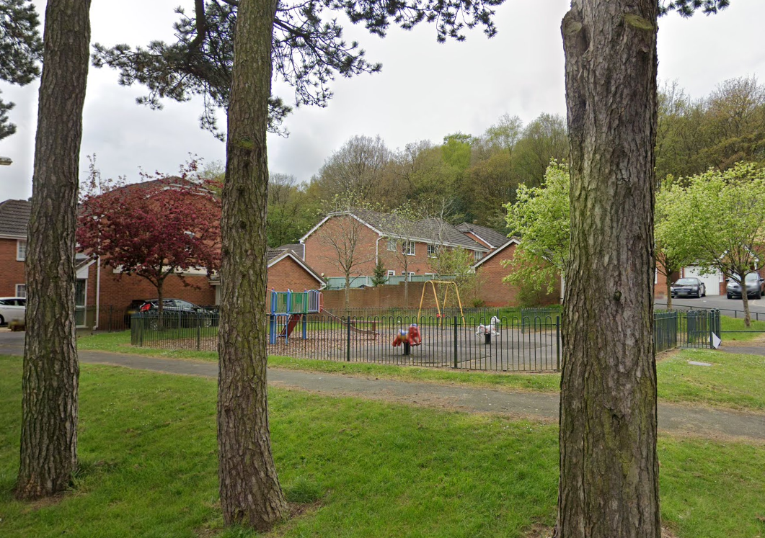
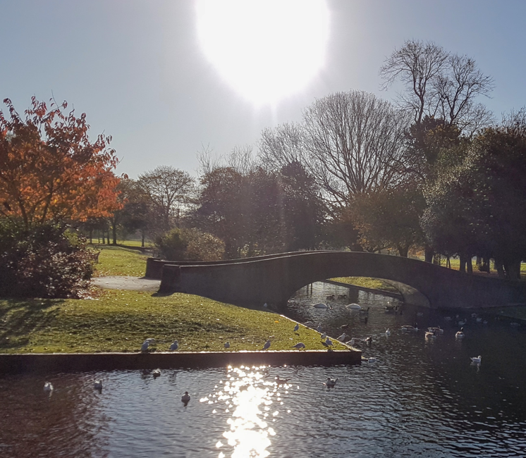
Notes:
Perry Hall Park: Largest Park other than Sutton Park
On click
The Pines: smallest of BCC’s public leisure sites

Slide 8
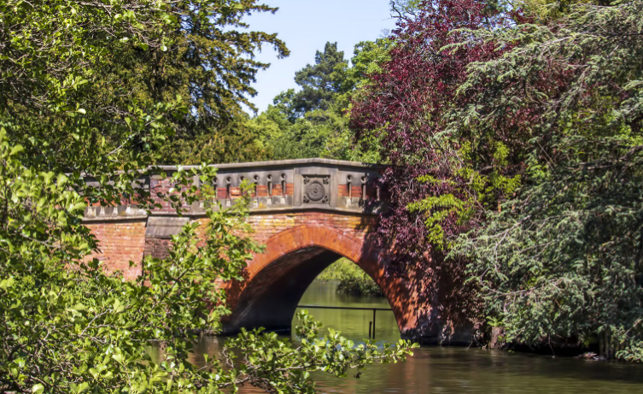
Notes:
Bridge at Cannon Hill Park

Slide 9
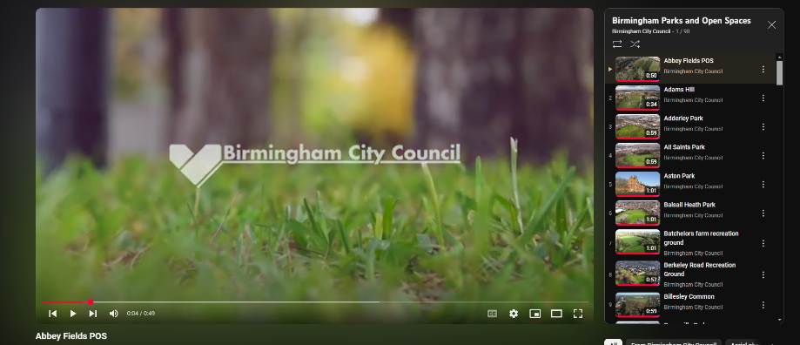
How to find them
Find a park | Birmingham City Council
Notes:
There are 100 parks on the Birmingham City Council YouTube Channel, each site has a drone flyover to give a feel of what the park looks like.
Many of the parks also have a webpage giving the location and facilities.
You can also use the: “Find a park” search on the BCC Website.
There are also other resources available to help explore the city’s green spaces such as EcoBirmingham’s “69wards by bike or foot” maps available on their website.

Slide 10
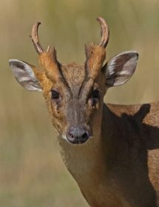
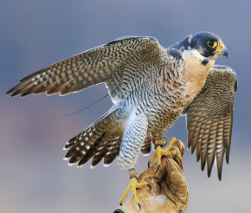
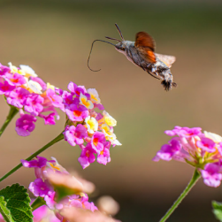
Birmingham’s wildlife
Birmingham, despite its urban sprawl, is home to a surprisingly diverse range of flora and fauna, thanks to its parks, canals, and nature reserves.
This green city offers vital habitats for numerous species, providing opportunities for wildlife enthusiasts and those new to visiting green spaces to connect with nature.
Birmingham’s natural environment demonstrates the resilience of flora and fauna, even in urban settings. Its parks and reserves offer residents and visitors a chance to appreciate the city’s living treasures while highlighting the importance of conservation efforts.
Notes:
Protecting Biodiversity
Local initiatives, such as those led by the Birmingham and Black Country Wildlife Trust, focus on habitat preservation, species monitoring, and community education.
The city's commitment to expanding green corridors and sustainable urban planning ensures that both residents and wildlife coexist harmoniously.
Birmingham’s natural environment demonstrates the resilience of flora and fauna, even in urban settings. Its parks and reserves offer residents and visitors a chance to appreciate the city’s living treasures while highlighting the importance of conservation efforts.
Peregrine falcon, muntjac deer, hummingbird hawkmoth.

Slide 11
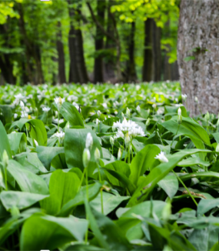
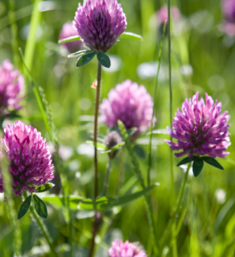
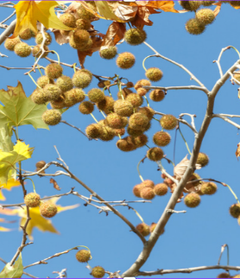
Plants of Birmingham
Birmingham’s green spaces are adorned with native and non-native plant species. Prominent examples include:
Woodlands: Areas like Moseley Bog and Sutton Park feature ancient woodland flora, including bluebells, wild garlic, and oaks, providing a lush understory for wildlife.
Grasslands: Meadows in parks such as Woodgate Valley support wildflowers like buttercups, daisies, and red clover, attracting pollinators.
Urban Planting: Birmingham’s efforts in urban greening introduce diverse plantings of ornamental shrubs, seasonal flowers, and trees, like London plane and birch, enhancing biodiversity.
Notes:
Wild garlic, red clover, London plane tree

Slide 12
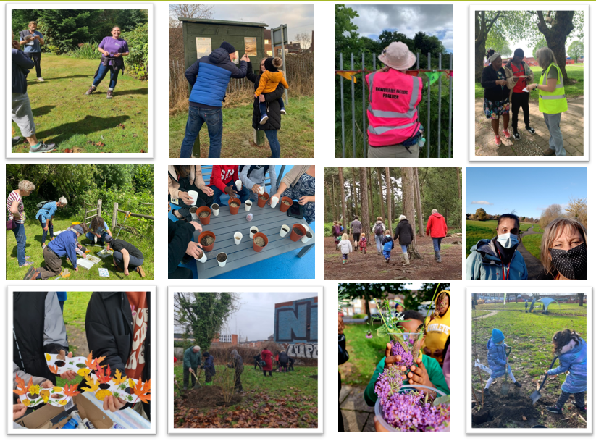
People of Birmingham

Slide 13
The Benefits
It is now possible to capture the value of our natural environment by combining the biological science of ecology with the pragmatic discipline of economics, through a joint venture known as Natural Capital. In this way the invisible benefits of blue and green spaces to the city and citizens can be made visible. (Natural Capital Accounts 2021, WSP)
Spending time in the natural environment – as a resident or a visitor – improves our mental health and feelings of wellbeing. It can reduce stress, fatigue, anxiety, and depression. It can help boost immune systems, encourage physical activity, and may reduce the risk of chronic diseases such as asthma. It can combat loneliness and bind communities together. However, there is more to do.
The number of people who spend little or no time in natural spaces is too high. Recent data from the Monitor of Engagement with the Natural Environment survey tells us that 12% of children do not visit the natural environment each year. In the most deprived areas of England, people tend to have the poorest health and significantly less green space than wealthier areas. Playing and learning outside is a fundamental part of childhood, and helps children grow up healthy.
Some children living in the city are lucky enough to have a family garden; others will not be, and it is important that we find other ways to give them better access to the great outdoors. We know that regular contact with green spaces, such as the local park, lake, or playground, can have a beneficial impact on children’s physical and mental health.

Slide 14
The Challenges
The 2016-17 Parliamentary Inquiry ‘The Future of Public Parks’ found that the value of parks and green spaces was well documented but not well understood; so not fully protected in policy.
The Inquiry found that as a non-statutory service they have often been seen as non-essential services and have suffered disproportionately with budget reductions imposed following the 2008 global financial crisis and subsequent austerity measures.
Although Birmingham has over 600 green spaces, many of them were inherited from our Victorian past. We need to see Birmingham as a 21st century city, not a city that looks backwards, but one that looks forward to the future addressing climate change, nature recovery and inequity of access. So, we need to change the way we view and manage all green areas in the city to identify more good quality publicly accessible green spaces.
As we engaged with communities across Birmingham, we became very aware that sections of our community faced barriers in accessing green spaces or making full use of the facilities on offer. Birmingham became the first city in the UK to develop a tool to highlight the inequalities in accessing green space.
We call the ambition to achieve equitable access to green spaces Environmental Justice.
Notes:
https://www.birmingham.gov.uk/info/50273/our_future_city_plan_ofcp/2518/our_future_nature_city_plan/2
City of Nature Plan: https://naturallybirmingham.org/birmingham-city-of-nature-delivery-framework/

Slide 15

Root and branch change
The transformation of the delivery mechanism
Notes:
West Midland Combined Authority
The requirement for Local Nature Recovery Strategies (LNRS) across the whole of England were set out in the Environment Act 2021. Following this in March 2023 DEFRA published the Local nature recovery strategy statutory guidance - What a local nature recovery strategy should contain document which sits alongside the The Environment (Local Nature Recovery Strategies) (Procedure) Regulations 2023 (LNRS Regs).
The LNRS Regs came into force on 13th April 2023 with the WMCA being appointed as Responsible Authority for delivering the LNRS for the West Midlands region in June 2023.
This LNRS boundary is defined as being those administrative areas covered by the following local authorities:
Birmingham City Council;
Coventry City Council;
Dudley Borough Council;
Sandwell Borough Council;
Solihull Borough Council;
Walsall Borough Council; and
Wolverhampton City Council.
These local authorities and Natural England are recognised in the LNRS Regs as ‘Supporting Authorities’ and we shall be working in partnership with them to prepare the LNRS.
https://www.wmca.org.uk/what-we-do/environment-energy/local-nature-recovery-strategy-for-the-west-midlands/
The Birmingham & Black Country Wildlife Trust and EcoRecord
Local Nature Recovery Strategies (LNRS) are a flagship measure in the Environment Act. They are a new system of spatial strategies for nature which will plan, map, and help drive more coordinated, practical, focussed action and investment in nature’s recovery to build the national Nature Recovery Network.
The Birmingham & Black Country Wildlife Trust and EcoRecord (the Local Environmental Record Centre for Birmingham and the Black Country) have been commissioned by the four Black Country local authorities (Dudley MBC, Sandwell MBC, Walsall MBC and Wolverhampton City Council, supported by the Black Country Consortium) to undertake an analysis of evidence to produce a draft Local Nature Recovery map and develop the Local Nature Recovery Strategy (LNRS) approach for the Black Country.
https://www.bbcwildlife.org.uk/local-nature-recovery-strategy-lnrs

Slide 16
The Journey – 10 years and before…..
2015 European Environment Agency about the state of the environment
2016-17 Parliamentary Inquiry ‘The Future of Public Parks’
2017 The Birmingham Parks Summit – People call for action.
2019 The Naturally Birmingham Project Birmingham’s Future Park Accelerator Project (FPA) starts.
2020 Covid Lockdowns – A strange new world the project goes digital four pilots.
2021 Big Conversations – In Person Consultations start and Alliance forms.
2022 The City of Nature Plan is adopted by BCC as the Green Infrastructure Strategy. FPA delivery phase the City of Nature Pilot – delivered by the CoN Alliance.
2023 The Delivery phase of the FPA project starts looking at Urban Nature Development. Phase 2 of the City of Nature Pilot. East Birmingham Master Plan
2024 BCC budget crises happens putting the breaks on the project work. Phase 3 of the City of Nature Pilot. Biodiversity Net Gaina and Nature Recovery.
2025 March 31st Completion of the FPA project delivery phase and the City of Nature Pilot.
The City of Nature Pilot was the first implementation of the City of Nature Plan at ward level delivered through collaboration with the City of Nature Alliance.
The City of Nature Programme is now delivering what needs to happen over the next 23 years.
Notes:
2008 Global financial crises.
In 2015 (when we were still part of the EU) a dawning realisation began in the European Environment Agency about the state of the environment and its relationship to health. Although many people had believed this for many years and had been campaigning for 100’s years. It seemed that at last it had been recognised at the highest level.
In 2015 One of the three thematic priority objectives set out in the EU's 7th Environment Action Programme is 'to safeguard citizens from environment-related pressures and risks to health and well-being’. At the global level, the World Health Organization (WHO) and related United Nations (UN) processes address a range of environmental and climate-related challenges to health and well-being.
However, there were still knowledge gaps, uncertainties and shortages of data limiting understanding of the complex interactions between human health, multiple environmental pressures, and social and demographic factors. And most importantly how were we all going to afford to solve these problems.
This search for a better understanding led to many inquiries and research to fill in the gaps.
In July 2016, the Communities and Local Government Select Committee conducted an inquiry to examine the future of public parks, with a specific focus on asking why parks matter, what challenges the parks sector is facing, and how a sustainable future can be secured for parks.
Recommendation Ten: The Minister should issue guidance to local authorities setting out key principles for the appropriate governance and accountability arrangements in non-traditionally managed parks which could be put in place as part of any emerging or alternative model for parks management. Such principles might include the involvement of local people in the governance and oversight arrangements and decision-making, or the establishment of appropriate objectives with which the activities of the management model must be aligned. Whatever innovative arrangement may be adopted, ownership of parks should stay with local authorities, as democratically accountable bodies. A new trust, for example, should have a long lease of a park, rather than taking over the freehold.

Slide 17
The Mechanism for green sites
The local authority – Birmingham City Council (BCC) has the responsibility to provide certain services for the general funds they receive. You are probably aware that doesn’t explicitly include the provision of parks. However, they do have a duty to provide the ecosystem services and the health and social benefits that parks can provide. They also must ensure that parks that they do provide are safe, clear of rubbish, accessible, biodiverse and value for money. Although City Operations have those basic responsibilities, parks also provide services to other BCC departments including Public Health, Education, Transport, and Housing. This is part of the normal democratic workings of local government.
The Future Park Standard has been developed to do two things. The first is to ensure that all parks are managed through the general fund to deliver statutory responsibilities for all Birmingham residents. This is what we call the Fair Score; this is one level above poor in the Green Flag Standard. That score is all we can expect the regular programme of maintenance will achieve with the present budget.
The second thing is to raise the score of parks above Fair to Good or above. Please note! This will normally require extra resource. That could be commercial income, grants, donations or a voluntary (unpaid for) resource. Unless – the cost of managing parks reduces (i.e., less litter to pick up). When parks are improved with extra resource this must be done in collaboration with residents, orgainsations who support residents, local schools and businesses. So, that is all those that use and benefit directly from the green space.
For some parks, this means there could be around three thousand stakeholders.
To be able to test the mechanism and invest in it the City of Nature pilot trialed this approach at one park, Dawberry Fields Park, then five parks in one ward, then five more wards.
To secure extra resource we had to consult, secure funding and then expand the workforce (through the Alliance) to deliver additional services and benefits inline with the consultation.
We call this process activating a park / ward. This process is part of the wider mechanism which includes nature recovery and nature connectedness to eventually, over the next 25 years, turn a Red Ward into a Green Ward.
Notes:
The more people are involved in the activation of parks and all green and blue spaces, and grey spaces too. In fact, their whole neighbourhood. The more benefits they receive and the less it costs to deliver them.
Even if people do no more than use their parks well that will reduce the cost of managing parks.
It also has the potential of reducing the cost of delivering other council services.

Slide 18

Key findings
Parks and green spaces support a diverse range of local authority agendas. Islington and Leeds approach their parks and green spaces as vital infrastructure that supports delivery of council priorities and a wide range of council services, including health, housing, highways, adult and child social care, and equality. The councils have embedded parks and green spaces across their core strategies, which has contributed to creating new ways of working, such as internal cross-team collaborations.
A collaborative partnership with the community multiplies the benefits that parks and green spaces deliver. Islington and Leeds have nurtured positive, productive relationships with a range of community partners, including local organisations, businesses and residents. The councils work with and support these partners, who deliver events, maintenance, fundraising, advocacy and programming that greatly extend the work a council could realistically achieve on its own. The increased use and engagement of parks and green spaces by diverse partners also contributes to inclusivity, as more people access and benefit from green spaces.
A forward-looking, supportive and innovative organisational culture fosters good practice. The parks teams in Islington and Leeds maintain positive, trusting relationships with council leadership, who understand the value parks and green spaces add to a range of council services. This fosters confidence, collaboration and a culture of innovation, which enables the parks teams to explore ambitious ways of working, including through creative partnerships and entrepreneurialism.
Prioritising quality improves the varied benefits of parks and green spaces. Islington and Leeds focus on delivering parks and green spaces that meet high-quality standards. Improving and sustaining the quality of their parks and green spaces supports wider council objectives, such as improving health and wellbeing, and is critical for reducing inequalities in access to nature and disparities in health outcomes. Informed by data and evidence and working in partnership with the community, the councils prioritise improvements in spaces that have failed to meet quality standards and in neighbourhoods that lack high-quality green space.
Notes:
Phew!
That would have been awful if after all this time, we hadn’t been going in the right direction.
Key recommendations
The report identified three principal recommendations that can be applied across both local and central government’s strategy and approach. These are:
To establish a strategic approach to parks and green space delivery and management.
To deliver parks and green spaces through collaborative and coordinated ways of working.
To cultivate a focus on quality and innovation.

Slide 19
What you do.
All members of the City of Nature Alliance have been working to deliver the aims of the City of Nature Plan for many years before these aims were captured in this plan and recognised by the council in this way.
Some examples are:
BOSF is in its 20th year as an organisation, but Friends Groups have been around far longer.
The Birmingham and Black Country Wildlife Trust used to be the Urban Wildlife Group Founded in 1980 as The Urban Wildlife Group we were the first organisation in what became a major urban wildlife movement by the 1990s. Today the importance of wildlife in towns and cities is accepted by everyone - even politicians! The Urban Wildlife Group didn’t just spring out of thin air in 1980. During the 1970s there was increasing public demand for public open space in towns to go beyond the conventional manicured parks with closely-mown lawns and ornamental bedding.
The Active Wellbeing Society was established in 2017 from Birmingham City Council’s Wellbeing Service. They are now a public service mutual.
Birmingham Tree People evolved from the Birmingham Trees for Life project that started in 2006 hosted by the Birmingham Civic Society.
Everyone has been involved in delivery of the aims included in the City of Nature Plan in some way before the City of Nature Plan was written and the pilot project started.
(For some of us longer than we wish to admit. )
Notes:
BCC Webpage with links to some Alliance organisations in Birmingham:
https://www.birmingham.gov.uk/info/20010/parks_leisure_and_wellbeing/1158/improving_your_health_with_nature/3

Slide 20
What you did to support the project.
All members of the City of Nature Alliance have contributed in some way to the delivery of the aims of the City of Nature Plan in the trial. This could be delivery, consultation or funding.
BOSF provided volunteer development officers proving engaging activities for all ages. They also provide the Community Facilitaor role.
The Birmingham and Black Country Wildlife Trust delivered educational sessions by working collaboratively with Laura from Learning Journey and then with their own officers. They delivered physical biodiversity improvements at Dawberry Fields Park and Bordesley and Highgate Ward parks and Green Champion Training for volunteers.
The Active Wellbeing Society delivered consultation activities including the first consultation in Bordesley and Highgate Ward and more recently Nature Neighbourhoods. During lockdown online activities including live nature walks and children's activities.
Legacy WM provided Daily Routes, walk leaders and walk leader training and other physical exercise activities.
The Birmingham Trees for Life Project / Birmingham Tree People provided tree warden training and tree planting activities.
The Birmingham Children’s Society provided mentor training and supported Teeny Explorer sessions for under fives.
Eco Birmingham delivered nature sessions with SOS Education nursery children, family nature sessions at the Growing up Green festival and The Stone Soup Story at Garrison Lane Park.
Patchwork Meadow delivered 16 sessions around engaging people of all ages in creating wildflower areas across the red wards and educating people about the importance of pollinators with a Bee Trail.
The Parakeet - The Growing up Green Festival took place in Sparkhill Park and was free to all. Workshops and activities included flower crown making, nature story telling in a life size nest among the trees, den building, a hidden book trail in the park with nature related books, and a loose parts playground spurring children’s imagination with everyday objects.
Thrive delivered a horticultural Therapy course for Green Champions.
National organisations, including The National Trust, RSPB, Natural England, Woodland Trust provided support and expertise.
Everyone has attended monthly meetings and in person workshops as often as their busy schedules allowed, shared stories, offered advice, supported each other and kept going through some very trying situations with exceptionally positive and can-do attitudes.
This brief list does not do you all justice, but all the details will be in the end of project report that will be shared with everyone.
You were all amazing and it could not have happened with out you.
Notes:
BCC Webpage with links to some Alliance organisations in Birmingham:
https://www.birmingham.gov.uk/info/20010/parks_leisure_and_wellbeing/1158/improving_your_health_with_nature/3

Slide 21
Thank You!
https://www.gov.uk/government/publications/sustaining-success-in-parks/sustaining-success-in-parks
For more information:
Email: info@cityofnature.com
Website: www.naturallybirmingham.com

