Slide 1


Exploring the city of Nature
Online Event | Mon, Jan 27, 2025 | 10:00 am via Teams
Presented by: Simon Needle – Park Service Manager

Slide 2

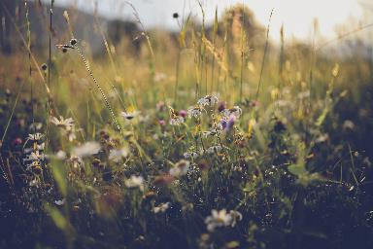
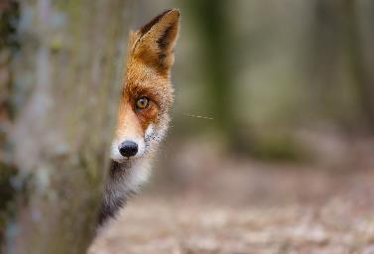
Event Overview
Thank you for joining us to “explore” some of the parks, gardens, and scenic spots that showcase the natural wonders of our city of nature.
Together we will look at some local flora and fauna and discover how you can get involved in these spaces.
Notes:
Wildflowers and Fox looking round a tree.

Slide 3
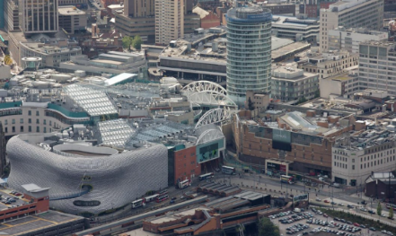
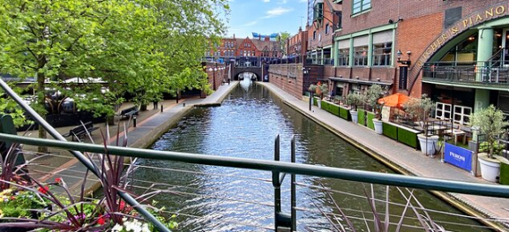
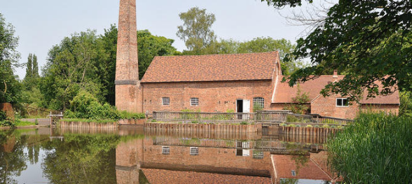
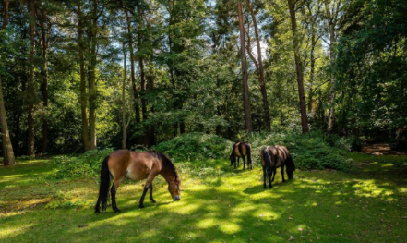
When we think about Birmingham what comes to mind?
When we think about Birmingham what comes into our minds?
Notes:
When we think about Birmingham what images come into our minds?
All these images are in Birmingham. The city centre (very grey, not much green just one tree if you look closely), Brindley Place canals, Sarehole Mill Museum and ponies in Sutton Park LNR.

Slide 4
How Green is our City?
Birmingham is one of the greenest cities in Europe - with over 600 publicly accessible parks and green spaces across the city.
These spaces cover over 4,700 hectares (47 Km2) - for comparison, this is three times the size of the city of Lichfield (14.02 Km2) or 1.5x the city of Worcester (33.3 Km2).
We have Local Nature Reserves, a National Nature Reserve which is also a SSSI, Sites of importance to Nature Conservation and sites of local importance to nature conservation.
Fifteen of our city’s parks, commons and country parks have previously held the Green Flag Award, the national quality award for parks and green spaces, making them among the best in the country.
There are over 1 million trees across the city - to recognize this, Birmingham has earned the prestigious ‘Tree Cities of the World’ status. In 2021 Birmingham was the first UK city to adopt an Urban Forest Master Plan.
Running through and connecting these green spaces are 32 miles (51km) of canals, 3 rivers and 250miles (400km) of urban brook courses; sometimes referred to as our blue infrastructure.

Slide 5
Some of your green spaces
National Nature Reserve
Sutton Park
Country Parks
Lickey Hills Country Park
New Hall Valley Country Park
Sheldon Country Park
Woodgate Valley Country Park
Kingfisher Country Park
The Shire Country Park
Local Nature Reserves including:
Edgbaston Reservoir
Plantsbrook
Quinton Meadows
The largest urban park we have is:
Perry Hall Playing Field which is
638,749 SQM
The smallest urban park we have is:
The Pines Public Open Space which is only
485 SQM and most of it is a play area.
Premier Parks:
Cannon Hill
Handsworth Park
Kings Heath Park
39 of our parks have pools
221 have play areas
We also have 68 green areas that are part of the leisure portfolio but aren’t classified as parks or public open spaces
There are also golf courses, allotments and cemeteries.
In addition, we have Housing green spaces, Education Playing Fields and Highways verges and roundabouts.
We even have rooftop gardens on buildings

Slide 6
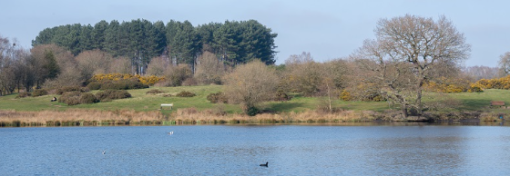
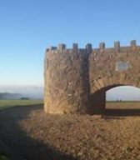
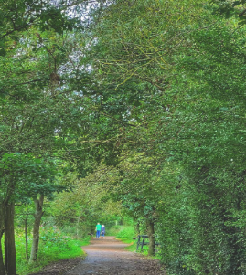
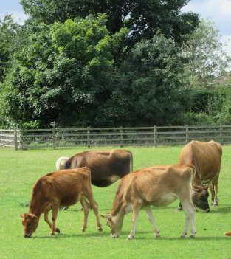
Notes:
Top: Sutton Park
Left to right:
Lickey Hills Country Park, New Hall Valley Country Park, Sheldon Country Park and Farm

Slide 7
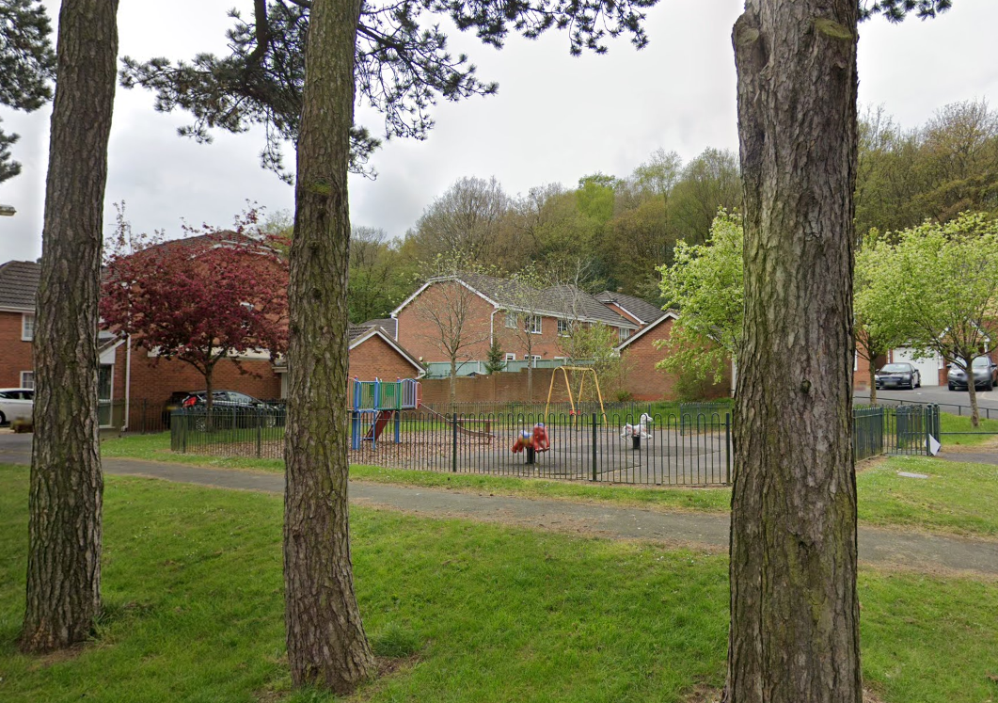
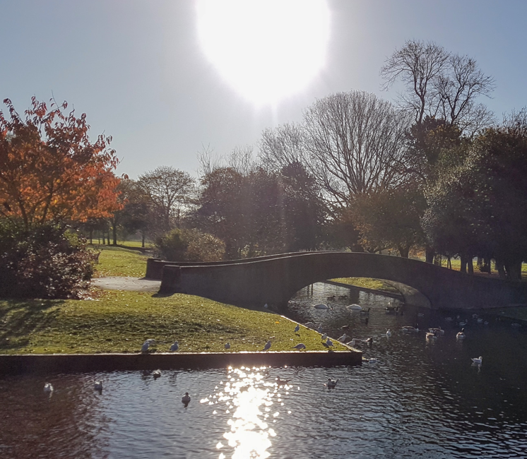
Notes:
Perry Hall Park: Largest Park other than Sutton Park
On click
The Pines: smallest of BCC’s public leisure sites

Slide 8
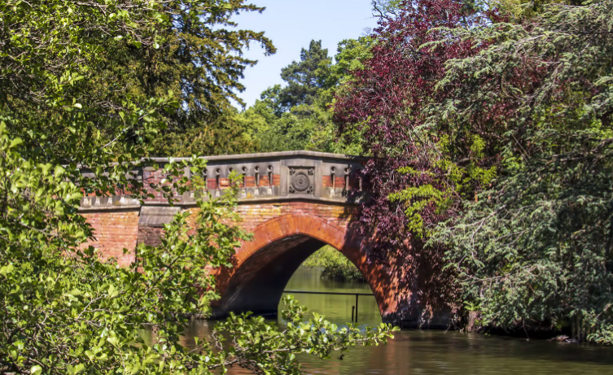
Notes:
Bridge at Cannon Hill Park

Slide 9
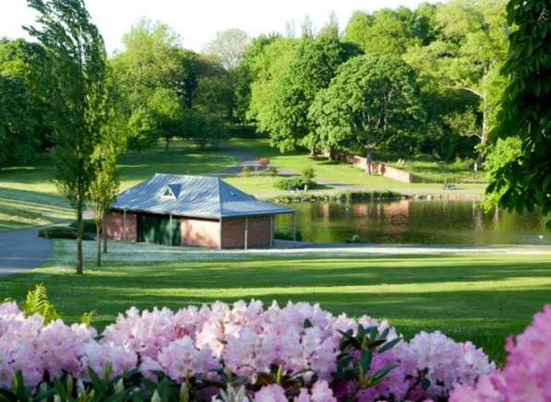
Notes:
Boat House Handsworth Park

Slide 10
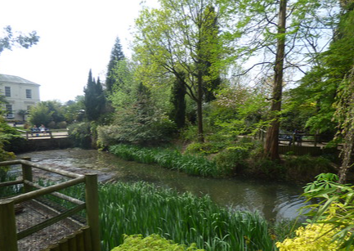
Notes:
The Pool at Kings Heath Park

Slide 11
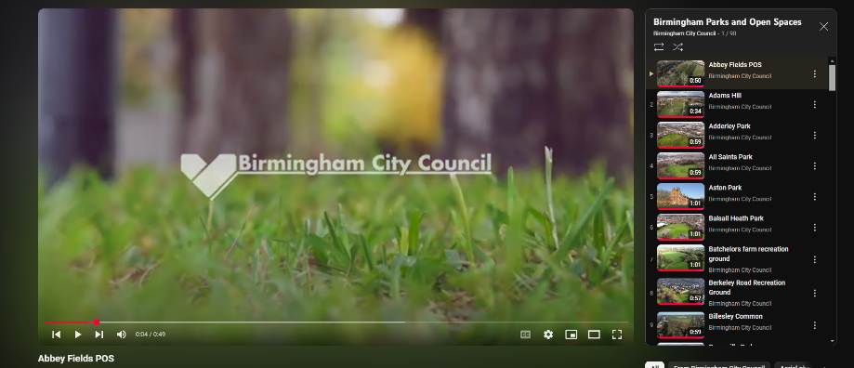
How to find them
Find a park | Birmingham City Council
Notes:
There are 100 parks on the Birmingham City Council YouTube Channel, each site has a drone flyover to give a feel of what the park looks like.
Many of the parks also have a webpage giving the location and facilities.
You can also use the: “Find a park” search on the BCC Website.
There are also other resources available to help explore the city’s green spaces such as EcoBirmingham’s “69wards by bike or foot” maps available on their website.

Slide 12
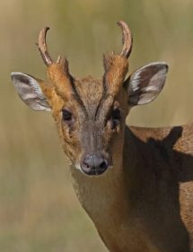
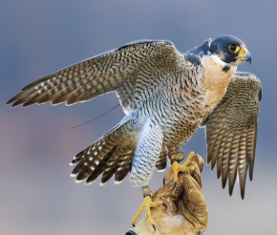
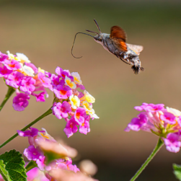
Birmingham’s wildlife
Birmingham, despite its urban sprawl, is home to a surprisingly diverse range of flora and fauna, thanks to its parks, canals, and nature reserves.
This green city offers vital habitats for numerous species, providing opportunities for wildlife enthusiasts and those new to visiting green spaces to connect with nature.
Birmingham’s natural environment demonstrates the resilience of flora and fauna, even in urban settings. Its parks and reserves offer residents and visitors a chance to appreciate the city’s living treasures while highlighting the importance of conservation efforts.
Notes:
Protecting Biodiversity
Local initiatives, such as those led by the Birmingham and Black Country Wildlife Trust, focus on habitat preservation, species monitoring, and community education.
The city's commitment to expanding green corridors and sustainable urban planning ensures that both residents and wildlife coexist harmoniously.
Birmingham’s natural environment demonstrates the resilience of flora and fauna, even in urban settings. Its parks and reserves offer residents and visitors a chance to appreciate the city’s living treasures while highlighting the importance of conservation efforts.
Peregrine falcon, muntjac deer, hummingbird hawkmoth.

Slide 13
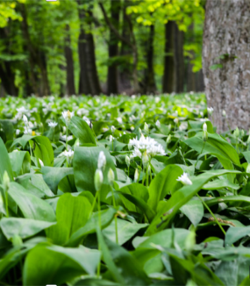
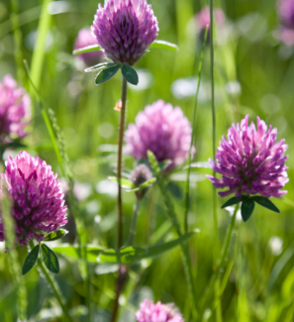
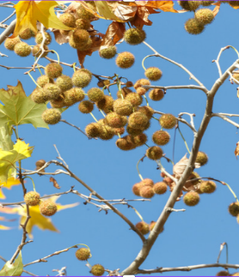
Plants of Birmingham
Birmingham’s green spaces are adorned with native and non-native plant species. Prominent examples include:
Woodlands: Areas like Moseley Bog and Sutton Park feature ancient woodland flora, including bluebells, wild garlic, and oaks, providing a lush understory for wildlife.
Grasslands: Meadows in parks such as Woodgate Valley support wildflowers like buttercups, daisies, and red clover, attracting pollinators.
Urban Planting: Birmingham’s efforts in urban greening introduce diverse plantings of ornamental shrubs, seasonal flowers, and trees, like London plane and birch, enhancing biodiversity.
Notes:
Wild garlic, red clover, London plane tree

Slide 14
Animals of Birmingham
The city is home to a variety of animals, many thriving in the urban ecosystem:
Birdlife:
Common species include robins, blackbirds, and magpies. Waterfowl like swans and mallards thrive along the city’s canals and ponds. Peregrine falcons have also been spotted nesting on tall city buildings.
Mammals:
Sutton Park and other reserves host deer, foxes, and badgers, while bats are frequently seen at dusk near water bodies.
Invertebrates:
The city’s wildflower initiatives have bolstered populations of bees, butterflies, and dragonflies, critical for pollination and ecosystem health.
Reptiles:
Common lizard, grass sakes and slow worms.
Aquatic Life:
The canals and rivers are home to fish like roach and perch, as well as amphibians like frogs and newts.

Slide 15
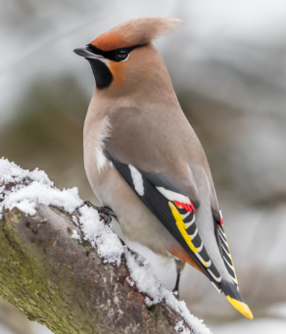
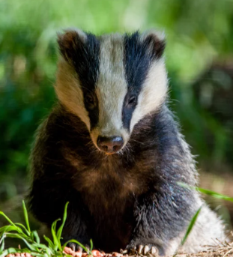
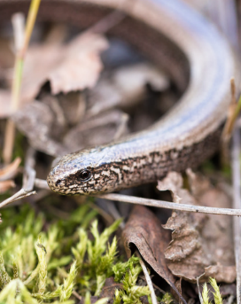
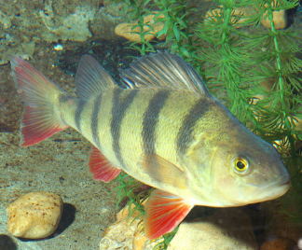
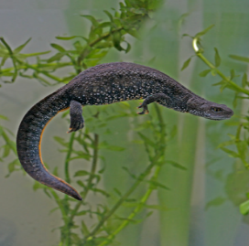
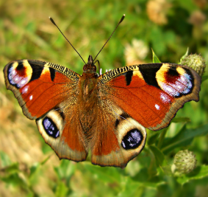
Notes:
Left to right, top to bottom:
Waxwing, badger, slow worm, perch, newt, peacock butterfly.

Slide 16
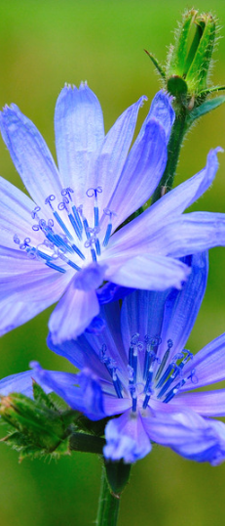
Learn About Local Flora and Fauna
Making these green and blue spaces their home is a diverse range of plant and animal species.
From vibrant wildflowers to fascinating birdlife, there's so much to discover.
EcoRecord collects, collates and makes available information about the wildlife, wildlife sites and habitats of Birmingham and the Black Country.
It currently has over 500,000 species records on its database.
Notes:
Chicory flower.
The landscape of Birmingham and the Black Country has a rich social, economic and natural heritage shaped by a complex history of rural, industrial, and more recent suburban and commercial land use.
The wildlife here is as varied and valuable as that of any other part of the United Kingdom.
Our partner organisation EcoRecord helps us to understand the diversity of wildlife we have in Birmingham. They collect, collate and make available information about the wildlife, wildlife sites and habitats of Birmingham and the Black Country.
They currently have over 500,000 species records on their database.
We find many rare and special species living here, from scarce mammals like water voles and polecats to dragonflies and kingfishers, plus a huge variety of plant life, as documented in the trailblazing book ‘Flora of Birmingham and the Black Country’.
Adding diversity to this is an astounding mix of native species there are other plants and animals that have been introduced to Birmingham including many ornamental garden plants, and African parakeets adding spice and interest reflecting the cosmopolitan nature of the city.
These records come from many sources, ranging from professional ecologists to amateur naturalists and other wildlife enthusiasts.
EcoRecord provides an information service to a wide range of users such as local authorities, statutory agencies, ecological consultants, national and local recording schemes and others with a an interest in the wildlife of Birmingham and the Black Country.
Without the support of volunteers and voluntary organisations across the region committed to biological recording over many years, the knowledge and understanding of the wildlife and ecology of Birmingham and the Black Country would be significantly poorer.
We are interested in all records from the tiniest bugs to the mightiest mammals! Records help us respond to planning and development applications, produce maps of species populations and help us build a picture of how wildlife is doing over time.

Slide 17
The Challenges
The 2016-17 Parliamentary Inquiry ‘The Future of Public Parks’ found that the value of parks and green spaces was well documented but not well understood; so not fully protected in policy.
The Inquiry found that as a non-statutory service they have often been seen as non-essential services and have suffered disproportionately with budget reductions imposed following the 2008 global financial crisis and subsequent austerity measures.
Although Birmingham has over 600 green spaces, many of them were inherited from our Victorian past. We need to see Birmingham as a 21st century city, not a city that looks backwards, but one that looks forward to the future addressing climate change, nature recovery and inequity of access. So, we need to change the way we view and manage all green areas in the city to identify more good quality publicly accessible green spaces.
As we engaged with communities across Birmingham, we became very aware that sections of our community currently face barriers in accessing green spaces or making full use of the facilities on offer. Work is already underway to understand exactly where the gaps are, and Birmingham is the first city in the UK to develop a tool to highlight the inequalities in accessing green space. We call the ambition to achieve equitable access to green spaces Environmental Justice.
Notes:
https://www.birmingham.gov.uk/info/50273/our_future_city_plan_ofcp/2518/our_future_nature_city_plan/2
City of Nature Plan: https://naturallybirmingham.org/birmingham-city-of-nature-delivery-framework/

Slide 18
The Benefits
It is now possible to capture the value of our natural environment by combining the biological science of ecology with the pragmatic discipline of economics, through a joint venture known as Natural Capital. In this way the invisible benefits of blue and green spaces to the city and citizens can be made visible. (Natural Capital Accounts 2021, WSP)
Spending time in the natural environment – as a resident or a visitor – improves our mental health and feelings of wellbeing. It can reduce stress, fatigue, anxiety, and depression. It can help boost immune systems, encourage physical activity, and may reduce the risk of chronic diseases such as asthma. It can combat loneliness and bind communities together. However, there is more to do.
The number of people who spend little or no time in natural spaces is too high. Recent data from the Monitor of Engagement with the Natural Environment survey tells us that 12% of children do not visit the natural environment each year. In the most deprived areas of England, people tend to have the poorest health and significantly less green space than wealthier areas. Playing and learning outside is a fundamental part of childhood, and helps children grow up healthy.
Some children living in the city are lucky enough to have a family garden; others will not be, and it is important that we find other ways to give them better access to the great outdoors. We know that regular contact with green spaces, such as the local park, lake, or playground, can have a beneficial impact on children’s physical and mental health.

Slide 19

Bigger, better, more joined up
Nature Recovery Network
Notes:
West Midland Combined Authority
The requirement for Local Nature Recovery Strategies (LNRS) across the whole of England were set out in the Environment Act 2021. Following this in March 2023 DEFRA published the Local nature recovery strategy statutory guidance - What a local nature recovery strategy should contain document which sits alongside the The Environment (Local Nature Recovery Strategies) (Procedure) Regulations 2023 (LNRS Regs).
The LNRS Regs came into force on 13th April 2023 with the WMCA being appointed as Responsible Authority for delivering the LNRS for the West Midlands region in June 2023.
This LNRS boundary is defined as being those administrative areas covered by the following local authorities:
Birmingham City Council;
Coventry City Council;
Dudley Borough Council;
Sandwell Borough Council;
Solihull Borough Council;
Walsall Borough Council; and
Wolverhampton City Council.
These local authorities and Natural England are recognised in the LNRS Regs as ‘Supporting Authorities’ and we shall be working in partnership with them to prepare the LNRS.
https://www.wmca.org.uk/what-we-do/environment-energy/local-nature-recovery-strategy-for-the-west-midlands/
The Birmingham & Black Country Wildlife Trust and EcoRecord
Local Nature Recovery Strategies (LNRS) are a flagship measure in the Environment Act. They are a new system of spatial strategies for nature which will plan, map, and help drive more coordinated, practical, focussed action and investment in nature’s recovery to build the national Nature Recovery Network.
The Birmingham & Black Country Wildlife Trust and EcoRecord (the Local Environmental Record Centre for Birmingham and the Black Country) have been commissioned by the four Black Country local authorities (Dudley MBC, Sandwell MBC, Walsall MBC and Wolverhampton City Council, supported by the Black Country Consortium) to undertake an analysis of evidence to produce a draft Local Nature Recovery map and develop the Local Nature Recovery Strategy (LNRS) approach for the Black Country.
https://www.bbcwildlife.org.uk/local-nature-recovery-strategy-lnrs

Slide 20
Get Involved
Whether you're a seasoned green space volunteer or looking to contribute for the first time, there are opportunities for everyone to help design, care for, and enjoy our city's green and blue spaces.
Connect with Fellow Nature Enthusiasts
Share your passion for nature with others to learn, exchange ideas, and collaborate on initiatives that make a positive impact on our environment.
Notes:
BCC Webpage with links to some Alliance organisations in Birmingham:
https://www.birmingham.gov.uk/info/20010/parks_leisure_and_wellbeing/1158/improving_your_health_with_nature/3

Slide 21
Thank You!
For more information:
Email: info@cityofnature.com
Website: www.naturallybirmingham.com

