Slide 1




City of Nature Alliance Pilot Project
Communication Workshop – Earth Stories and Green Champions

Slide 2

Involving people in the delivery of the City of Nature Plan actions requires good communication
Earth Stories and Green Champions.

Slide 3

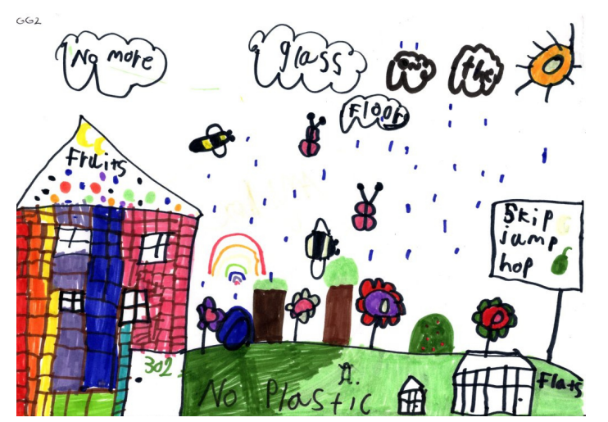
Notes:
Traditionally when gathering data around use of green spaces the focus has been on quantitative data gathering, how many people visit parks, how many times a week for how long.
Or very directed data gathering, “Why do you visit the park?” and answers are from a dropdown list.
Using story telling as a method of collecting data allows collection to be focussed on qualitative data instead and gives control of the sharing of data completely to the person sharing it. Why stories? Stories are fascinating and they are one of the best ways to capture our imagination.
From childhood to adulthood, people are attracted to stories and the lessons they teach, the journeys made, and the knowledge gained. They allow us to feel what something was like and to empathise with the storyteller.
Stories celebrate the fact that people are social creatures with language as their means of communication. So, essentially, storytelling is the oldest form of knowledge transfer. People have been telling stories ever since the spoken language evolved, and possibly even before through sign language and drawings - with the Chauvet cave in France being the oldest representation of stories found thus far dating back to approximately 36,000 years ago. Initially, stories functioned to tell of danger, set examples, or just relate events, but they also lead to attempts to explain the seemingly unexplainable through fairy tales and fiction.

Slide 4
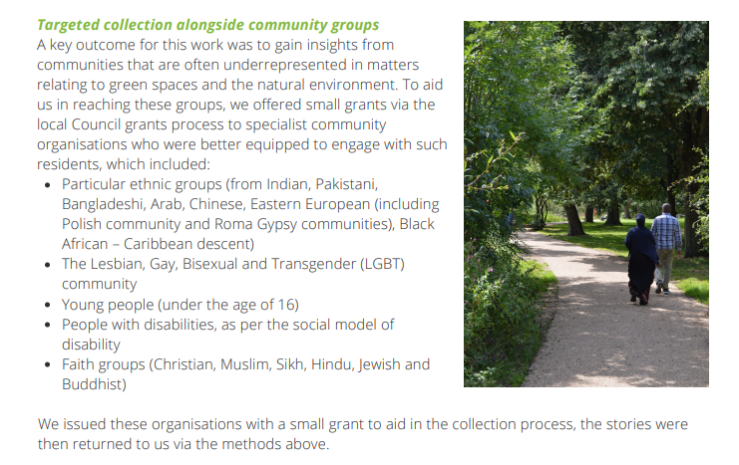
Community Network story collection model
Notes:
Targeted collection alongside community groups A key outcome for this work was to gain insights from communities that are often underrepresented in matters relating to green spaces and the natural environment. To aid us in reaching these groups, we offered small grants via the local Council grants process to specialist community organisations who were better equipped to engage with such residents, which included:
Particular ethnic groups (from Indian, Pakistani, Bangladeshi, Arab, Chinese, Eastern European (including Polish community and Roma Gypsy communities), Black African – Caribbean descent) The Lesbian, Gay, Bisexual and Transgender (LGBT) community Young people (under the age of 16) People with disabilities, as per the social model of disability Faith groups (Christian, Muslim, Sikh, Hindu, Jewish and Buddhist)
We issued these organisations with a small grant to aid in the collection process, the stories were then returned to us via the methods above.

Slide 5
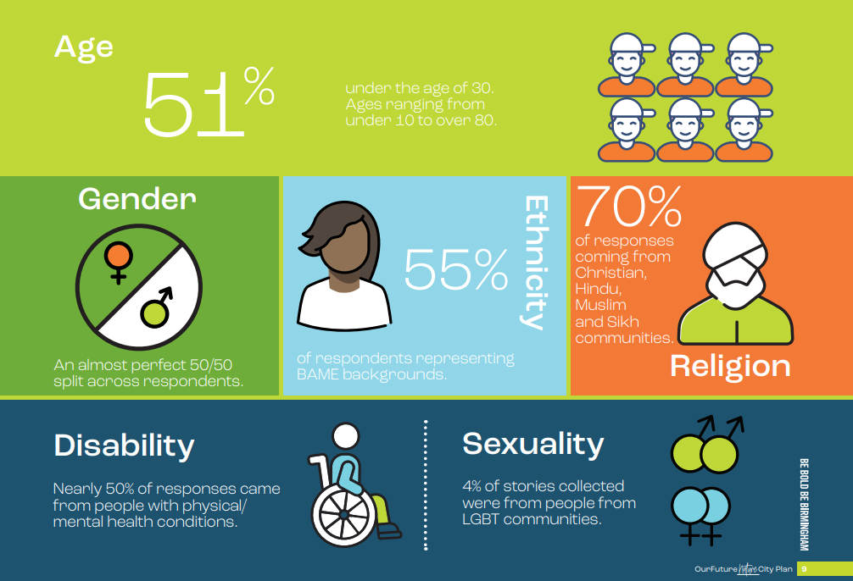
Notes:
Our 247 stories came from people with a wide range of backgrounds – not typical of usual green space survey respondents:
51% under the age of 30.
Ages ranging from under 10 to over 80.
An almost perfect 50/50 gender split across respondents.
55% of respondents representing BAME backgrounds.
70% of responses coming from Christian, Hindu, Muslim, and Sikh communities.
Nearly 50% of responses came from people with physical/mental health conditions.
4% of stories collected were from people from LGBT communities.

Slide 6
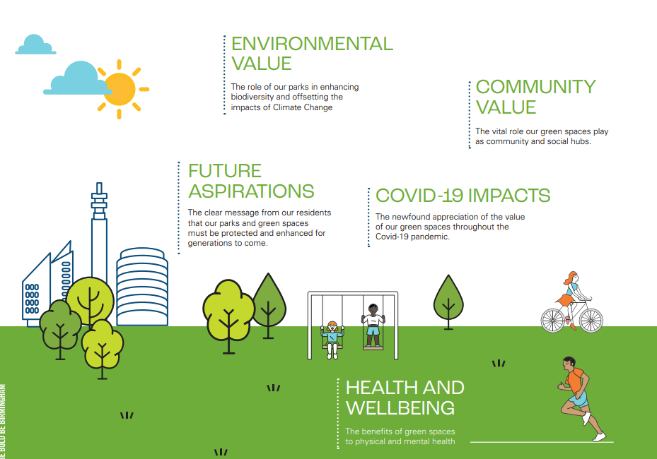
Notes:
As part of the development of the City of Nature Plan, it was essential we found a way to capture the views of local and diverse community groups regarding their green spaces.
We also wanted to go beyond asking the usual suspects or asking people to complete a survey – so we took a different approach.
Our parks are more than just patches of greenery. They are places where so many of our memories were made, and where so many more will be formed in the future. From childhood to adulthood, green spaces are where we connect with both nature and each other, shaping memories that last a lifetime.
Analysing stories of varying formats from 247 residents is challenging. To collate and compare such a broad range of information necessitated the use of qualitative analysis to help categorise the data into more manageable ‘chunks’ for review. The key themes that came out are summarised below and were woven into our City of Nature Plan:
ENVIRONMENTAL VALUE The role of our parks in enhancing biodiversity and offsetting the impacts of Climate Change
FUTURE ASPIRATIONS The clear message from our residents that our parks and green spaces must be protected and enhanced for generations to come.
COMMUNITY VALUE The vital role our green spaces play as community and social hubs
COVID-19 IMPACTS The newfound appreciation of the value of our green spaces throughout the Covid-19 pandemic
HEALTH AND WELLBEING: The benefits of green spaces to physical and mental health.

Slide 7

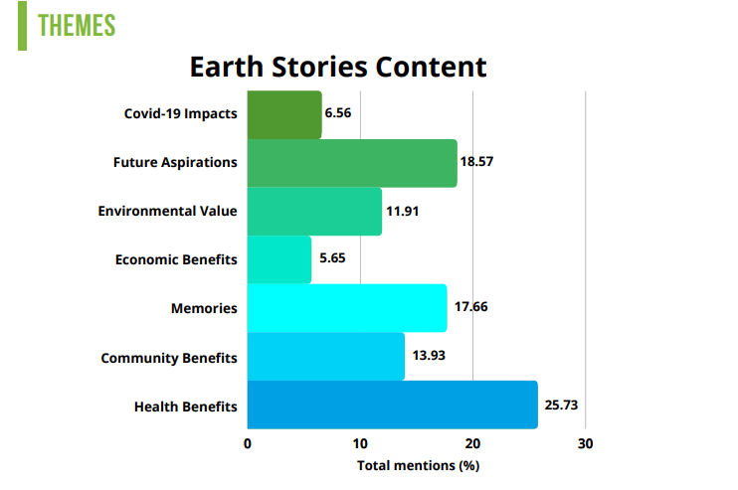

What is important to people.
Helps us to understand how to engage them.
Notes:
Health Benefits
It should be remembered that the Earth Story project happened during the “Covid Years”
But by far the most common theme in the stories we analysed was the impact of parks on our health and wellbeing.
A majority of stories shared how essential green spaces were to their physical health, providing a pleasant space to get active alone or in groups.
We heard stories of people discovering outdoor yoga, dance classes, trying new sports, lunchtime walks, and running clubs – things many only do because our parks. Many others also focussed on the benefits to mental health, using their time in nature as a way to escape the pressures of life and really focus on the things that matter.
There is a wealth of literature on the benefits of green spaces and nature on our health and our analysis only adds to the support of these findings. Green spaces provide unquantifiable benefits to our mental and physical health, and their benefits are felt across our entire population. It is clear that these spaces take a key role in improving the health of our residents, and will be vital in the race to tackle obesity and ill-health as a result of inactivity, as well as the ongoing mental health crisis that is being felt nationally
Economic Benefits
A small number of stories highlighted the economic benefits of green spaces in Birmingham. Much of this highlighted the perhaps surprising wealth of jobs and skills opportunities linked to parks and green spaces, and the range of careers that tie-in to the environment – with many of our younger residents expressing how excited they were to work with animals and the environment in the future.
Some stories also highlighted the link between access to parks/nature and economic development, and how closely linked the two outcomes are in Birmingham, with many poorer areas having much lower access to good quality green spaces. Parks are something that everyone should have access too, and addressing these inequalities is key to our work as a City of Nature

Slide 8
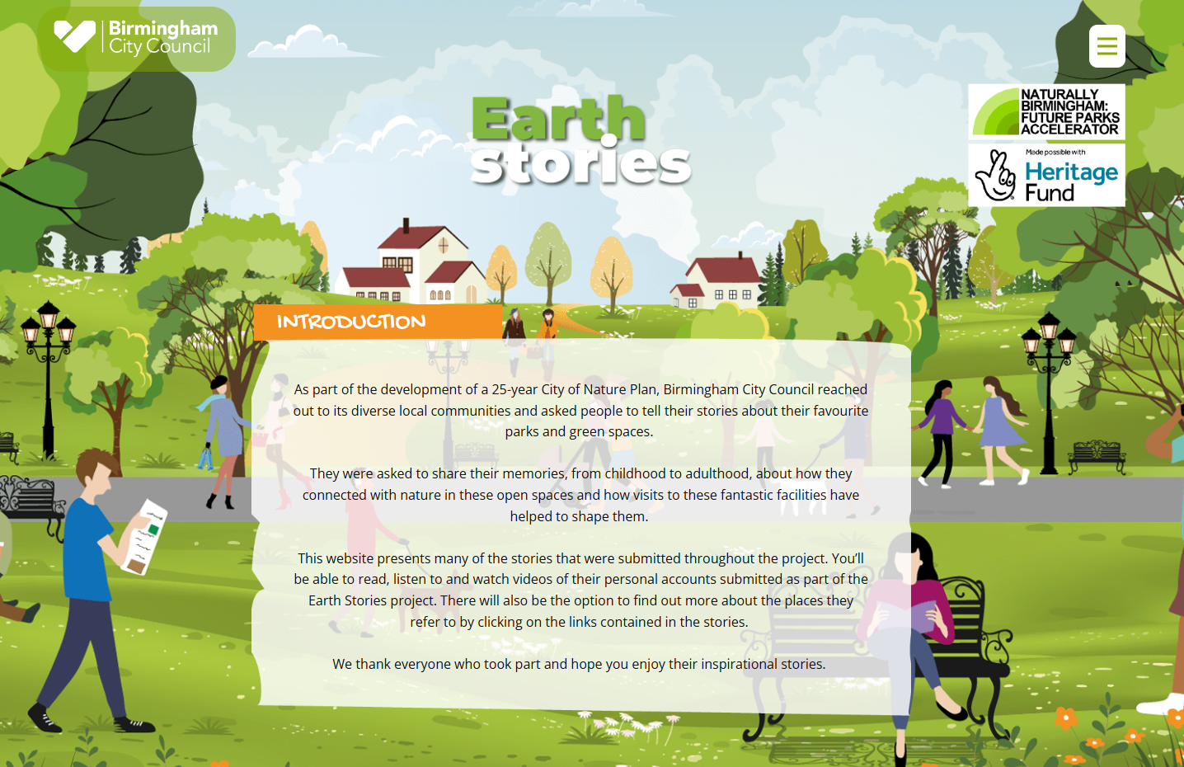
Earth Stories

Slide 9
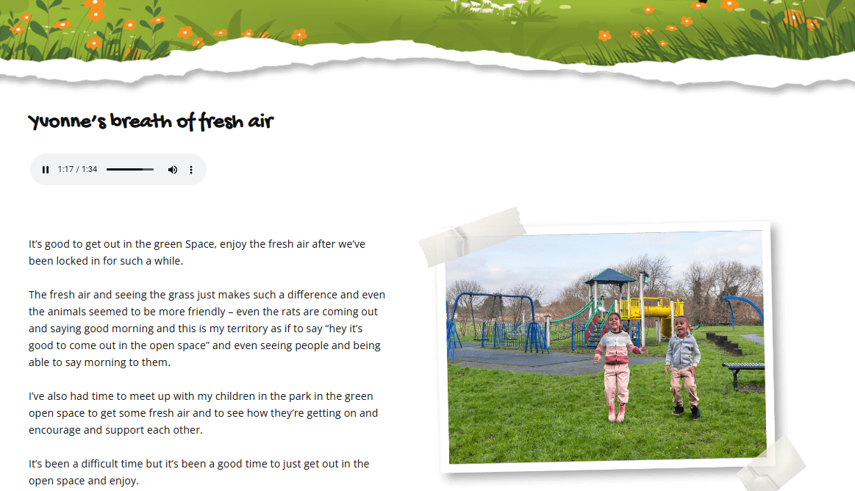

Slide 10
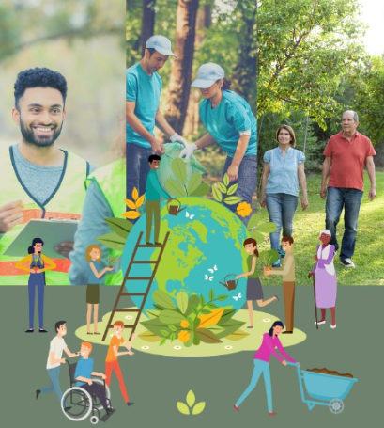

Green Champion Programme

Slide 11

Why Green Champions and not Park Stars?
After a few iterations it was decided to go with the name Green Champions rather than the original “Park Stars” and “Park Ambassadors” that followed some consultation sessions with younger adults as part of the Jobs and Skills Pilot. If you say people can decide on a name you may end up with “Parky McPark Face” so there needs to be a wide enough consultation process to ensure the name is as inclusive as possible.
Looking at champion first it can mean:
A person, animal, or team that wins a competition:
An Olympic champion
World champions
But it can also mean:
A person who enthusiastically supports, defends, or fights for a person, belief, right, or principle:
She has long been a champion of prisoners' rights
To start with the Green Champion programme was more closely linked to the jobs and skills pilot for younger adults which included leadership skills, volunteer coordinator skills, community engagement and leading conservation work party skills. Volunteering in the programme was seen more as a way young people could get experience in “Green Jobs” so an economic focus rather than the more environmental or social benefits of volunteering. Although these would be added benefits.
But then the question was asked, what if you don’t want to access the programme to further your career, what if you just want learn more or do more for yourself and your community. There was a challenge around including older people who wanted to develop themselves, keep up to date, grow their confidence and make a real difference. It wasn’t just in parks either but also community gardens, allotments, cemeteries all kinds of green and grey spaces.
So rather than a specific Parks Jobs and skills programme (parks professionals of the future) it became the Green Champions Programme, a much more inclusive programme that anyone who wanted to do something more than they did now could sign up to.
Notes:
.

Slide 12
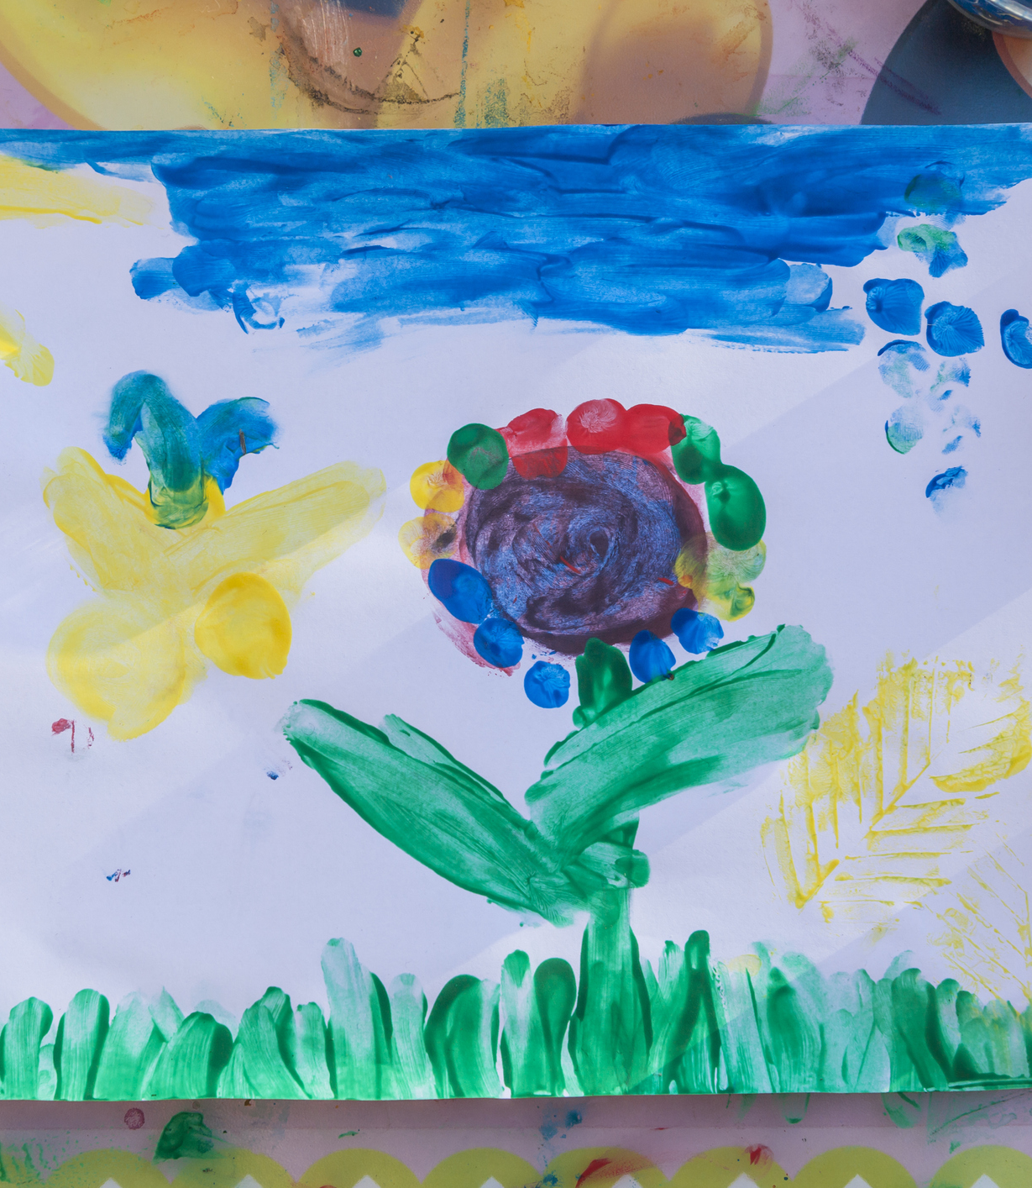
“In short, green living is a means of developing sustainable habits in one’s daily life so that their daily routines work alongside the resources of nature instead of depleting them or doing more long-term damage to the environment or ecological system. The most common way that people become more cognizant of the vital aspects to green living are through the need to reduce pollution, to protect our wildlife from going extinct, and to preserve our conservation of natural resources. Predominantly, people recognize that green living can alleviate the rapidly increasing rates of climate change and global warming.” - Greenly.Institute
So not just Park Champions but we didn’t want to use the term Sustainability Champions; Nature Champions didn’t feel wide enough. The council used the expressions Greener Cleaner and Bolder Greener.
The term Green Spaces is often used, although many people consulted didn’t know what was meant by that. There is even the negative expression – Green Washing when organisations are trying to appear more sustainable than they are.
Planet Champions / Earth Champions sounded like too bigger job, City of Nature Champions – yes but too long.
So Green Champions it was.
People who are living and helping other to live more sustainable lives.
What do we mean by Green?
Notes:
In short, green living is a means of developing sustainable habits in one’s daily life so that their daily routines work alongside the resources of nature instead of depleting them or doing more long-term damage to the environment or ecological system. The most common way that people become more cognizant of the vital aspects to green living are through the need to reduce pollution, to protect our wildlife from going extinct, and to preserve our conservation of natural resources. Predominantly, people recognize that green living can alleviate the rapidly increasing rates of climate change and global warming.” - Greenly.Institute
So not just Park Champions but we didn’t want to use the term Sustainability Champions; Nature Champions didn’t feel wide enough. The council used the expressions Greener cleaner and Bolder Greener.
The term Green Spaces is often used, although many people consulted didn’t know what was meant by that. There is even the negative expression – Green Washing when organisations are trying to appear more sustainable than they are.
Planet Champions / Earth Champions sounded like too bigger job, City of Nature Champions – yes but too long.
So Green Champions it was.
People who are living and helping other to live more sustainable lives.

Slide 13
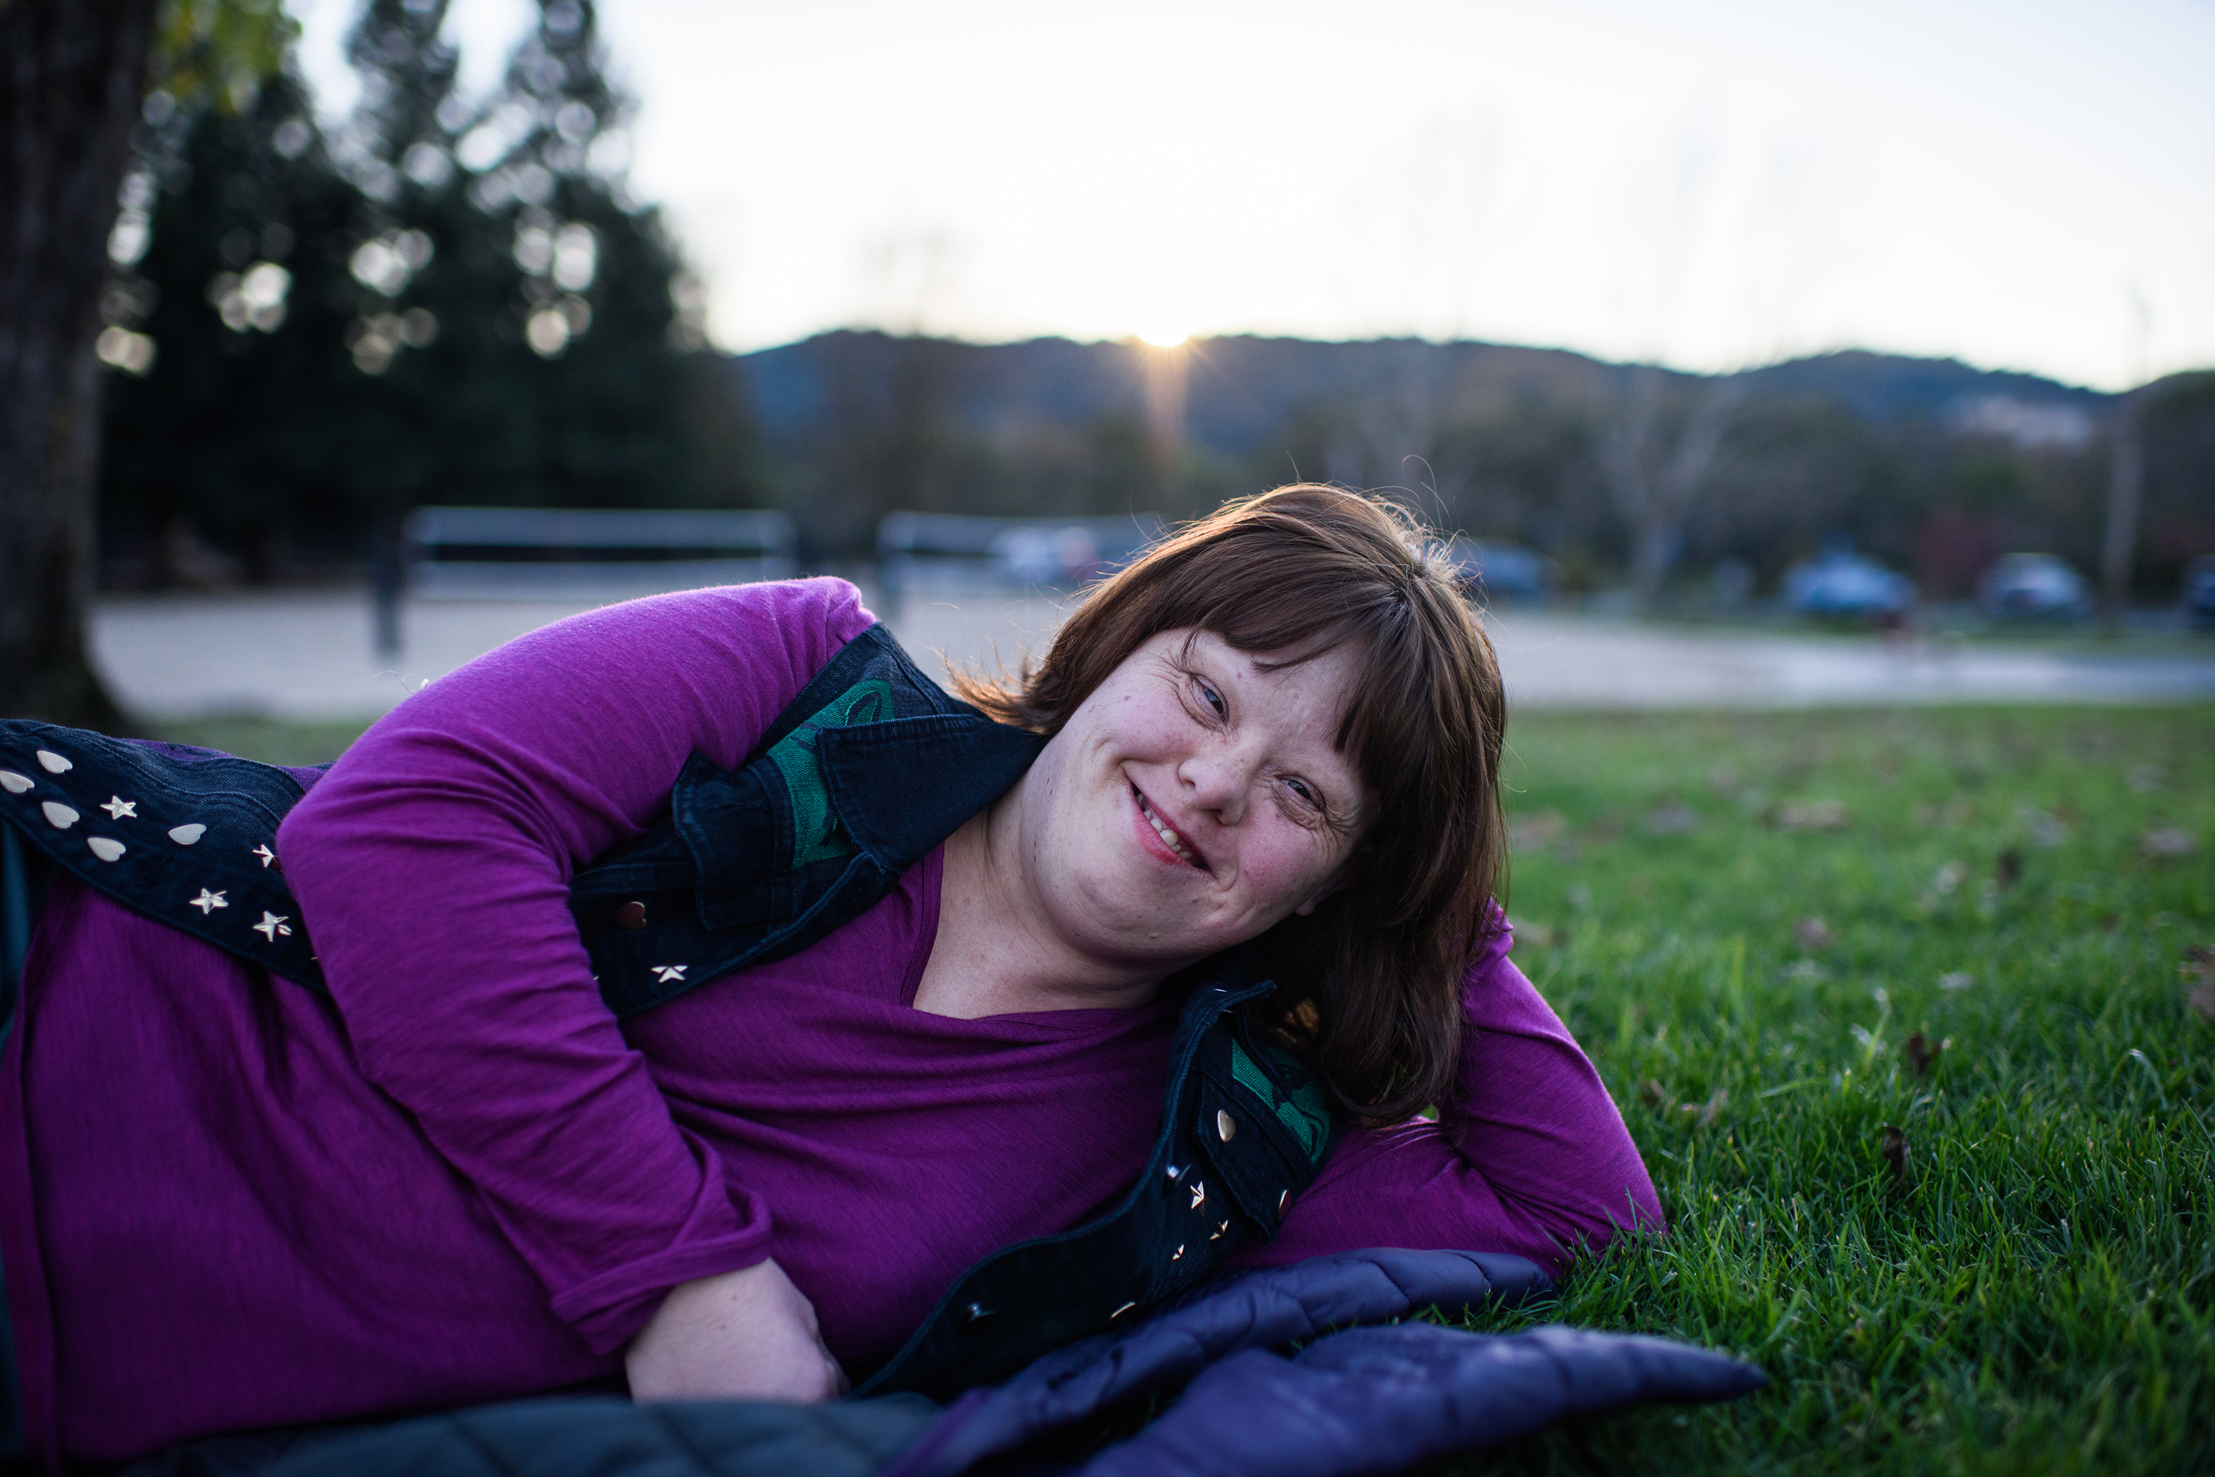
Who are Green Champions
Notes:
Well, to start with in many ways you are. You are interested in the environment and want to do a bit more than you are doing now.
However, just like Earth Stories in the widest sense of the name Green Champions are people who work as volunteers in their local green spaces with their communities, running Friends Groups, or helping as part of a Friends Group, coordinating food growing or conservation activities or litter picks, leading walks, organising activities or community events in green spaces, running gardening, photography or art workshops, tree wardens, tree planters, eco warriors or tea makers, a person who has a house full of plants or an allotment, advocating, campaigning the list is very long.
There are Green Champions everywhere, in all organisations and communities.
But then we have the Green Champions that sign up to the BCC Green Champion Programme because they want to do a little bit more than they are now, they want to increase their capability or take on more responsibility.
More than organisers or joiners in, they want to be catalysts for change. They might want to learn how to be a story-tellers or deliver therapeutic gardening sessions, they might want to learn how to share conservation skills or become an urban forester. They want their role to be to get more people outdoors, and bring the outdoors to everyone, connect people to their green spaces and to each other. Together they will aim to tackle the climate & ecological crises by reconnecting people in cities to nature.
They must be over 17 years old (otherwise they are Young Green Champions) they need to live or work in Birmingham and that’s it.

Slide 14
What is the Green Champion Programme?
The City of Nature Plan says:
• Our most passionate advocates of nature will become Green Champions - recognising the importance of their work looking after our blue and green spaces.
• Our children will learn about the wonders of nature as Young Green Champions.
• Citizens will be encouraged to bring their local green spaces to life using nature focused activities.
This is more than participating in events like community picnics, walks and talks, family activities and litter picks. This is about having some responsibility beyond yourself and your family.
You can’t do these things without having the knowledge and skills to do them. We want to offer the opportunities to get these skills. The most important part of the Green Champion idea is that anyone / everyone can be involved in the City of Nature Plan somehow. But we can’t expect that people can just get on with that on their own. So – we want to ensure that if they want to do something (if they aspire to do something), even if it is just one thing, they can find the support they need to achieve that. Not only children and young people but anyone who wants to do more.
A list of set opportunities to learn new skills.
An “interview” process for free courses.
Sign post to opportunities to sign up as a long-term volunteer with any organisation – Agree to sign up to that organisation’s volunteer process
Payback social value if you receive a free course, i.e. one / two days volunteering.
Receive monthly newsletter
Monthly online meetings.
Notification of any opportunities, training / jobs etc.
Invited to an annual in person meeting.
Single point of contact ?? Green Champion Coordinator Role ( Volunteer / Training Coordinator )
Notes:
The City of Nature Plan says:
• Our most passionate advocates of nature will become Green Champions - recognising the importance of their work looking after our blue and green spaces.
• Our children will learn about the wonders of nature as Young Green Champions.
• Citizens will be encouraged to bring their local green spaces to life using nature focused activities.
You can’t do these things without having the skills to do them. We want to offer the opportunities to get these skills. The most important part of the Green Champion idea is that anyone / everyone can be involved in the City of Nature Plan somehow. But we can’t expect that people can just get on with that on their own. So – we want to ensure that if they want to do something (if they aspire to do something) they can find the support they need to achieve that. Not only children and young people but all people.
A list of set opportunities to learn new skills.
An interview process for free courses.
Sign up as a long-term volunteer (only if you want to) with any organisation – Agree to sign up to that organisation’s volunteer process
Payback social value if you receive a free course, i.e. one / two days volunteering.
Receive monthly newsletter
Monthly online meetings.
Notification of any opportunities, training / jobs etc.
Invited to an annual in person meeting.

Slide 15

How many Green Champions do we have?
Notes:
There are currently 72 people that have signed up to be Green Champions.
The Green Champions Programme has not been actively promoted since the end of the Green Champions Pilot last December.
We do have monthly online meetings and send out a monthly Newsletter: City of Nature Newsletters 2024 – Naturally Birmingham Future Parks Project , but BCC don’t currently have a coordinated training programme.
There are Green Champions in the following wards:
Allens Cross, Bartley Green, Billesley, Bordesley & Highgate, Bournbrook & Selly Park, Brandwood & Kings Heath, Bromford & Hodge Hill, Druids Heath & Monyhull, Edgbaston, Glebe Farm & Tile Cross, Hall Green North, Hall Green South, Harborne. Heartlands. King Standing, Kings Heath, Kings Norton South, Kings Norton North, Ladywood, Longbridge & West Heath, Moseley, North Edgbaston, Northfield, Perry Common, Pype Hayes, Quinton, Selly Oak & Highters Heath, Soho & Jewellery Qtr, Sparkbrook & Balsall Heath East, Sutton & Wylde Green, Sutton Four Oaks, Sutton Reddicap, Sutton Vesey, Tyseley & Hay Mills, Weoley & Selly Oak, Yardley East.

Slide 16
What opportunities for learning have been offered so far?
Green Champion Leadership Course: Provided by BCC City of Nature Team
Therapeutic Horticulture Introduction: Provided by Thrive.
Urban Forester Training: Provided by Birmingham TreePeople https://youtu.be/xAlW2yQbbHI
Nature Conservation and Recovery: Provided by the Wildlife Trust for Birmingham and Black Country https://youtu.be/JfRgyURuCtI
Leading Volunteers and Community Gardening: Provided by Birmingham Open Spaces Forum https://youtu.be/UKp66nv0rvc
Connecting with Nature for Health: Provided by BCC Public Health GP Registrars
Health and Wellbeing Guides – Naturally Birmingham Future Parks Project
Story Telling: Provided by BCC City of Nature Team
Early Years Outdoors: Provided by BCC Early Years Team https://youtu.be/Z2Z5x8TpGk0
Walk Leader Training: Provided by Legacy WM https://youtu.be/DluIdRpIRnc
Outdoor Education Teacher Training: Provided by Learning Journey

Slide 17

What next for the Green Champions Programme?
1. Program Structure
Leadership and Coordination
Program Coordinator:
- Oversees the Green Champions Programme.
- Acts as the main point of contact for champions.
- Provides resources, guidance, and support.
Steering Committee:
- Composed of senior leaders, green experts, and representatives from various departments and organisations.
- Provides strategic direction and aligns the program with organizational goals.
2. Green Champions Roles
Green Champions:
- Volunteers from different organisations, BCC departments or community groups or individuals.
- Act as advocates, leading or delivering green initiatives within their “teams”.
- Encourage colleagues or wider community to adopt City of Nature practices.
Green Champion Leaders :
- Champions who provide mentorship to others.
- Liaise between champions and the steering committee.
- Lead larger, cross-departmental / community initiatives.
Notes:
1. Program Structure
Leadership and Coordination
Program Coordinator:
- Oversees the Green Champions Programme.
- Acts as the main point of contact for champions.
- Provides resources, guidance, and support.
Steering Committee:
- Composed of senior leaders, green experts, and representatives from various departments and organisations.
- Provides strategic direction and aligns the program with organizational goals.
2. Green Champions Roles
Green Champions:
- Volunteers from different organisations, BCC departments or community groups or individuals.
- Act as advocates, leading or delivering green initiatives within their “teams”.
- Encourage colleagues or wider community to adopt City of Nature practices.
Green Champion Leaders :
- Champions who provide mentorship to others.
- Liaise between champions and the steering committee.
- Lead larger, cross-departmental / community initiatives.

Slide 18

What next for the Green Champions Programme?
3. Recruitment and Selection of Leaders
Open Call for Volunteers
- Invite employees or community members to join the program.
- Highlight the benefits of participation, such as skill development and networking.
Nomination Process
- Allow departments or teams to nominate individuals who are passionate about sustainability.
- Consider diversity in roles, departments, and expertise.
Selection Criteria
- Enthusiasm for sustainability.
- Ability to influence others.
- Commitment to the organization’s environmental goals.
4. Training and Development
Introductory Workshops
- Provide an overview of sustainability principles and the organization’s environmental goals.
- Teach champions how to identify opportunities for improvement and initiate projects.
Specialized Training
- Offer free to join modules on City of Nature Themes.
- Provide tools and resources, binoculars, bat detectors, litter pickers, ID sheets. First Aid Kits etc.
Ongoing Learning
- Organize regular webinars, guest lectures, and field trips to enhance champions' knowledge.
- Encourage champions to share experiences and best practices.
Notes:
3. Recruitment and Selection of Leaders
Open Call for Volunteers
- Invite employees or community members to join the program.
- Highlight the benefits of participation, such as skill development and networking.
Nomination Process
- Allow departments or teams to nominate individuals who are passionate about sustainability.
- Consider diversity in roles, departments, and expertise.
Selection Criteria
- Enthusiasm for sustainability.
- Ability to influence others.
- Commitment to the organization’s environmental goals.
4. Training and Development
Introductory Workshops
- Provide an overview of sustainability principles and the organization’s environmental goals.
- Teach champions how to identify opportunities for improvement and initiate projects.
Specialized Training
- Offer free to join modules on City of Nature Themes.
- Provide tools and resources, binoculars, bat detectors, litter pickers, ID sheets. First Aid Kits etc.
Ongoing Learning
- Organize regular webinars, guest lectures, and field trips to enhance champions' knowledge.
- Encourage champions to share experiences and best practices.

Slide 19

Initiative Development and Implementation
5. Initiative Development and Implementation
Idea Generation
- Encourage champions to brainstorm and propose green initiatives, such as reducing single-use plastics, promoting cycling to work, or energy-saving campaigns.
Project Planning
- Support champions in developing action plans for their initiatives.
- Assign roles, set timelines, and identify necessary resources.
Implementation
- Champions lead their initiatives, with regular check-ins and support from the Program Coordinator.
- Collaborate with relevant departments to integrate initiatives into broader organizational practices.
Notes:
5. Initiative Development and Implementation
Idea Generation
- Encourage champions to brainstorm and propose green initiatives, such as reducing single-use plastics, promoting cycling to work, or energy-saving campaigns.
Project Planning
- Support champions in developing action plans for their initiatives.
- Assign roles, set timelines, and identify necessary resources.
Implementation
- Champions lead their initiatives, with regular check-ins and support from the Program Coordinator.
- Collaborate with relevant departments to integrate initiatives into broader organizational practices.

Slide 20

Communication and Engagement
6. Communication and Engagement
Internal Communication
- Regularly update all employees or community members on the program’s progress.
- Use newsletters, intranet posts, and meetings to share successes and upcoming events.
Recognition and Incentives
- Celebrate achievements through awards, certificates, or public recognition.
- Consider small incentives, like vouchers or extra time off, for outstanding contributions.
Community Building
- Create a network or forum for champions to share ideas and support each other.
- Organise social events to strengthen the community and foster collaboration.
Notes:
6. Communication and Engagement
Internal Communication
- Regularly update all employees or community members on the program’s progress.
- Use newsletters, intranet posts, and meetings to share successes and upcoming events.
Recognition and Incentives
- Celebrate achievements through awards, certificates, or public recognition.
- Consider small incentives, like vouchers or extra time off, for outstanding contributions.
Community Building
- Create a network or forum for champions to share ideas and support each other.
- Organise social events to strengthen the community and foster collaboration.

Slide 21

Monitoring and Evaluation
7. Monitoring and Evaluation
Tracking Progress
- Develop key performance indicators (KPIs) to measure the impact of initiatives (e.g., reduction in energy use, waste diverted from landfill).
- Use surveys or feedback forms to gauge participant engagement and satisfaction.
Regular Reporting
- Champions submit reports on their initiatives, highlighting challenges, successes, and lessons learned.
- The Program Coordinator compiles these into a broader sustainability report for senior management.
Continuous Improvement
- Regularly review and refine the program based on feedback and performance data.
- Introduce new challenges or themes annually to keep the program dynamic and relevant.
Notes:
7. Monitoring and Evaluation
Tracking Progress
- Develop key performance indicators (KPIs) to measure the impact of initiatives (e.g., reduction in energy use, waste diverted from landfill).
- Use surveys or feedback forms to gauge participant engagement and satisfaction.
Regular Reporting
- Champions submit reports on their initiatives, highlighting challenges, successes, and lessons learned.
- The Program Coordinator compiles these into a broader sustainability report for senior management.
Continuous Improvement
- Regularly review and refine the program based on feedback and performance data.
- Introduce new challenges or themes annually to keep the program dynamic and relevant.

Slide 22

Sustainability and Legacy - Partnerships and External Engagement
8. Sustainability and Legacy
Long-Term Integration
- Encourage the adoption of successful initiatives into standard operating procedures.
- Develop a succession plan to ensure the continuation of the Green Champions Programme.
Alumni Network
- Create a network of former champions who can continue to contribute their expertise.
- Offer advanced roles or advisory positions for experienced champions.
9. Partnerships and External Engagement
Collaborate with NGOs, local government, and other organizations
- Enhance the impact of initiatives through partnerships.
- Offer champions opportunities to participate in broader sustainability efforts.
External Resources
- Utilize grants, training programs, and certifications available from external organizations to enhance the program.
Notes:
8. Sustainability and Legacy
Long-Term Integration
- Encourage the adoption of successful initiatives into standard operating procedures.
- Develop a succession plan to ensure the continuation of the Green Champions Programme.
Alumni Network
- Create a network of former champions who can continue to contribute their expertise.
- Offer advanced roles or advisory positions for experienced champions.
9. Partnerships and External Engagement
Collaborate with NGOs, local government, and other organizations
- Enhance the impact of initiatives through partnerships.
- Offer champions opportunities to participate in broader sustainability efforts.
External Resources
- Utilize grants, training programs, and certifications available from external organizations to enhance the program.

Slide 23


Debbie Needle,
Community Facilitator
City of Nature Projects
Email:
Cityofnature@birmingham.gov.uk
Website:
https://naturallybirmingham.org/

