Slide 1



City of Nature Alliance Pilot Project
Communication Workshop

Slide 2
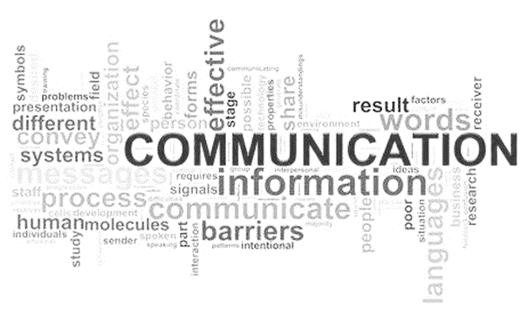


City of Nature Alliance Pilot Project
Workshop Facilitator
Debbie Needle
Community Facilitator
For the city’s Urban Nature Development Project
(Part of the City of Nature Programme)

Slide 3

Communicating the City of Nature Plan actions
In this presentation we will look at:
The City of Nature Plan Overview.
What are the actions in the plan
Why is community communication important
Earth Stories – Hearing People’s voices
Communicating activities
Making connections – 1,000,000+

Slide 4

City of Nature Plan overview

Slide 5
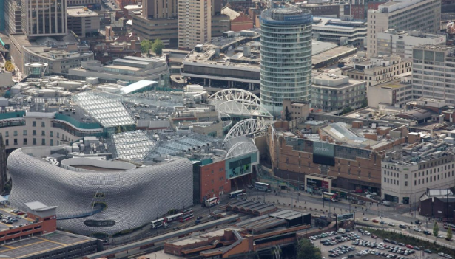
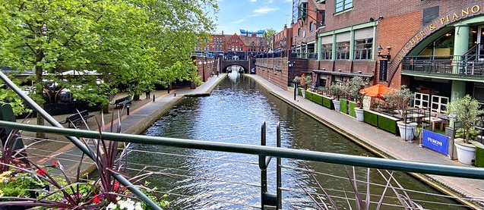
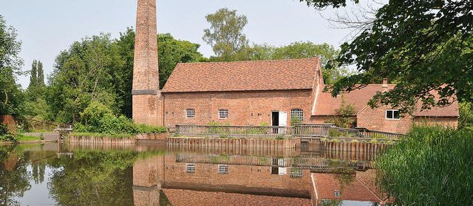
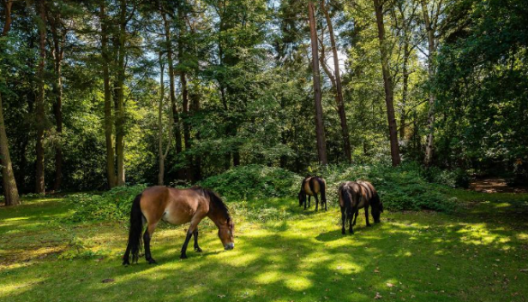
Birmingham
Notes:
When we think about Birmingham what images come into our minds?
All these images are in Birmingham. The city centre (very grey, not much green just one tree if you look closely), Brindley Place canals, Sarehole Mill Museum and ponies in Sutton Park LNR.

Slide 6
25-year Plan for a City of Nature – The long game
Over thirty years ago, at the Rio Summit in 1992, the world formally recognised how important the environment, biodiversity and sustainability would be as a new framework for 21st century living. Sustainability has three pillars, economical, ecological and social. Without all three being balanced, it will not work.
Over the intervening 30 years Birmingham has undergone a significant transformation rebuilding its city centre and creating a vibrant economy. (Economic and Social)
In 2019 we started out by deciding that over the next 30 years Birmingham would deliver its plan for the design, management and use of green infrastructure by creating a city of nature. (Ecological) This will help to create the balance for a sustainable city.
Notes:
Over thirty years ago, at the Rio Summit in 1992, the world formally recognised how important the environment, biodiversity and sustainability would be as a new framework for 21st century living. Sustainability has three pillars, economical, ecological and social. Without all three being balanced, it will not work.
Over the intervening 30 years Birmingham has undergone a significant transformation rebuilding its city centre and creating a vibrant economy. (Economic and Social)
In 2019 we started out by deciding that over the next 30 years Birmingham would deliver its plan for the design, management and use of green infrastructure by creating a city of nature. (Ecological) This will help to create the balance for a sustainable city.

Slide 7

From a vision to delivering a City of Nature
2018 - Our Future City Plan (OFCP) 2040 ‘Shaping This City Together’
This “vision document” introduced a new approach to strategy and plan making based on a shared and inclusive vision for Birmingham’s central region.
2019 - The Naturally Birmingham Project
This was the name of Birmingham’s Future Park Accelerator (FPA) Project funded by Heritage Lottery and supported by the National Trust, which took two years to develop a plan for the whole city building on the original OFCP vision for just the central region of Birmingham.
2022 - The City of Nature 25-year Plan
In February 2022, the City of Nature Plan was agreed and adopted by Birmingham City Council as the Green Infrastructure Strategy. This documents the why, what, when and who of how the vision would get delivered across the whole city.
2023 - The City of Nature Programme and City of Nature Alliance of organisations Pilot.
This was about increasing knowledge about exactly what needs to happen, what it will cost and what else we still need to know, for the plan to be delivered.
2024 - The Urban Nature Development Project, Urban Forest Accelerator and Green Champions Programme
This is the first implementation of the City of Nature Plan across multiple wards.
Notes:
There are lots of different plan, policy and project names that we use when talking about the City of Nature.
We started in 2018 with a vision for a more balanced sustainable plan for Birmingham. This became the Our Future City Plan (OFCP) 2040 ‘Shaping This City Together’
This vision document introduced a new approach to strategy and plan making based on a shared and inclusive vision for Birmingham’s central region.
In 2019 The councils Green City Manager – Nick Grayson but together a bid to apply for funding from the Future Park Accelerator (FPA) Project. He called the Birmingham Project – Naturally Birmingham. The project was funded by Heritage Lottery and supported by National Trust, which took two years to develop a plan for the whole city building on the original OFCP vision for just the central region of Birmingham. This project would take two years to build on the vision for central Birmingham and make it deliverable for the whole city.
In February 2022, the City of Nature Plan was agreed and adopted by Birmingham City Council as the Green Infrastructure Strategy. This documents the why, what, when and who of how the vision would get delivered across the whole city.
In 2023 - The City of Nature Programme and City of Nature Alliance of organisations pilot was developed. This project was about increasing knowledge about exactly what needs to happen at site level, what it will cost and what else we still need to know, for the actions in the plan to be delivered on the ground.
2024 - The Urban Nature Development Project, Urban Forest Accelerator and Green Champions Programme
This is the first implementation of the City of Nature Plan across multiple wards.

Slide 8
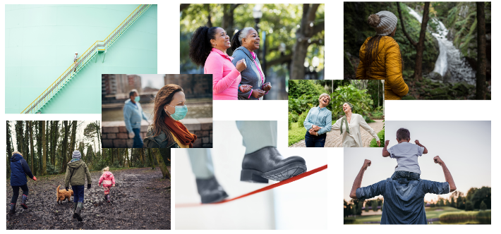
The start.
5 priorities for Birmingham.
Health, Housing, Children, Employment & Environment
Notes:
At the start of the Naturally Birmingham project, we looked at the councils' priorities for the city: Health, Housing, Children and Young People and Jobs and Skills.
We added the environment to this list of priorities and set about showing why the environment was so important, in fact vital, to tackling the other 4 existing priorities.

Slide 9
The Journey to the 5 Themes
Focusing on : Funding, Involvement & Communication
Notes:
Eventually we would develop five themes for the basis of the City of Nature, but we started by thinking about funding (money), involving people at every stage and communicating about this.

Slide 10

The 5 Themes
And delivery
Delivered
Valued
Involved
Green
Healthy
Fair
A city that is: Fair, Healthy, Green, Involved & Valued
Notes:
After many iterations we landed on five themes that made up a city of nature.
A city would need to deliver green infrastructure and services that are Fair, Healthy, Green, Involved and Valued – and – these would need to be delivered.
Without delivery it would remain just a plan rather than a transformation process.
All the themes are interrelated and interdependent. You will see this translate in each section.

Slide 11




Environmental justice is at the heart of what a fair city would look like.
It is defined as the fair treatment and meaningful involvement of all people regardless of race, colour, national origin, or income, with respect to the development, implementation and enforcement of environmental laws, regulations, and policies.
Measuring Environmental Justice in Birmingham The Birmingham Future Parks Accelerator Project has looked at how other cities around the world have responded to this issue of unequal access to green space; and is the first UK local authority to develop a measurement tool for Environmental Justice; based on the existing Indices of Multiple Deprivation.
The Environmental Justice score measures:
• Access to a green space (2 hectares or larger) within 1,000m.
• Flood Risk.
• Urban Heat Island effect.
• Health inequalities (through Excess Years of Life Lost).
• Indices of Multiple Deprivation.
Birmingham City Council Geospatial Team developed a new map that shows where in the city all these compound issues are being felt most acutely. This then provides a very useful new baseline from which to develop an evidence-based approach to levelling-up Fair City outcomes We will make sure every citizen has access to good quality green space wherever they live and that there is fair access to training and green jobs and our workforce reflects our diverse communities.
To do this we need:
• Good quality green spaces close to where people live, through the adoption of the Birmingham Future Parks Standard process (F1).
• To Identify up to 400 more public green spaces (F2).
• Green spaces that are managed to ensure they are appealing to our diverse communities (F3).
• Green spaces that are accessible for those with additional needs and those who may need support (F4).
• A training and employment showcase of opportunities in the ‘green sector’ (F5).
• A green space workforce more reflective of Birmingham’s diverse communities (F6).
• A children and young people strategy with City of Nature as part of that (F7).
Notes:
A Fair City – is one that has Environmental justice is at the heart.
Environmental Justice is defined as the fair treatment and meaningful involvement of all people regardless of race, colour, national origin, or income, with respect to the development, implementation and enforcement of environmental laws, regulations, and policies.
Measuring Environmental Justice in Birmingham The Birmingham Future Parks Accelerator Project has looked at how other cities around the world have responded to this issue of unequal access to green space; and is the first UK local authority to develop a measurement tool for Environmental Justice; based on the existing Indices of Multiple Deprivation.

Slide 12
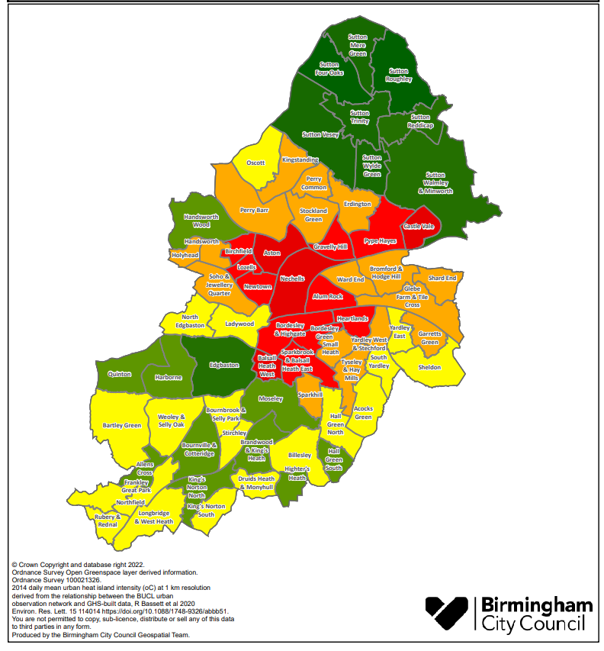
Delivering Environmental Justice
Starting with Birmingham’s priority “Red Wards”:
Castle Vale
Pype Hays
Gravelly Hill
Nechells
Bordesley and Highgate
Balsall Heath West
Achieving:
Levelling Up environmental justice
Climate Change Adaptation
Nature Recovery
Notes:
First 12 months: 2022 -2023 We trialled this approach first in 5 open spaces in Bordesley and Highgate Ward to ensure it is working well before taking it elsewhere.
First five years: 2022 to 2027
We are using the findings from the Bordesley and Highgate pilot to bring together council departments and community organisations to focus upon the green spaces in another 5 wards:
• Balsall Heath West.
• Nechells.
• Gravelly Hill.
• Pype Hayes.
• Castle Vale.
3 of these wards - Balsall Heath West, Nechells and Castle Vale are in the top 5 areas of most need of environmental justice; the other two are geographical neighbours making a central north-south spine of the city.
Years 6 to 10: 2028 - 2032 This will be followed by 8 more red wards:
• Alum Rock.
• Aston.
• Birchfield.
Bordesley Green.
• Heartlands.
• Lozells.
• Newtown.
• Sparkbrook and Balsall Heath East
Within the 25 years of the plan: by 2047 All our parks and green spaces will meet the Birmingham Future Parks Standard, with the 35 highest scoring wards forming a vital part of the city’s nature recovery network and therefore it’s response and resilience to climate change; ensuring our whole parks network moves from red to green. But the City of Nature outcomes don’t stop with the Birmingham Fair Parks Standard Audit process.
The City of Nature plan supports all green spaces throughout the 25 years to reach their full potential through the involvement of the local community to access resources that Birmingham City Council alone can no longer provide. For example, there is already substantive work planned along the South and East of Birmingham as part of the East Birmingham Inclusive Growth Strategy.
The Cole Valley is a key green corridor running through East and South Birmingham. It is identified within the Council’s Route to Zero and East Birmingham programmes as a focus for the improvement of the natural environment and as an active travel artery.
The Environment Agency has published a Vision for the Cole Valley Catchment in partnership with the Council and other stakeholders and this provides a useful starting point for planning the delivery of improvements to blue and green infrastructure.

Slide 13


The value of parks, green spaces and nature is not just defined by numbers.
The health benefits of green spaces have been intuitively known by communities for a long period of time. In recent years there has been an explosion of evidence which comprehensively supports the idea that green spaces are integral for both our physical and mental health.
Green space has been demonstrated to improve physical health in the following ways:
• Studies have shown that for children and young people access to green space helps regulate emotional and behavioural activity, specifically inattention and hyperactivity; encourages prosocial behaviour; and is the most significant factor to influence the reduction in childhood obesity.
• For adults, access to green space brings significant benefits in terms of reducing the likelihood of cardiovascular diseases, type two diabetes, hip fractures, bowel, and breast cancers. Older adults also benefit from reduction in levels of obesity, numbers of fractures and reduced death from cardiovascular diseases.
• Access to green space can also bring significant benefits in terms of mental health with evidence suggesting higher levels of life satisfaction; lower levels of self-reported stress; and lower levels of anxiety and depression.
To do this we need:
• Nature connectedness - whereby citizens understand the benefits of using green space and having contact with nature for physical and mental health (H1).
• Safe and attractive routes for walking and cycling (H2).
• An increased number of parks offering health and wellbeing services and green social prescribing (H3).
• To work with fitness providers to offer health and wellbeing activities in parks and other green spaces (H4).
• Support to citizens living in council housing to make communal gardens where they live (H5).
• To establish at least one Community Growing Space in every ward (I7).
Notes:
The value of parks, green spaces and nature is not just defined by numbers.
The health benefits of green spaces have been intuitively known by communities for a long period of time. In recent years there has been an explosion of evidence which comprehensively supports the idea that green spaces are integral for both our physical and mental health.
Green space has been demonstrated to improve physical health in the following ways:
• Studies have shown that for children and young people access to green space helps regulate emotional and behavioural activity, specifically inattention and hyperactivity; encourages prosocial behaviour; and is the most significant factor to influence the reduction in childhood obesity.
• For adults, access to green space brings significant benefits in terms of reducing the likelihood of cardiovascular diseases, type two diabetes, hip fractures, bowel, and breast cancers.
Older adults also benefit from reduction in levels of obesity, numbers of fractures and reduced death from cardiovascular diseases.
• Access to green space can also bring significant benefits in terms of mental health with evidence suggesting higher levels of life satisfaction; lower levels of self-reported stress; and lower levels of anxiety and depression.
Healthy City outcomes: We will make sure every citizen in Birmingham can access green spaces to improve their health and wellbeing as part of the foundations of a good life.

Slide 14


Where nature is recognised as integral to wider decision and plan making; and where green spaces, nature and the environment are protected, maintained, and sustainably managed.
The City of Nature Plan will address one of the themes prioritised in England’s 25 Year Environment Plan:
“Support the delivery of the national Nature Recovery Network, with its focus on enhancing landscapes; improving connectivity between wildlife rich places; climate resilience; protection of existing natural environments and supporting access to nature for health and well-being.”
To do this we need:
The restoration of green spaces, nature, and the environment (G4).
A complete change in how we build all our public realm, providing improved connectivity and supporting the restoration and viability of urban areas (G1).
Green corridors that are easier to find and use, helping citizens to use them for active travel and so improve air quality (G2).
An enhanced network of green space and green infrastructure that are safe, clean, sustainably managed and meet the Birmingham Future Parks Standard (G3).
Greener development bringing natural landscapes or features into every place and neighbourhood (G5).
Opportunities to help citizens make better use of green space outside of their home for food growing or communal gardens (G6).
The Nature Recovery Network, stretching right across the city and linking with all our West Midlands neighbours, forming part of the West Midlands National Park (G7).
An increase to the tree canopy coverage across the city to 25%, through the Birmingham Urban Forest Master Plan (G8).
A change to the city’s governance structures that oversee the city’s natural environment across the full 25-year term (G9).
Notes:
A Green City is one where nature is recognised as integral to wider decision and plan making; and where green spaces, nature and the environment are protected, maintained, and sustainably managed.
The City of Nature Plan will address one of the themes prioritised England’s 25 Year Environment Plan: “Support the delivery of the national Nature Recovery Network, with its focus on enhancing landscapes; improving connectivity between wildlife rich places; climate resilience; protection of existing natural environments and supporting access to nature for health and well-being.”

Slide 15


One of the greatest challenges facing the long-term maintenance and recovery of the natural environment and parks and green spaces, is the issue of funding.
The 2016-17 Parliamentary Inquiry ‘The Future of Public Parks’ found that the value of parks and green spaces was well documented but not well understood; so not fully protected in policy. The inquiry found that as a non-statutory service they have often been seen as non-essential services and have suffered disproportionately with budgets reductions imposed following the 2008 global financial crisis and subsequent austerity measures.
Historically the economic model adopted by all cities has been a linear one resulting in the maintenance of parks being registered as nothing but a cost; with their value not being captured. The City of Nature plan moves away from that model towards a circular economy one, that better fits how the city will need to meet its twin challenges of levelling-up and climate change.
In addition, the city will develop a Sustainable Finance Framework with external green investors allowing for the long-term investment into the city’s blue and green infrastructure.
This will help the city realise the true value of the natural environment as captured in the latest Natural Capital Account which valued the city’s future potential green estate as £14.93 billion after 25 years.
Notes:
The City of Nature plan depends on everyone understanding the value of the connections within nature. We are part of those connections.
One of the greatest challenges facing the long-term maintenance and recovery of the natural environment and parks and green spaces, is the issue of funding.
The 2016-17 Parliamentary Inquiry ‘The Future of Public Parks’ found that the value of parks and green spaces was well documented but not well understood; so not fully protected in policy.
The inquiry found that as a non-statutory service parks and green spaces have often been seen as non-essential services and have suffered disproportionately with budgets reductions imposed following the 2008 global financial crisis and subsequent austerity measures. In most recent times this has slowed but not stopped.
Historically the economic model adopted by all cities has been a linear one resulting in the maintenance of parks being registered as nothing but a cost; with their value not being captured.
The City of Nature plan moves away from that model towards a circular economy one, that better fits how the city will need to meet its twin challenges of levelling-up and climate change.
In addition, the city will develop a Sustainable Finance Framework with external green investors allowing for the long-term investment into the city’s blue and green infrastructure.
This will help the city realise the true value of the natural environment as captured in the latest Natural Capital Account which values the city’s future (after 25 years) potential green estate (if all the actions in the City of Nature Plan were delivered) as £14.93 billion.

Slide 16


Involving citizens throughout the delivery of actions in the City of Nature plan will mean that there is a greater understanding of the challenges the city faces and ensure local people have a voice in how their area is run. In the most deprived areas of England, people tend to have the poorest health and significantly less green space than wealthier areas.
Involving Council officers, other than just those in Street Scene, and their network of citizens from their associated service areas such as Planning, Public Health, Highways, Neighbourhoods and Jobs and Skills will result in the delivery of appropriate housing, better health outcomes, places for children to learn and play and a sense of pride of our citizens in their local area and in Birmingham as a whole.
The number of people who spend little or no time in natural spaces is too high.
Recent data from the Monitor of Engagement with the Natural Environment survey tells us that some 12% of children do not visit the natural environment each year. Playing and learning outside is a fundamental part of childhood, and helps children grow up healthy. Some children are lucky enough to have a family garden; others will not, and it is important that we find other ways to give them better access to the great outdoors. We know that regular contact with green spaces, such as the local park, lake, or playground, can have a beneficial impact on children’s physical and mental health.
To do this we need:
A City of Nature Alliance, made up of charities and community organisations, to provide a new civic voice and engagement mechanism (I6).
New and more flexible ways for the citizens to participate and to get involved in volunteering in green spaces; and become Green Champions (I5).
Support to children and young people to learn, play and explore the wonders of nature as part of their education and acting as Young Green Champions (I3).
New City of Nature pages on Birmingham City Council’s website to bring our green spaces to people at home, helping them to connect to nature wherever they are (I1).
Opportunities in green spaces to explore and celebrate art and culture, for example: work with libraries to organise book clubs in parks (I4).
Notes:
The City of Nature Plan was Co-created with as many people as possible for the project, the process tried to support involvement rather than just engagement or consultation.
Continuing to involve citizens throughout the delivery of actions in the City of Nature plan will mean that there is a greater understanding of the challenges the city faces and ensure local people have a voice in how their area is run. In the most deprived areas of England, people tend to have the poorest health and significantly less green space than wealthier areas.
Involving Council officers, other than just those in Street Scene, and their network of citizens from their associated service areas such as Planning, Public Health, Highways, Neighbourhoods and Jobs and Skills will result in the delivery of appropriate housing, better health outcomes, places for children to learn and play and a sense of pride of our citizens in their local area and in Birmingham as a whole.
The number of people who spend little or no time in natural spaces is too high.
Recent data from the Monitor of Engagement with the Natural Environment survey tells us that some 12% of children do not visit the natural environment each year. Playing and learning outside is a fundamental part of childhood, and helps children grow up healthy. Some children are lucky enough to have a family garden; others will not, and it is important that we find other ways to give them better access to the great outdoors. We know that regular contact with green spaces, such as the local park, lake, or playground, can have a beneficial impact on children’s physical and mental health.

Slide 17

City of Nature Plan actions
Notes:
Bordesley and Highgate Ward Delivery Framework Pilot The Alliance will help deliver the Bordesley and Highgate pilot project through the following actions:
Phase 2 Small grants of £2,000 x 5 Customer relation management development and procurement Creation of action plans for the remaining 5 wards as part of 2 and 3
Identify, engage, and involve at least 1 Green Champion for each of the 5 sites in Bordesley and Highgate ward (5 Green Champions). Green Champions are members of the community who will help deliver actions on site and or advocate for environmental justice and green spaces. They may be volunteers or professionals such as teachers who have a green focus. Training will be provided as appropriate.
Community involvement activities with early years children and local schools, monthly activities.
Community involvement activities for individuals and families offered in at least the 5 parks in Bordesley and Highgate ward, 2 occasions per month March to December 2022 on site, delivering activities including healthy parks, walks, exercise, and mental health mindfulness activities.
Physical landscape improvements including wildflower areas and tree planting appropriate for each site - being developed through the action planning process.
Objectives for the Birmingham City of Nature (BCoN) Alliance: • Continue to identify organisations across Birmingham that deliver outcomes in line with the aims of the Our Future City Plan - City of Nature Vision and invite them to join the Alliance membership to help delivery of actions identified in the City of Nature Delivery Framework. • Establish and maintain a forum for BCoN Alliance members to come together, whether online or in person to contribute to decision making regarding action taken in each of the 6 red wards as identified in the 5 year plan. • Communicate information between BCoN members, communities, and other stakeholders. Nature • Maintain relationships with people interested/ involved with the City of Nature project, including but not limited to volunteers and may include teachers, police officers, local businesses. • Leading the development and implementation of a data management system. • Help deliver opportunities for volunteers to be involved in site development and management not already resourced. • Deliver educational establishment engagement not already resourced. • Deliver community engagement activities like Earth Stories. • Identify community leads (Green Champions), who are individuals willing to train to lead community activities on a voluntary basis. • Help to identify funding opportunities and investment to develop a sustainable funding model for the delivery framework including but not limited to, paying for assistance with bid writing for any established groups. • Delivery of actions required to bring parks up to Birmingham Fair Standard - even in areas that do not have established friends of groups

Slide 18
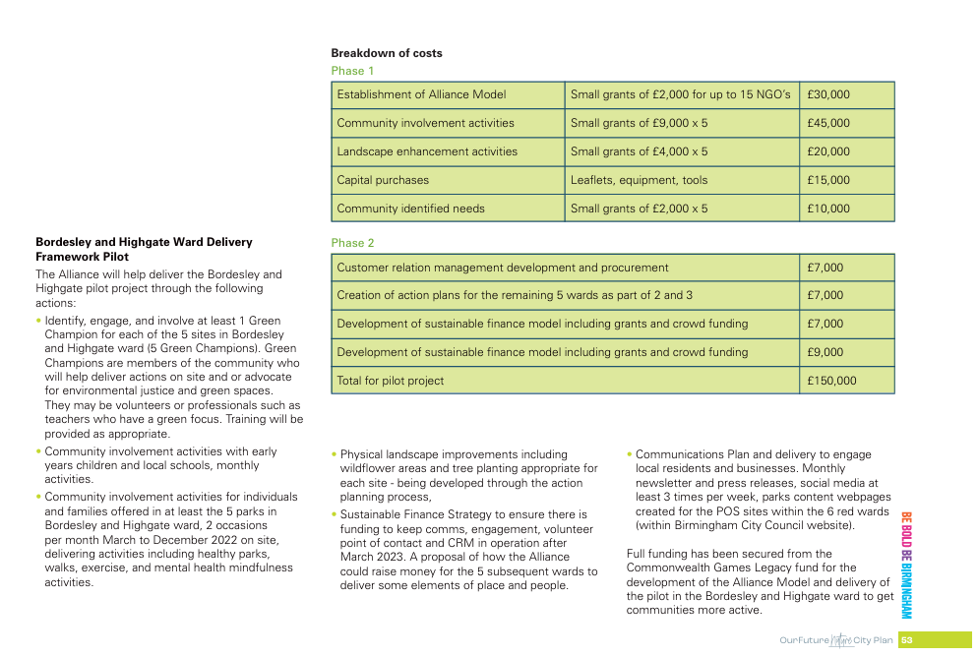
Notes:
Communications Plan and delivery to engage residents and businesses.
Monthly newsletter
Press releases
Social media at least 3 times per week,
Parks content webpages created for the POS sites within the 6 red wards

Slide 19
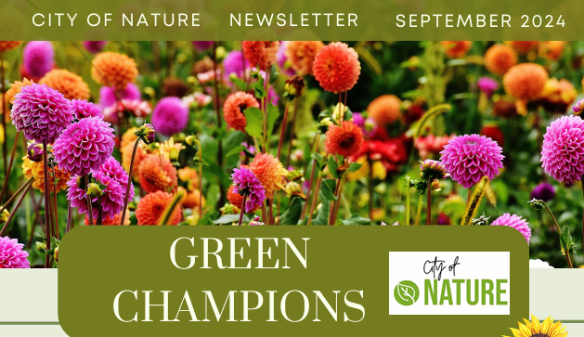
Notes:
Tips for Writing Effective Newsletters
Know Your Audience
Tailor your content to the interests, needs, and preferences of your readers. Segment your audience if necessary to deliver personalized newsletters.
Craft an Engaging Subject Line
Keep your subject line clear, intriguing, and concise. Aim to capture attention with a few words, but avoid clickbait.
Be Clear and Concise
Keep your content brief and to the point. Focus on delivering valuable information in a format that’s easy to scan.
Include a Strong Call to Action (CTA)
Direct your readers to take a specific action (e.g., “Read more,” “Shop now,” “Register here”) with clear, compelling CTAs that stand out visually.
Use Visuals and White Space
Break up text with images, graphics, and plenty of white space to make your newsletter more visually appealing and easier to read.
Maintain Consistency
Use a consistent format, tone, and style that aligns with your brand. Regular newsletters help establish a routine and keep readers engaged.
Provide Value
Focus on offering value, whether through exclusive content, discounts, news, or useful tips. Readers are more likely to stay subscribed if they feel they're gaining something.
Use Personalization
Address your readers by name and, if possible, customize content based on their past interactions. Personalized newsletters increase engagement.
Optimize for Mobile
Ensure your newsletter is mobile-friendly since many people read emails on their phones. Use a responsive design that adjusts well to different screen sizes.
Test and Analyse
Use A/B testing to experiment with different subject lines, formats, or CTAs. Analyze open rates, click-through rates, and conversions to improve future newsletters.
Include a Clear Unsubscribe Option
Make it easy for readers to opt out if they choose. A clear unsubscribe button keeps your list engaged and reduces frustration.
Use Engaging Headlines and Subheadings
Break up sections with engaging headlines and subheadings to guide readers and encourage them to keep reading.
Keep a Friendly Tone
Write conversationally, using a tone that reflects your brand’s personality but is also approachable and engaging.
Offer Exclusive Content
Reward your subscribers with special deals, behind-the-scenes content, or early access to new products, making your newsletter feel valuable.
Proofread Thoroughly
Ensure your newsletter is free of errors by proofreading carefully. A polished and professional newsletter reflects well on your brand.
By applying these tips, your newsletters will be more engaging, relevant, and effective in building relationships with your readers.
4o

Slide 20
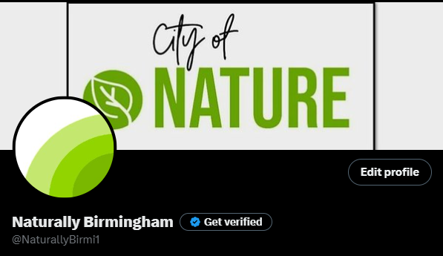
Notes:
Tips for Success in Social Media
Know Your Audience
Understand who your target audience is, their preferences, and behaviors. Tailor your content to resonate with their interests and needs.
Be Consistent
Post regularly to stay visible and maintain engagement. Develop a content calendar to ensure consistent updates without overwhelming followers.
Engage with Your Followers
Respond to comments, messages, and mentions. Show genuine interest in your audience's feedback, and create conversations to build relationships.
Create High-Quality Content
Invest in visually appealing images, videos, and well-written posts. Quality content is more likely to be shared and remembered.
Use Hashtags Strategically
Research relevant hashtags to increase the discoverability of your posts. Don’t overdo it—focus on quality and relevance.
Leverage Analytics
Track the performance of your posts using platform analytics to understand what works best and adjust your strategy accordingly.
Be Authentic
Show your brand’s personality and values. Authenticity builds trust and helps followers feel connected to your brand.
Stay Trend-Aware
Keep up with social media trends, memes, or challenges relevant to your brand, but only participate if it aligns with your voice and audience.
Mix Content Types
Use a combination of images, videos, stories, live sessions, and user-generated content to keep your feed dynamic and engaging.
Collaborate with Influencers
Partner with influencers or brand advocates who align with your audience. Influencer marketing can expand your reach and credibility.
Run Contests and Giveaways
Encourage participation through interactive posts like contests, challenges, or giveaways. This boosts engagement and attracts new followers.
Optimize for Each Platform
Tailor your content to fit the strengths of each social platform. For example, videos perform well on Instagram and TikTok, while articles or long posts suit LinkedIn.
Promote User-Generated Content
Encourage your followers to share their own content related to your brand, creating community and building authenticity.
Have a Clear Call to Action (CTA)
Each post should guide followers toward an action, whether it's visiting your website, subscribing to your newsletter, or commenting on a post.
Stay Professional and Respectful
Handle criticism or negative feedback professionally. Always engage with users respectfully to maintain a positive brand image.
By following these tips, you can build a strong, engaged social media presence and connect more effectively with your audience.

Slide 21
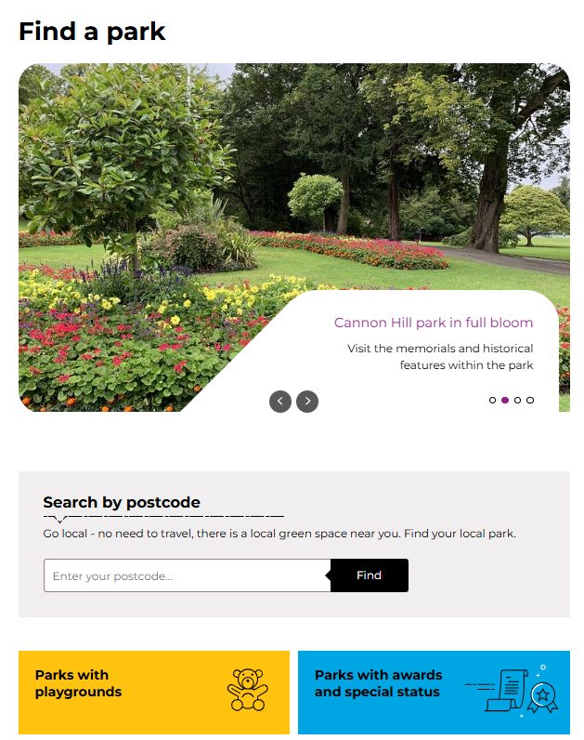
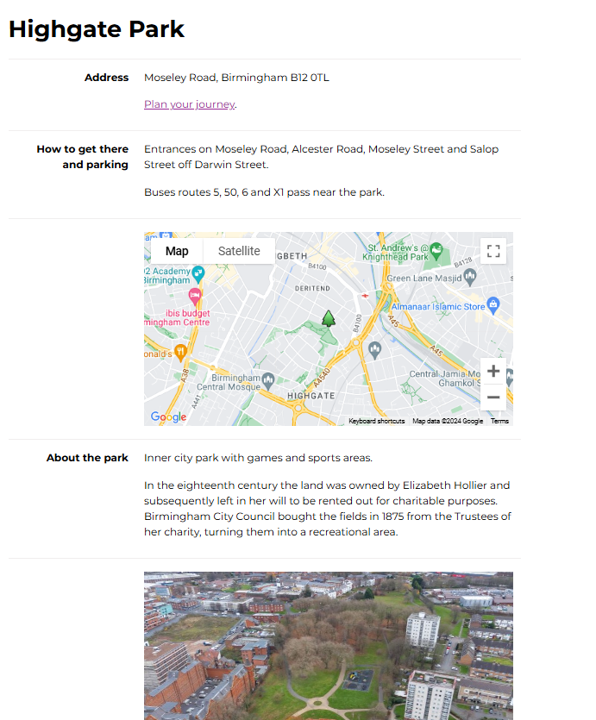

Slide 22
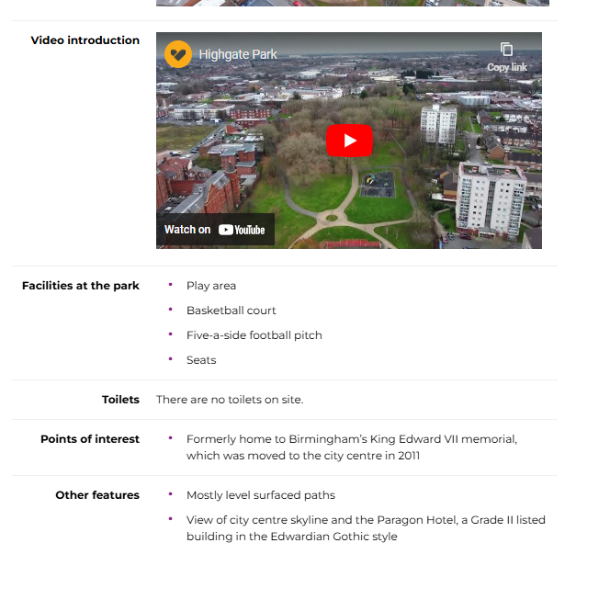
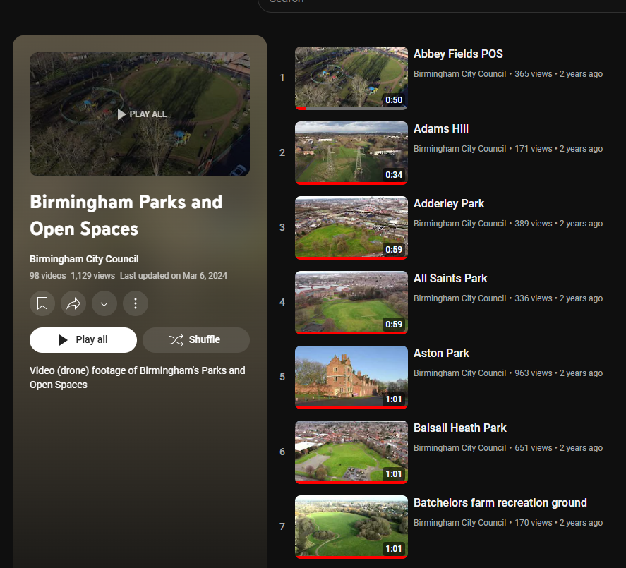

Slide 23
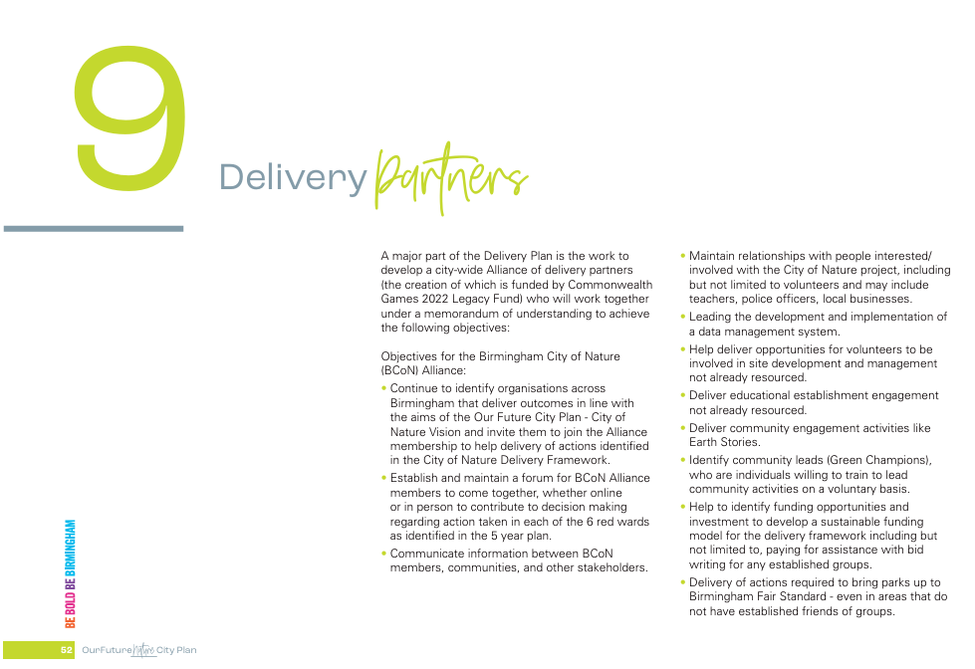

Slide 24

The Urban Nature Development Project and Urban Forest Accelerator Project
BCC needed to make the City of Nature Plan both deliverable and sustainable and the National Trust wanted to be able to expand, develop and share the work started in the Future Parks Accelerator Project.
Although much had already been achieved for Birmingham through the work done in the Future Parks Accelerator Project, there was still a lot of work to do to ensure the detail, data and mechanisms, both operational and the governance for the delivery of the plan are in place.
The first two projects in the City of Nature Programme are:
The Urban Nature Development Project
The Urban Forest Accelerator (Birmingham Pilot) in response to the then government's “Trees Call for Action”
Both projects are supported by the National Trust and funded by the National Lottery Heritage fund.
Notes:
BCC needed to make the City of Nature Plan both deliverable and sustainable and the National Trust wanted to be able to expand, develop and share the work started in the Future Parks Accelerator Project.
Although much had already been achieved for Birmingham through the work done in the Future Parks Accelerator Project, there was still a lot of work to do to ensure the detail, data and mechanisms, both operational and the governance for the delivery of the plan are in place.
The first two projects in the City of Nature Programme are:
The Urban Nature Development Project
The Urban Forest Accelerator (Birmingham Pilot) in response to the then government's “Trees Call for Action”
Both projects are supported by the National Trust and funded by the National Lottery Heritage fund.

Slide 25

The Future Parks Standard - Improving existing parks
UND - Focusing on Nature on Your Doorstep / Nature Connection for Health
We are improving existing parks so people in most need can benefit from their green spaces and nature on their doorstep.
To do this we are establishing mechanisms to:
Convene a City of Nature BCC Operations Group
Support a City of Nature Alliance partnership to enhance working with communities.
Activate five ‘red’ wards (identified through the environmental justice map) using the “Birmingham Future Park Standard” method to manage assets and deliver services.
Develop a Green Champions model for eco volunteers.
Identifying and testing a programme of nature-based health interventions and growing a range of online information and opportunities to involve new audiences.
Trialling a Social Impact Assessment app to monitor and report on this work.
Identifying key sources of parks related income to fund this work in the future.
Notes:
We want to establish a capacity and capability building mechanism for people in most need to be able to benefit from the enjoyment of the natural world by becoming involved with their green spaces and nature on their doorstep.
We are improving existing parks so people in most need can benefit from their green spaces and nature on their doorstep.
To do this we are establishing mechanisms to:
Convene a City of Nature BCC Operations Group
Support a City of Nature Alliance partnership to enhance working with communities.
Activate five ‘red’ wards (identified through the environmental justice map) using the “Birmingham Future Park Standard” method to manage assets and deliver services.
Develop a Green Champions model for eco volunteers.
Identifying and testing a programme of nature-based health interventions and growing a range of online information and opportunities to involve new audiences.
Trialling a Social Impact Assessment app to monitor and report on this work.
Identifying key sources of parks related income to fund this work in the future.

Slide 26
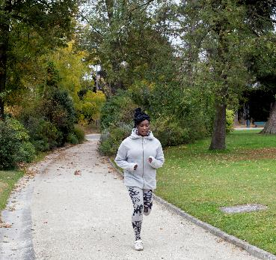
Master Planning - New parks and green spaces
Produce a pipeline of projects for the East Birmingham Inclusive Growth geography by:
Developing a green infrastructure (GI) master plan that will:
Identify improvement options for all existing green space, starting with East Birmingham.
Identify all future opportunity sites & linkages across East Birmingham.
Develop costed investment proposals for nominated sites, across a range of typologies, with recommended financial resources.
Inform the City’s local development plan, wider GI master planning and sustainable investment strategies.
Notes:
Produce a pipeline of projects for the East Birmingham Inclusive Growth geography by:
Developing a green infrastructure (GI) master plan that will:
Identify improvement options for all existing green space, starting with East Birmingham.
Identify all future opportunity sites & linkages across East Birmingham.
Develop costed investment proposals for nominated sites, across a range of typologies, with recommended financial resources.
Inform the City’s local development plan, wider GI master planning and sustainable investment strategies.

Slide 27


Nature Recovery Network
The requirement for Local Nature Recovery Strategies (LNRS) across the whole of England were set out in the Environment Act 2021. The LNRS Regs came into force on 13th April 2023 with the WMCA being appointed as Responsible Authority for delivering the stratergy for the West Midlands region in June 2023.
What is the LNRS?
Local nature recovery strategies are a system of spatial strategies for nature and environmental improvement required by law under the Act.
Each strategy must:
agree priorities for nature’s recovery;
map the most valuable existing areas for nature; and
map specific proposals for creating or improving habitat for nature and wider environmental goals (adopting Nature Based Solutions).
Together, the strategies will cover the whole of England with no gaps and no overlaps.
The main purpose of the strategies is to identify locations to create or improve habitat most likely to provide the greatest benefit for nature and the wider environment.
Urban Nature Development Project
Create a schedule of Birmingham City Council sites that could successfully benefit from future Biodiversity Net Gain credits and embedded maintenance payments through identification of BCC owned sites against the 25-year nature recovery vision map developed through FPA.
Notes:
The requirement for Local Nature Recovery Strategies (LNRS) across the whole of England were set out in the Environment Act 2021. The LNRS Regs came into force on 13th April 2023 with the WMCA being appointed as Responsible Authority for delivering the stratergy for the West Midlands region in June 2023.
What is the LNRS?
Local nature recovery strategies are a system of spatial strategies for nature and environmental improvement required by law under the Act.
Each strategy must:
agree priorities for nature’s recovery;
map the most valuable existing areas for nature; and
map specific proposals for creating or improving habitat for nature and wider environmental goals (adopting Nature Based Solutions).
Together, the strategies will cover the whole of England with no gaps and no overlaps.
The main purpose of the strategies is to identify locations to create or improve habitat most likely to provide the greatest benefit for nature and the wider environment.
Urban Nature Development Project
Create a schedule of Birmingham City Council sites that could successfully benefit from future Biodiversity Net Gain credits and embedded maintenance payments through identification of BCC owned sites against the 25-year nature recovery vision map developed through FPA.

Slide 28
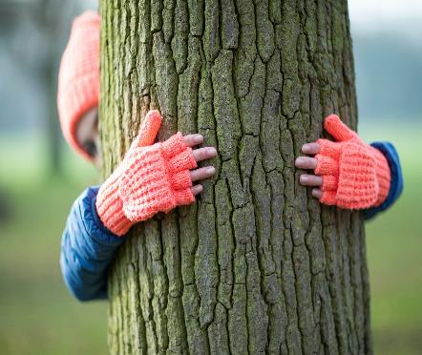
Growing Birmingham’s Urban Forest and Urban Foresters
The Urban Forest Accelerator (UFA) project is a joint project between the National Trust, Birmingham Treepeople CIO and Birmingham City Council. It contributes to the vision of the England Trees Action Plan (ETAP) and will deliver against multiple objectives from it.
Its objectives are:
Connecting people with trees and woodlands
Making trees and woodlands part of the green economy
Protecting and improving our trees and woodlands
Expanding and connecting our trees and woodlands
As a local authority we have stated a clear commitment to Net Zero and as part of that a commitment to future tree planting and protection. This will take those reoccurring resources of money, volunteers and communication alongside building skills for a future green workforce.
Notes:
The Urban Forest Accelerator (UFA) project is a joint project between the National Trust, Birmingham Treepeople CIO and Birmingham City Council. It contributes to the vision of the England Trees Action Plan (ETAP) and will deliver against multiple objectives from it.
Its objectives are:
Connecting people with trees and woodlands
Making trees and woodlands part of the green economy
Protecting and improving our trees and woodlands
Expanding and connecting our trees and woodlands
As a local authority we have stated a clear commitment to Net Zero and as part of that a commitment to future tree planting and protection. This will take those reoccurring resources of money, volunteers and communication alongside building skills for a future green workforce.

Slide 29
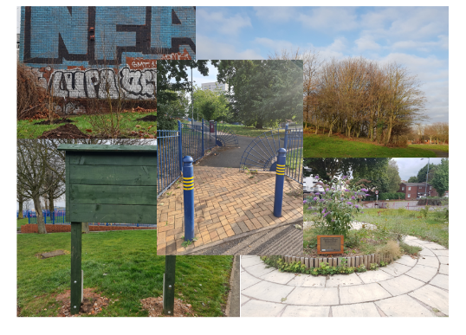
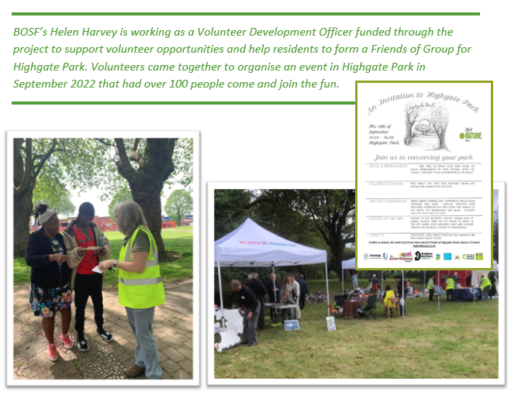

The City of Nature Alliance Ward Pilot – Improving 5 Existing Parks
Bordesley and Highgate pilot project - managing parks and greenspaces differently following the City of Nature Plan – How much did that cost £150,000 +?
Notes:
In 2023 the council’s Urban Nature Development Project (funded by the Heritage Lottery) commenced the City of Nature Alliance Pilot applying the Future Park Standard to activate five parks in one red ward which was Bordesley and Highgate.
The Bordesley and Highgate pilot project looked at managing parks and greenspaces differently following the City of Nature Plan. The work of the Alliance organisations was funded with £ 150,000 from the Commonwealth Games Legacy fund.
But do we know how much it really cost to run the pilot? What if we added in volunteer time, organisational support, use of equipment that had already been purchased etc.
We need to be able understand the true cost of things and the true value of them.

Slide 30

BCC Housing
BCC Route to Zero Team
BCC Street Scene (Including Parks)
BCC Commonwealth Games Legacy
BCC Adult Education
Birmingham Children’s Trust
BCC Public Health
At the start of the FPA project there was already fantastic work being done in Birmingham by individuals, groups and organisations, but we wanted to bring all of those together with all BCC Departments to continue the collaborate of developing the plan into a collaboration to deliver the plan at ward level. We would look for gaps and make the most of the strengths by sharing knowledge and skills.
This collaboration is known as the: City of Nature Alliance
Core third sector members of the Alliance were:
Birmingham Open Spaces forum
The Birmingham and Black Country Wildlife Trust
The Active Wellbeing Society
The Birmingham Children's Trust
Charities Birmingham Tree People (previously the BTFL project), Legacy WM and Patchwork Meadow and local entrepreneurs like Learning Journey and the Parakeet have joined these and the wider City of Nature Alliance that helps to shape the delivery of the City Nature Programme includes National organisations like the RSPB, The National Trust, Natural England, The Canals and Rivers Trust and it is growing all the time.
City of Nature Alliance
Birmingham Open Spaces Forum
The Active Wellbeing Society
Legacy WM
Learning Journeys
Birmingham and Black Country Wildlife Trust
Neighbourhood Networks
Birmingham Tree People
Notes:
At the start of the FPA project there was already fantastic work being done in Birmingham by individuals, groups and organisations, but we wanted to bring all of those together with all BCC Departments to continue the collaborate of developing the plan into a collaboration to deliver the plan at ward level. We would look for gaps and make the most of the strengths by sharing knowledge and skills.
This collaboration is known as the: City of Nature Alliance
Core third sector members of the Alliance were:
Birmingham Open Spaces forum
The Birmingham and Black Country Wildlife Trust
The Active Wellbeing Society
The Birmingham Children's Trust
Charities Birmingham Tree People (previously the BTFL project), Legacy WM and Patchwork Meadow and local entrepreneurs like Learning Journey and the Parakeet have joined these and the wider City of Nature Alliance that helps to shape the delivery of the City Nature Programme includes National organisations like the RSPB, The National Trust, Natural England, The Canals and Rivers Trust and it is growing all the time.

Slide 31
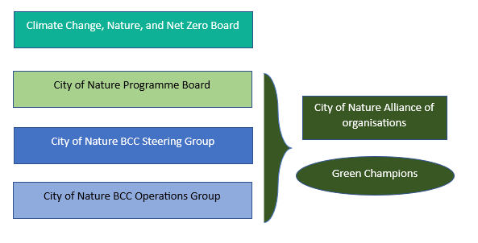

Governance for a City of Nature
The Climate Change, Nature, and Net Zero Board overseas all the work being delivered for the Environment Portfolio.
The City of Nature Programme Board ensure the delivery of projects are on track.
The City of Nature Steering Group - advises the delivery of the programme.
The City of Nature BCC Operations Group – supports delivery.
The City of Nature Alliance – plays a part in all City of Nature levels.
Green Champions can include anyone involved at any level and / or interested citizens.
Notes:
Governance and Finance
How do we ensure that when we look at what people need, how nature can help, what human services are needed to meet the need (so what are the benefits from the services), what is the cost, how do we find the funding and how we ensure the original need is being met in the most nature friendly and cost-effective way possible.
Birmingham participated as a case study city in a 5-year national research study - Liveable Cities (2012- 2017) which looked at the world’s most liveable cities to understand the critical ingredients needed to be successful as a green sustainable city.
One of its main findings was that successful cities were clear about how they linked municipal governance, with municipal planning and municipal finance.
These lessons have been built into the City of Nature Plan http://liveablecities.org.uk/
Strong and inclusive leadership will be key to the success of the City of Nature Plan.
To ensure the long-term governance and management of Birmingham’s natural environment a series of new bodies and groups have been formed to connect agendas and outcomes; with the benefits that the natural environment can bring to the improved performance of the city.
The core aims and ethos of the plan need to be considered when any decisions relating to Birmingham green spaces are being taken.
These new bodies are:
• The City of Nature Board: chaired by Cabinet Member for Parks and Street Scene.
• The City of Nature Steering Group: chaired by Assistant Director for Development who will bring together other Assistant Directors from across the council.
• The City of Nature Operations Group: chaired by Principal Planning Officer who will bring together operational officers from across the council.
• The Birmingham City of Nature Alliance: facilitated by the City of Nature Officer who will bring together representatives from external organisations.
The City of Nature Alliance will hold the Council accountable for the delivery of this plan

Slide 32

Why is community communication important

Slide 33

In today’s interconnected world, the success of businesses, governments, non-profits, and other organizations relies on their ability to engage with the communities they serve.
Whether these communities are local neighbourhoods, customer bases, or social media networks, effective communication plays a pivotal role in fostering trust, collaboration, and growth.
Communication with communities is not just important, but essential.
Building Trust and Transparency
One of the foundational elements of any relationship is trust, and this is especially true in the relationship between organizations and their communities. When there is open and honest communication, trust develops.
By keeping communities informed about key decisions, challenges, and opportunities, organizations demonstrate transparency, which, in turn, builds credibility.
Without clear communication, rumours and misunderstandings can spread, leading to distrust.
For example, a local government that regularly updates its residents on changes to infrastructure, public safety, or budgeting earns the confidence of the people it serves.
Similarly, businesses that communicate openly about their practices, product changes, or policies create a more loyal customer base.

Slide 34

When communities feel they are being heard and respected, they are more likely to support the organization or entity.
Facilitating Collaboration and Engagement
Effective communication is a two-way street. It’s not only about delivering messages but also about listening and engaging.
Communities often have valuable insights, ideas, and feedback that can help shape better decisions and solutions. When organizations actively listen and engage with community members, they gain a deeper understanding of their needs and concerns.
This participatory approach can lead to stronger collaboration, where community members feel they have a stake in the outcomes. Whether it’s a city council seeking input on a new public park or a brand asking its customers for feedback on a product, communication encourages collaboration. Engaged communities are more likely to support initiatives and contribute to the organization's long-term success.
Fostering Inclusion and Diversity
Every community is diverse, made up of people from different backgrounds, cultures, and perspectives. By effectively communicating with all segments of the community, organizations can ensure that diverse voices are heard. This inclusivity fosters a sense of belonging and promotes equity.
When organizations fail to communicate with all parts of their community, they risk alienating certain groups, which can lead to marginalization and division. On the other hand, active communication that respects and reflects the diversity of a community builds bridges and helps create a more unified, cohesive environment.

Slide 35

Driving Innovation and Growth
Communities are often the best source of inspiration for innovation. By fostering open lines of communication, organizations can tap into the creativity and insights of the people they serve. Whether through meetings, customer surveys, social media discussions, or focus groups, organizations can gain valuable input that leads to new ideas and opportunities.
Moreover, when community members feel that their voices matter, they are more likely to contribute innovative solutions and help organizations adapt to changing circumstances. For businesses, this can lead to improved products and services; for governments, this can mean more effective public policies.
Maintaining Relevance and Adaptability
Communities are dynamic—they change with time, influenced by economic, cultural, technological, and social shifts. Regular communication helps organizations stay attuned to these changes. By engaging with communities, organizations can remain relevant and responsive, adjusting their strategies to meet evolving needs.
For example, brands that constantly communicate with their customer base through social media or market research can pivot quickly when preferences change. Non-profits that maintain open dialogues with their beneficiaries are better positioned to adapt their services to meet new challenges. When organizations fail to keep up with their communities, they risk becoming outdated and disconnected.

Slide 36

Making Connections

Slide 37
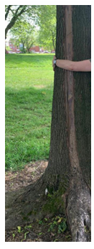

Helen Harvey (BOSF) – Garrison Lane Park activities.
Meeting / talk and activity with Highgate Ladies (HCSL)
INTRODUCTIONS
  Tell us your name and one wonderful thing in your life at the moment.
What do you think of when you hear the word nature? – ROUND
VISUALISATION exercise
  BE AWARE SOME MAY NOT TRUST ENOUGH TO DO THIS EXERCISE – ALLOW FOR THIS.
  Sit back, close eyes, relax, imagine walking through the door into a bountiful place of nature. Smell how it feels. Think what you can hear. Is there something to touch, smell, hear, that you enjoy? Take time, slow down.
  Open your eyes when ready. ROUND what did you see / smell / hear / touch
  How did you feel.
  TALK IN PAIRS – reminisce on nature in your childhood home / or another place important to your past. ( BE AWARE SOME CHILDHOODS MAY NOT BE A GOOD PLACE TO REVISIT) After 2 minutes SHARE with the group.
Attendees: Fourteen ladies, most of Somalian background. On a Tuesday coffee morning, I was asked to talk to them about nature and the benefits. Hoping to encourage them to connect with the park across the road from the building they meet in and their children attend at nursery and for additional educational needs. Four of the group did not speak English but could understand some phrases. I had to be mindful of leaving occasional gaps for translation.
Activity: I gave a talk (using some of the time to think principles of good community meetings. Every lady had the opportunity to speak and be encouraged and listened to. I included rounds – questions where everyone in turn spoke and gave an opinion without interruption. I included a visualisation round – allowing the ladies to be calm, still, focused on my voice and follow my guidance through the doors into nature. Once ‘back in the room’ the ladies were encouraged to share their feelings on the exercise. Main feedback from this exercise was quite overwhelming – they were so calm, relaxed, ‘infinitely happy’, safe, etc. very much enjoyed. Followed this up with talking in pairs about nature in their childhood / place back home / other important nature memory. Then shared back to the group. I then talked about 10 health benefits of nature: using information from Mind.org Homework – every lady has to find the safe, quiet space to hug a tree and report back. Bringing the focus back to Birmingham, we talked about Garrison Lane and its history – from 1643 and the English Civil war, to the brickworks and farm in 1724, to the park forming in 1905. Then talked about how the ladies want to get involved in the park and what they would like to see.
Notes:
Helen Harvey Volunteer Coordination Officer from BOSF told us about the sessions she has been running in Garrison Lane Park.
Helen also work with the children’s group delivering activities developed through the FINCH project.
We use the Bench Chat idea for the Talking in pairs, turn and talk to the person next to you talk for about 10 mins, when comfortable ask if the other person is OK.

Slide 38
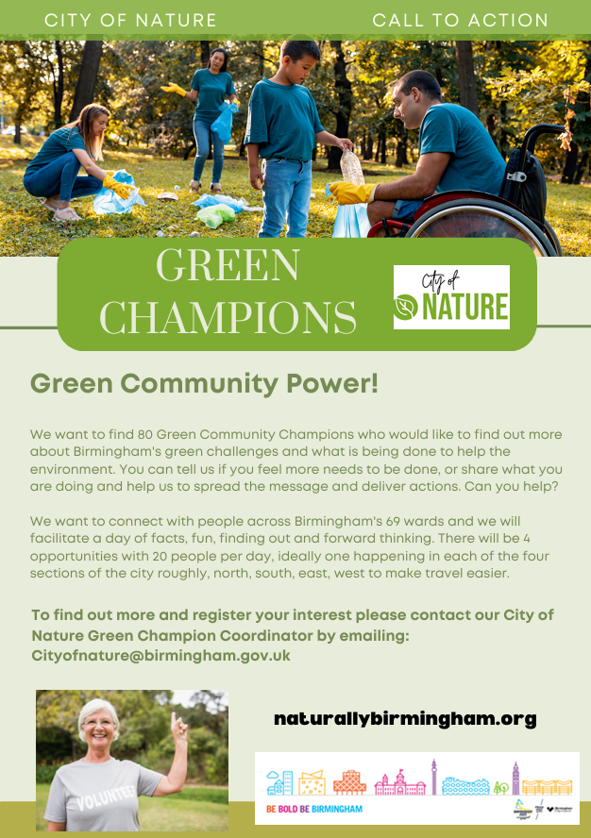
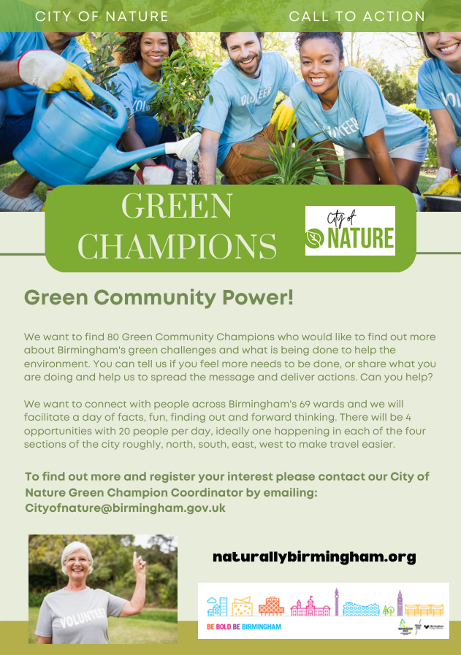
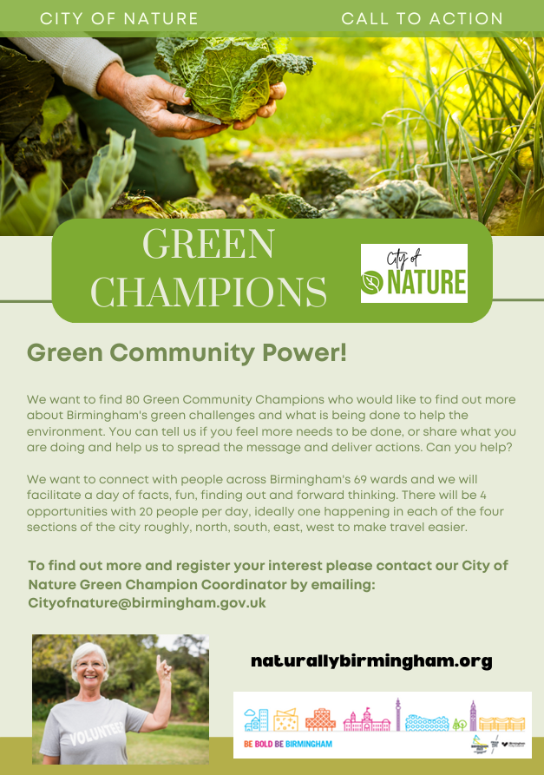
Green Champions Call to action – Green Community Power
These were a range of 10 posters showing different demographic images of Green Champions doing different activities including, litter picking, growing plants, growing vegetables and children's activities.
Notes:
https://www.refuelagency.com/blog/multicultural/examples-of-brands-who-got-multicultural-marketing-right/ What do you think?
Three Principles
Diversity
Equity
Inclusion
Diversity is when your brand not only welcomes that particular person but invites all multicultural audiences by showing a great deal of variety.
Equity is whether your brand is optimized for all multicultural audiences, including physically and visually challenged people.
Inclusion is respecting everyone’s opinion, whether a group or a person says it. An example of diversity is Coca-Cola. An example of equity is Proctor and Gamble. An example of inclusion is Fenty Beauty.
Tips on Embracing Diversity
Embracing diversity in advertising means redefining it within the organization and perceiving it as an essential element of the organization’s innovation strategy.
Diverse thoughts are contagious, and they add significant value to the ideation process. Below are industry tips on just a few of the steps that brands can take to make a positive impact on their marketing campaigns:
“Are You Including Enough Diversity in Your Marketing?”External link:open_in_new Brands that take steps to improve diversity in their marketing efforts often have greater success in targeting new audiences, improving their conversion rates and generating more revenue.
“Data Shows Consumers Want Diversity in Marketing.”External link:open_in_new Brands’ cultural intelligence has become more important than ever — but how do marketers get it right?
“How to Build a More Inclusive World Through Advertising.”External link:open_in_new Industry experts and creative leaders weigh in on equitable advertising.

Slide 39
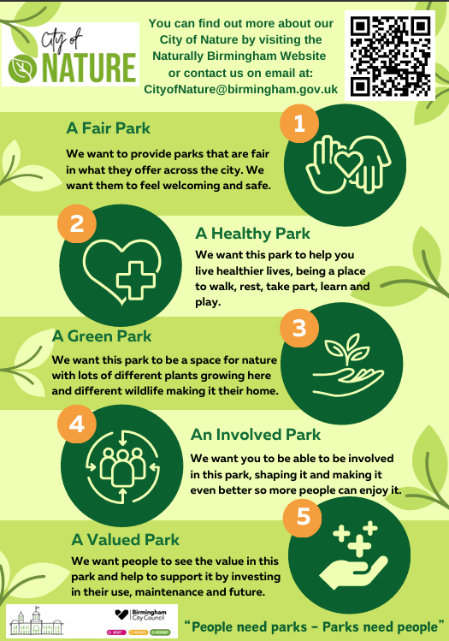
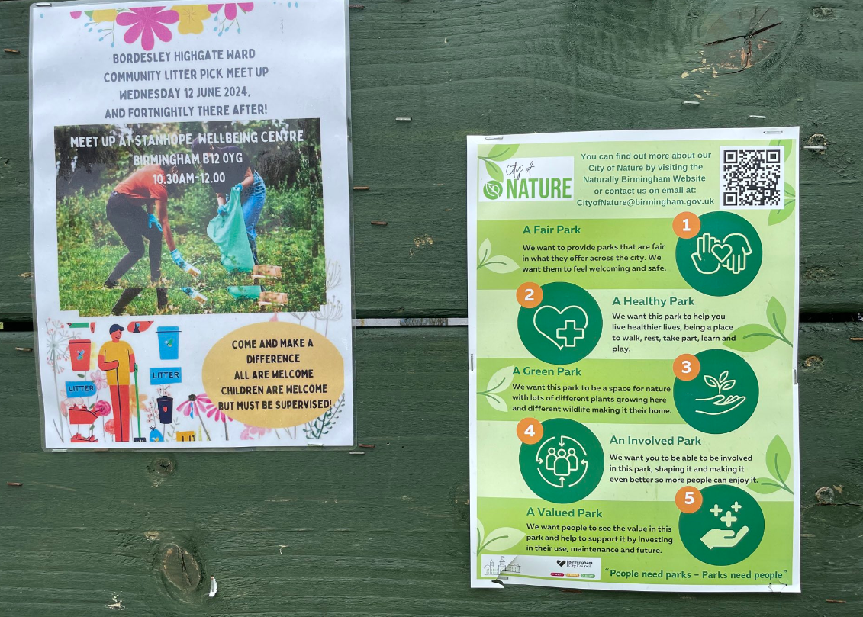
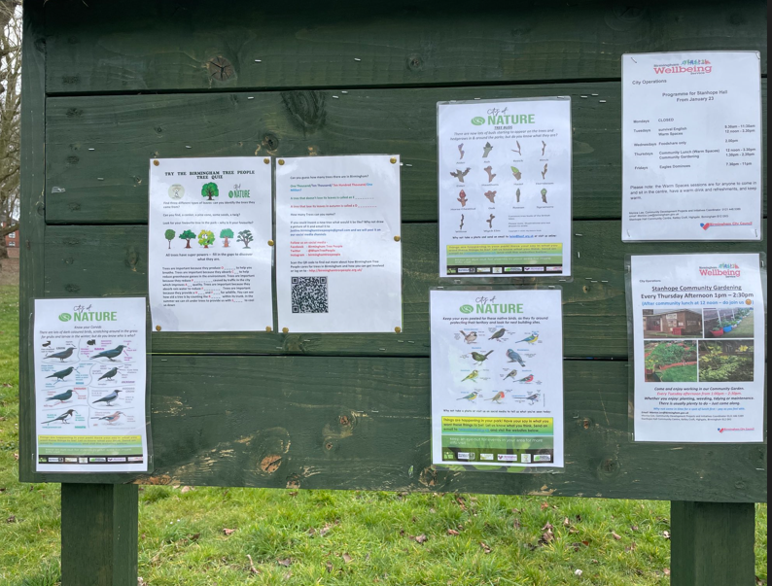
Raising the standard of your park
This poster was designed to tell people about the five themes of the City of Nature and the Future Park Standard.
It uses symbols rather than images of people, but the symbols still relate to people.
There is a short description with each symbol to provide more information.
It uses the City of Nature branding and colours.
There is a QR code link to the website and an email address for more information.
This would be one poster on the public notice board. Actives or opportunities for each of the themes would also be advertised on the board.
Notes:
Tips for Creating Effective Posters
Keep it Simple
Focus on delivering a clear and concise message. Avoid clutter by limiting the amount of text and elements on the poster.
Use Eye-Catching Visuals
Choose bold, high-quality images or graphics that grab attention. Visuals should support the message and be relevant to your theme.
Choose Bold, Readable Fonts
Use large, easy-to-read fonts for headlines and important information. Avoid overly decorative fonts that may be hard to decipher.
Create a Strong Focal Point
Make sure the most important element (headline, image, or offer) is prominent and immediately draws the viewer's eye.
Maintain a Consistent Colour Scheme
Use a cohesive colour palette that aligns with your message or brand. Limit your colours to 2-3 complementary shades for a clean look.
Use Contrast for Emphasis
Ensure your text stands out against the background by using contrasting colours (e.g., dark text on a light background). This improves readability.
Focus on a Clear Message
Your message should be obvious at first glance. Highlight one key point and use simple language to communicate it.
Incorporate a Call to Action (CTA)
Clearly state what you want the viewer to do next (e.g., "Visit us today," "Sign up now," "Call for more info"). Make the CTA bold and prominent.
Use Negative Space
Don’t be afraid of white or empty space. It helps avoid clutter, makes your poster easier to read, and emphasizes key elements.
Ensure Balance and Alignment
Organize elements symmetrically or asymmetrically but keep a visual balance. Align text and images to create a structured flow.
Prioritize Hierarchy
Arrange information in order of importance. Headlines should be bold and large, followed by subheadings and body text in descending size.
Think About Placement and Size
Consider where your poster will be displayed. Adjust font size, colour, and layout to ensure it remains legible from a distance or in different lighting conditions.
Make It Memorable
Add a unique design element, catchphrase, or image that makes your poster stand out and is easy to remember.
Use QR Codes or URLs
If promoting an event, product, or service, include a scannable QR code or a short URL to direct viewers to more information or registration.
Test Readability
Step back and view your poster from a distance. Make sure the most important information is still clear and legible from afar.
By following these tips, you can design posters that are visually appealing, informative, and effective at communicating your message.

Slide 40
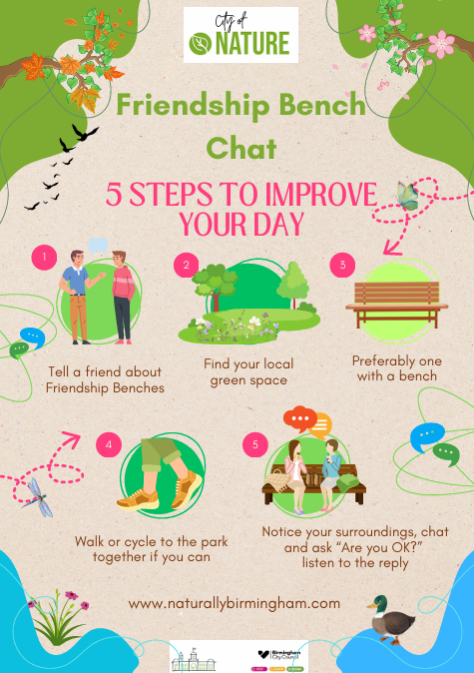
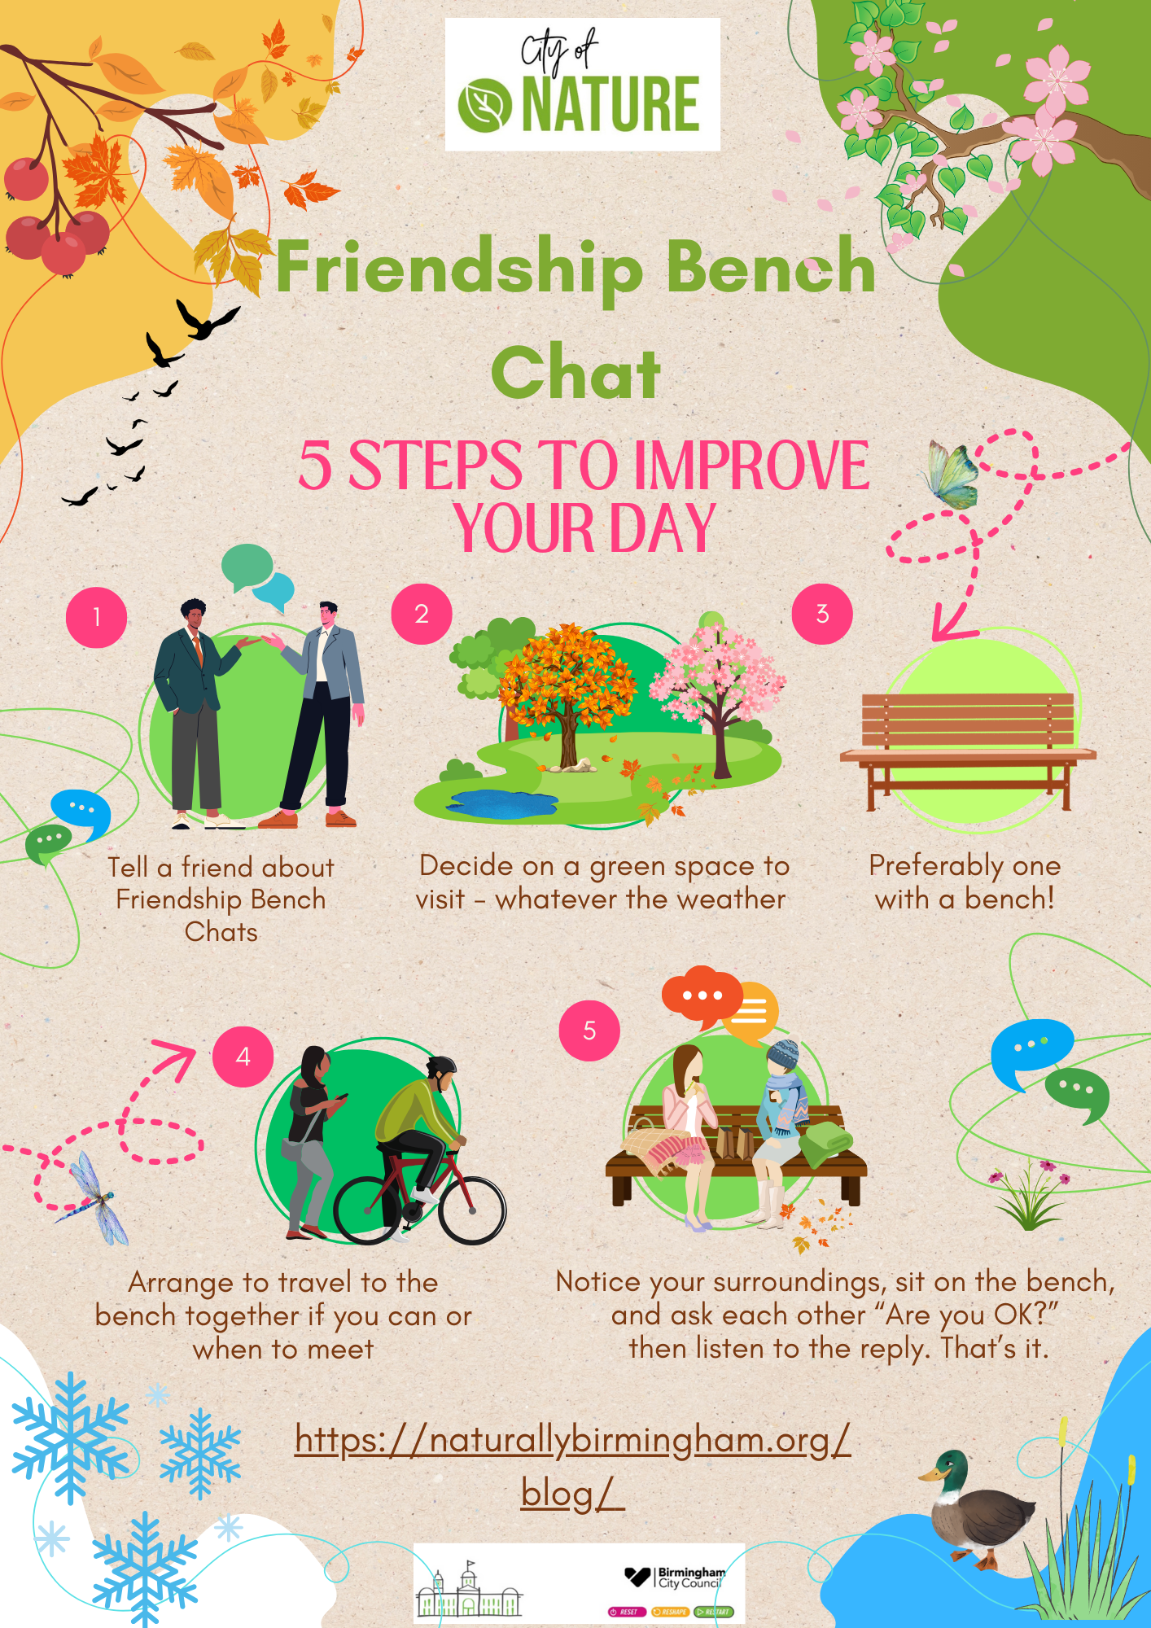
Mental health related prompt to team
This digital flyer was created to encourage a Public Health Team to try out the bench chat.
The Friendship Bench is a Non-Governmental Organization (NGO) registered in Zimbabwe. Their vision is a Friendship Bench within walking distance for all.
With this inspiration, their mission is to get people out of “kufungisisa” – depression & anxiety – by creating safe spaces and a sense of belonging in communities to improve mental wellbeing and enhance quality of life.
Agreeing that benches are a very important social tool for health and wellbeing, we wanted to get people talking about benches and supporting them as an important part of park infrastructure.
So, the idea of the “Friendship Bench Chat” was born. To start with it was going to be chatting about friendship benches, but it quickly became friends sitting on a bench chatting, but either of these are a great idea and you can do both.
We discussed what we thought was good and bad about this flyer in the workshop, including what should be the visual focus, perhaps rather than people the bench could be more central to the graphics. I think this represents the two sides of bench chats, the need for infrastructure to support people's needs and the act of talking to each other in a natural environment whether there is a bench or not, lots of green spaces don’t have benches. This gave us lots to discuss and made the workshop feel much more collaborative. Thanks to attendees for their feedback on this.

Slide 41
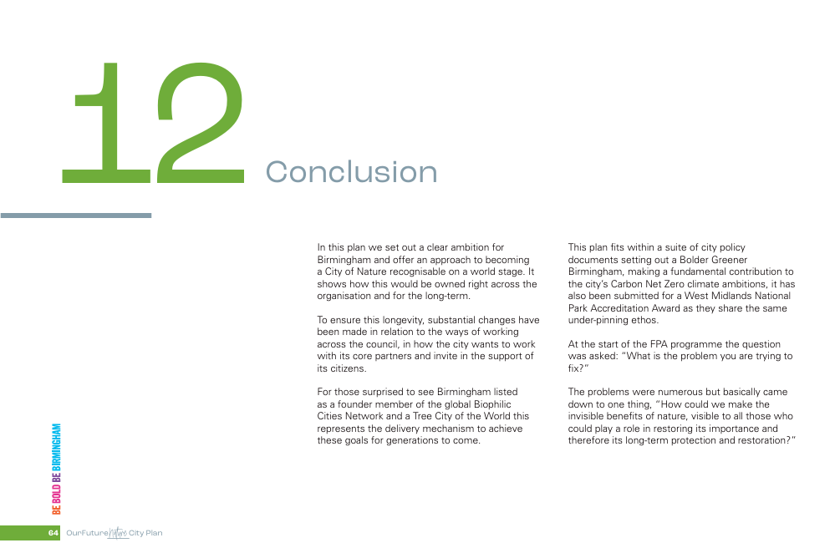
It’s not a silver bullet but - good communication must be at least part of the solution.

Slide 42

Sharing information
Notes:
Information sharing refers to the process of exchanging relevant information between team members, departments government agencies, or even organizations.
It can involve conveying data, insights, or knowledge that can help team members make better decisions, solve problems, or improve their performance.
Needs to be: Necessary, proportionate, relevant, adequate, accurate, timely and secure.
The Data Protection Act 2018 controls how your personal information is used by organisations, businesses or the government.
The Data Protection Act 2018 is the UK’s implementation of the General Data Protection Regulation (GDPR).
Everyone responsible for using personal data has to follow strict rules called ‘data protection principles’. They must make sure the information is:
used fairly, lawfully and transparently
used for specified, explicit purposes
used in a way that is adequate, relevant and limited to only what is necessary
accurate and, where necessary, kept up to date
kept for no longer than is necessary
handled in a way that ensures appropriate security, including protection against unlawful or unauthorised processing, access, loss, destruction or damage

Slide 43
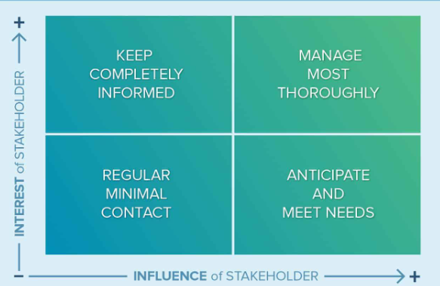
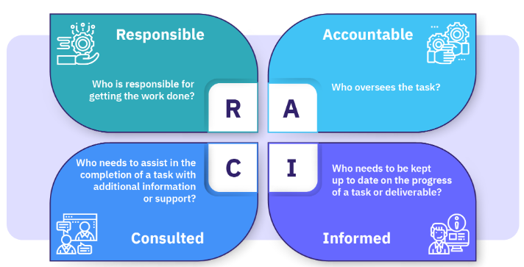
What is informing? Informing people is probably the most common way in which people and communities are involved.
Put simply, it means telling people something. Local public services are informing people all the time, through websites, leaflets, adverts and press releases. What can we do to improve how we keep people informed?
Why is informing important?
Informing ensures that people are given the right messages at the right time. There is often a legal duty to tell people about what we do and what services we offer. It is important to get it right.
Be clear about who, what, why, when and how?
These simple questions need answers before you start informing the public. When you have answered them effectively, you’ll have great information! There is a lot of information bombarding the public – how will yours stand out?
It’s good to talk Having a conversation with someone is the best way to convey information. Keep it simple writing in plain English is important. The average reading age for the public is 12 years old – so always keep it simple. Public sector information is often difficult to read and understand.
It’s a lot easier to inform people if they can relate to a story. A story about a real person using a service is much more engaging than a list of instructions. Stories don’t need to be long – just a few sentences about a real person can make your work come alive. 6 - Paint a portrait Pictures of people can make your information warmer and human. A picture does tell a thousand words – especially if someone is smiling. Make sure people’s faces are clear and that pictures represent our diverse communities. But remember to get peoples consent for their photos to be used.
Notes:
Provide clear contact details Include correct phone numbers and email addresses – people may want to find out more and it’s vital that they know who to contact. Double check contact details are reliable before you give them out.
Multiple logos and branding can be confusing so keep to a minimum. If you include too many logos on your communication people may be unsure who to get in touch with.
Make it accessible Think about who your information is intended for and if there’s anything you need to do to make it accessible. For example, does it need to be in bigger print? Is it readable on a coloured background? Are there specific audiences for your information who would benefit from a different approach – maybe a face to face conversation?
Wherever possible work with others to develop your communications. Try out ideas, words and pictures. People interpret information in lots of ways, many images and words have different meanings to different people. Test out your information before you give it out.

Slide 44
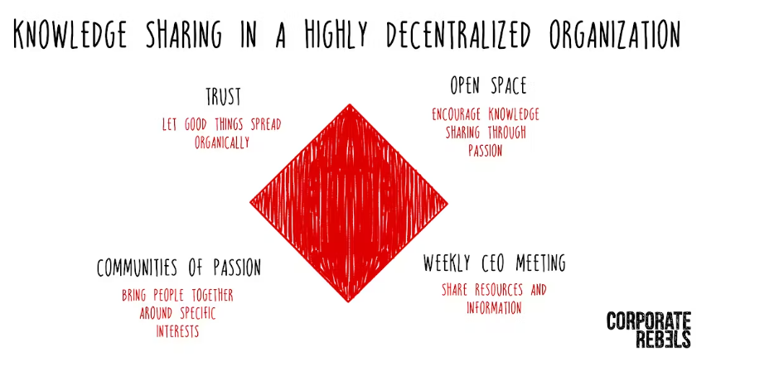
REGULAR MEETINGS
Email
  Used for direct communication, newsletters, reports, and updates in both personal and professional settings.
Face-to-Face Communication
  In-person meetings, presentations, and casual conversations are effective for direct, immediate information exchange.
Webinars
  Online seminars or workshops that share detailed information with an audience through video, screen-sharing, and live Q&A sessions.
Video Conferencing
  Tools like Zoom, Microsoft Teams, or Google Meet enable live sharing of presentations, updates, and discussions with remote participants.
Workshops and Training
  Interactive sessions where knowledge and skills are shared through teaching, discussions, and hands-on practice.
Presentations
  PowerPoint or slide-based presentations are often used in meetings, conferences, or workshops to share structured information.
Websites and Blogs
  A central hub where articles, resources, and information are shared with a wide audience.
Printed Materials
  Flyers, brochures, posters, newsletters, and reports allow for physical distribution of information in public spaces or during events.
Publications
  Books, journals, and reports published in print or digital formats that provide in-depth information on specific subjects.
Notes:
Knowledge sharing is critical for all organizations to operate effectively—and it's no different for highly decentralized ones. In more decentralized organisations like the Alliance, knowledge sharing can become challenging. It's not always easy to get information to the right people, and it can be difficult to ensure that insights from one part of the organization have the opportunity of adding value to another part.
These difficulties can be overcome by trusting in organic sharing, creating open spaces for passion, holding regular meetings, and fostering communities of passion,
Guide for Sharing Information Effectively
Sharing information is a key part of communication, whether for business, education, or personal purposes. To ensure information is shared effectively, it's important to consider the audience, medium, and message. This guide will help you structure your approach.
1. Identify Your Purpose
Why are you sharing the information?: Clarify your goals (inform, educate, persuade, or engage).
What outcome do you expect?: Understand what you want the audience to do with the information (e.g., make a decision, take action, provide feedback).
2. Know Your Audience
Understand their needs: Tailor the information to their interests, knowledge level, and expectations.
Consider demographics: Age, profession, location, and familiarity with the topic can influence how information is received.
3. Select the Right Medium
Email: Ideal for professional or detailed communication.
Social Media: Best for quick, visual, or engaging updates.
Face-to-Face: Good for direct, personal, or sensitive conversations.
Messaging Apps: Useful for real-time, brief communication with individuals or small groups.
Printed Materials: Effective for handing out information at events or displaying in public places.
Webinars/Presentations: Great for detailed explanations or group learning.
4. Craft a Clear Message
Be concise: Focus on the key points and remove unnecessary details.
Use simple language: Avoid jargon unless it’s appropriate for the audience.
Emphasize important details: Highlight critical information using bullet points, bold text, or headings.
Be objective and accurate: Ensure all facts and data are correct.
5. Use Visual Aids When Necessary
Infographics: Condense complex information into visual formats for easy understanding.
Images or Videos: Use visual content to engage the audience and reinforce key points.
Charts and Graphs: Present data clearly for quick interpretation.
6. Encourage Interaction
Provide a Call to Action (CTA): Direct the audience to take a specific action (e.g., click a link, respond to a survey, sign up for updates).
Ask for Feedback: Create opportunities for your audience to ask questions, give input, or offer comments to ensure clarity and engagement.
Be responsive: If you share information through a medium that allows replies, be available to address any questions or concerns promptly.
7. Check for Accessibility
Ensure clarity: Use simple, straightforward fonts and a layout that is easy to navigate.
Make it mobile-friendly: Many users access information via mobile devices, so ensure your format is responsive.
Consider language barriers: If necessary, translate information or provide alternative formats for diverse audiences.
8. Follow Up When Appropriate
Reinforce the message: Share reminders or summaries of key information, especially if it's time-sensitive.
Answer questions: Provide follow-up communication if there are questions or if additional information becomes available.
Track the impact: If the goal is to prompt action, monitor the results (e.g., open rates, clicks, attendance) and adjust your approach for future communication.
9. Respect Privacy and Confidentiality
Be mindful of sensitive information: Share private or confidential details only with authorized recipients, using secure channels.
Comply with regulations: Ensure adherence to relevant data protection laws, such as GDPR, when handling personal information.
10. Evaluate Effectiveness
Gather feedback: Ask your audience if the information was clear and helpful. Use surveys or casual conversations to gauge their reactions.
Measure success: Use metrics like engagement rates, open rates, or attendance to assess how well your message was received.
Refine for next time: Learn from each experience and adapt your approach based on what worked and what didn’t.
Conclusion
Effective information sharing requires thoughtful planning, the right medium, and a clear message. By considering the audience, delivering content through appropriate channels, and encouraging engagement, you can ensure that your information is well-received and acted upon.

Slide 45

Communication our most important tool
Notes:
In every aspect of life—whether personal, professional, or societal—communication is at the heart of human interaction.
It’s the bridge that connects ideas, fosters relationships, and enables progress.
Without effective communication, collaboration breaks down, misunderstandings arise, and opportunities are lost. Here’s why communication stands out as our most essential tool.
1. Foundation of Relationships
Communication is the cornerstone of building and maintaining relationships. From friendships to family dynamics and professional connections, strong relationships are rooted in effective dialogue. Whether through conversations, text messages, or facial expressions, the ability to express thoughts and emotions strengthens bonds. Miscommunication or lack of communication can lead to tension, mistrust, and disconnection.
Open and honest communication helps people understand each other’s needs, resolve conflicts, and grow closer. It allows us to share joys and frustrations and to connect on a deeper level. In workplaces, strong communication fosters teamwork and collaboration, enhancing productivity and morale.
2. Facilitator of Knowledge Sharing
Knowledge is most effectively shared through communication, whether written, verbal, or visual. Through discussions, presentations, and written content, ideas and innovations can spread, leading to collective learning and growth. In education, teaching is impossible without clear communication between instructors and learners.
In the workplace, communication is critical for the transfer of knowledge, training, and skills. It enables employees to understand objectives, perform tasks effectively, and learn from one another. In a fast-paced world, where technology and industries evolve rapidly, the ability to share knowledge quickly and accurately is essential for staying competitive and informed.
3. Problem-Solving and Decision-Making
Effective communication is vital for solving problems and making informed decisions. In any group setting—be it a business, family, or government—people must share their perspectives, ideas, and concerns to find solutions. When communication is clear, people are better equipped to evaluate situations, weigh options, and come to consensus.
Miscommunication can lead to flawed decisions, inefficiencies, or costly mistakes. Clear communication allows teams to brainstorm, address challenges head-on, and arrive at the best solutions. It encourages collaboration, where diverse viewpoints can converge into a well-rounded solution.
4. Enhances Leadership and Influence
Great leaders are often defined by their ability to communicate well. Whether motivating a team, providing direction, or addressing challenges, communication is at the heart of leadership. Leaders who communicate effectively inspire confidence, encourage loyalty, and rally people toward a common goal.
In addition, communication is key to influence. Politicians, business leaders, and social influencers rely on their ability to share ideas persuasively. By articulating a vision or delivering a powerful message, they shape public opinion, drive action, and lead change.
5. Prevention of Misunderstandings and Conflicts
Many conflicts, whether personal or professional, stem from misunderstandings or assumptions. Poor communication or lack of clarity can lead to confusion, resentment, or even conflict. On the other hand, clear and proactive communication helps prevent issues before they arise. It allows people to express their needs, clarify expectations, and negotiate solutions.
Open communication promotes transparency, reducing the risk of misunderstandings and fostering a culture of trust. In professional environments, it leads to better collaboration, fewer disputes, and a more harmonious workplace. In personal life, it helps maintain healthy relationships by addressing issues before they escalate.
6. Drives Innovation and Progress
Innovation thrives on communication. The exchange of ideas and feedback sparks creativity and inspires new solutions. Companies and industries rely on open communication channels to drive progress, whether through brainstorming sessions, collaborative platforms, or global networking.
Global communication allows for the sharing of knowledge across borders, cultures, and disciplines. Without it, scientific breakthroughs, technological advancements, and social changes would be significantly hindered. Communication facilitates the flow of ideas that propel society forward.
7. Adaptability in a Digital World
In today’s digital age, communication has become even more essential. We live in a world where businesses are global, teams are remote, and interactions happen across digital platforms. Mastering communication in virtual environments is key to staying connected and competitive.
Emails, video conferencing, and social media have transformed how we interact. However, the principles of effective communication—clarity, empathy, and responsiveness—remain the same, whether in person or online. As the digital landscape evolves, the ability to communicate across multiple platforms is more important than ever.
Communication is the lifeblood of human interaction, and its importance cannot be overstated. It builds relationships, fosters collaboration, solves problems, and drives innovation. Whether leading a team, learning from others, or simply engaging with friends and family, communication is the most powerful tool we have to connect, grow, and achieve our goals. Investing in communication skills—listening, speaking, writing, and non-verbal cues—can transform not only personal success but also the success of communities, organizations, and society.

Slide 46
Links and documents
Find a park | Birmingham City Council
Highgate Park | Birmingham City Council
City of Nature Newsletters 2024 – Naturally Birmingham Future Parks Project
Friendship Bench Chat – Naturally Birmingham Future Parks Project
Families in Nature, Connecting and Helping (FINCH) - Birmingham Open Spaces Forum (bosf.org.uk)
City Of Nature Walk & Talk – Bloomsbury Park | Legacy West Midlands (legacy-wm.org)
EcoPark | Birmingham & Black Country Wildlife Trust (bbcwildlife.org.uk)
Home - ecobirmingham
What is green social prescribing? | Improving your health with nature | Birmingham City Council

Slide 47


Debbie Needle,
Community Facilitator
City of Nature Projects
Email:
Cityofnature@birmingham.gov.uk
Website:
https://naturallybirmingham.org/

