Slide 1




City of Nature Alliance Pilot Project
Finance Workshop Notes – 30th July 2024

Slide 2
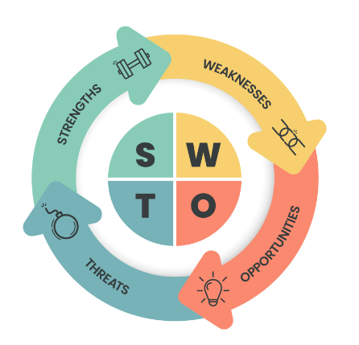
Working together - strategic planning - finance
Thank you to those that could attend the in-person workshop at Kings Heath Park. We fully appreciate how busy everyone is so we will endeavour to share with and involve all those that couldn’t attend on the day.
We had 10 attendees.
BOSF
EcoBirmingham
Birmingham TreePeople
The Patch Work Meadow
National Trust
City of Nature Team
There were presentations from Tonia - Birmingham TreePeople and Alison - The Patchwork Meadow. The afternoon discussions proved to be extremely useful and gave us a chance to find out more about what organisations have been doing, successes and obstacles and propose ways forward with sustainable finance model.

Slide 3
Getting started with finance – the basics
When we start thinking about finance for our organisations or groups (in this workshop BCC and partners) we need to ask our self these questions first:
Why do we need to do something?
What do we need to do?
Will we needing funds to do it?
How much will it cost?
Do we have enough income?
If not, where will the extra funds come from?
That may sound really basic but it’s really important to start from the point of need rather than how much funding there is available.
Once we know we need to find funding we also need to think about all the different ways to get funding.
This includes:
Grants
Fundraising from individuals and corporations ( voluntary donations, membership and sponsorship)
Earned income – being paid for the services or products you offer
Contracts – being paid on a larger and formal scale ( for the council we will include income through taxation here)
Investments.
Social Value / Corporate Social Responsibility.
Funding and income planning | NCVO

Slide 4
Finding funds can be hard work
Then we need to start thinking about the balance of time and energy. Planning, securing, spending and reporting on funding can be hard work and will also normally require funding, you will need to add this into your total project costs or organisations core costs.
Which of these types of funding will work best for you?
What skills are needed for each type of funding or income?
What expectations do they create that you will need to meet?
Do you have a mix of income that is sustainable?
Ideally organisations should create a plan of their funding and income targets. That is what the City of Nature programme is doing over the next few months.
Please note we used the NCVO (The National Council for Voluntary Organisations) website for some of this information.
NCVO members can use the funding and income planner to do this.
Next steps
Ready to think about all your funding and income? Use the planner.
Completely new to funding and income? Most people’s first steps are either a small grants bid or a small amount of fundraising from individuals and businesses.
Decide which is best for you in our guide to grants.
For this workshop, The Patchwork Meadow has provided us with a case study overview of grant funding. The slide are available on the webpage: https://naturallybirmingham.org/city-of-nature-alliance-finance-workshop-resources/
Funding and income planning | NCVO

Slide 5
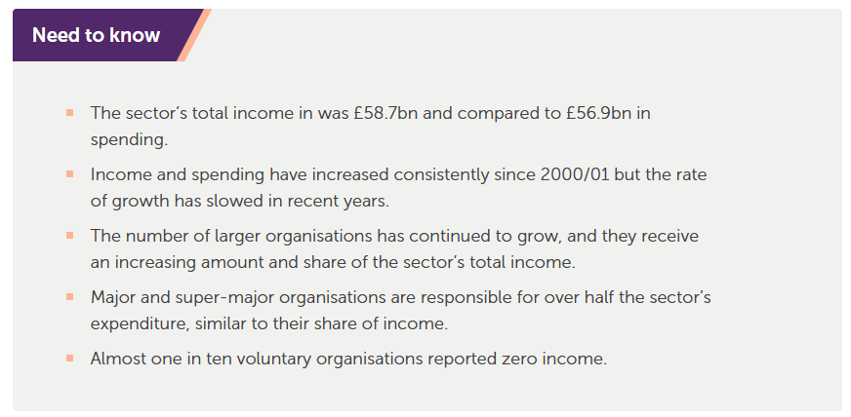
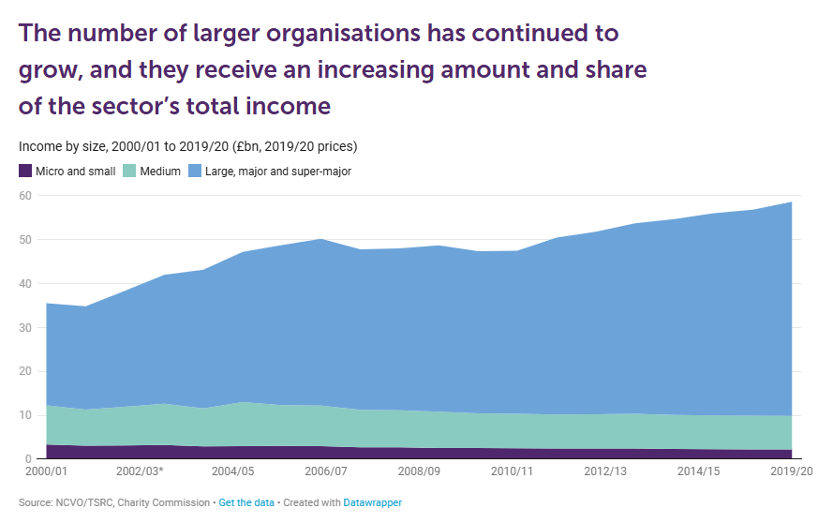
What do the data tell us about charitable finances
In 2019/20, combined income fell slightly for micro, small and medium-sized organisations (income under £1m) and rose for large, major and super-major organisations (income over £1m).
The total growth in the income of super-major organisations can be explained by their increased number but also by the strategies and decisions of the organisations themselves. For example, they include organisations that received large one-off donations.
Question: Are there benefits for smaller organisations working with larger organisations who are more likely to receive bigger grants and donations? Just as there are benefits for micro groups to work with small organisations in the same way.

Slide 6
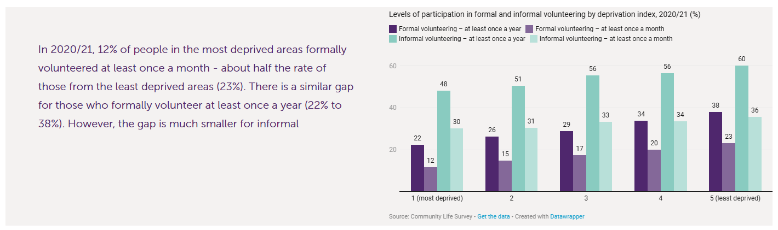
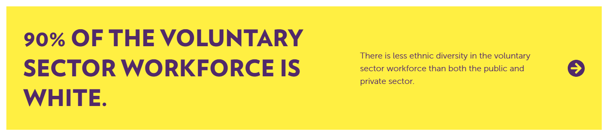
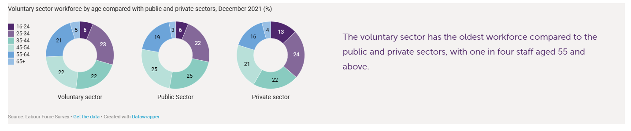
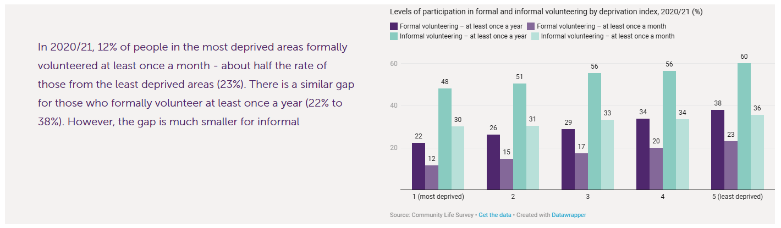
What else do the data tell us – social data

Slide 7
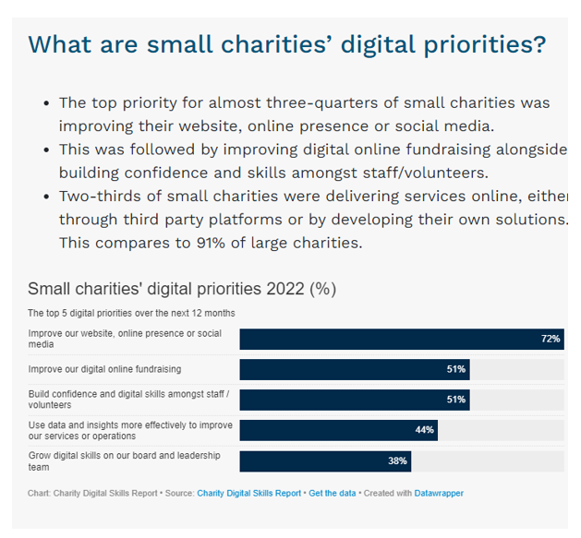
Skills data – digital skills are important for fund raising
It is important to recognise that all organisations, even big ones, will have a digital skills gap, some more than others.
The pandemic increased the need for digital tools and services. But we need the right skills to use them. This is something we all need to consider, explore and improve where needed. It may not be important for delivering our outputs and achieving our outcomes on the ground, but it will make a difference when it comes to securing funding.
Not having the required digital skills in your organisation is common.
88% of organisations have a digital skills shortage (Open University, 2019) which has hit their productivity, efficiency and competitiveness.
27% of respondents to Charity Digital Skills Survey (Charity Digital Skills Report, 2020) had cancelled services because either their charity or the people they support didn’t have the necessary skills or technology.
Bigger charities have the resources to have a very good digital presence often supplied through a third party while smaller charities will more often depend on the inhouse skills for creating websites and running social media accounts.

Slide 8
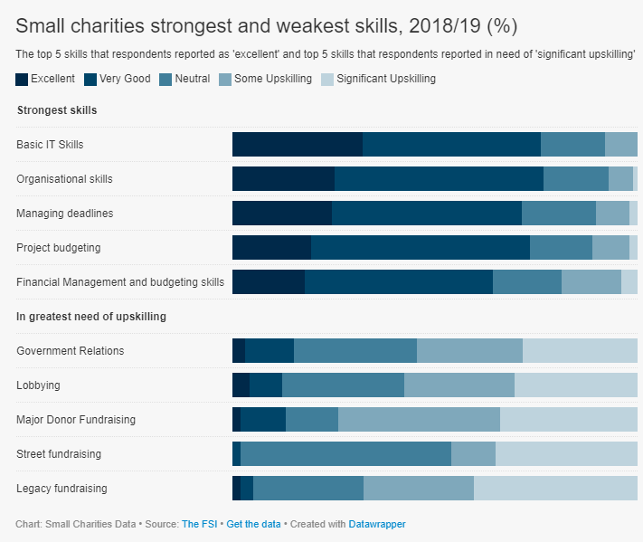
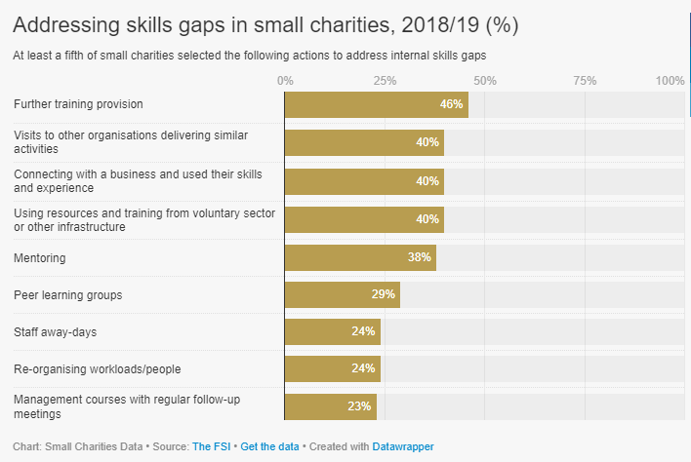
Closing the skills gap.
Most organisations have good skills to run their day-to-day business it is around raising funding that there is a skills gap. The same can be said for the Parks department, they have not had to focus on these skills before as most of their funding came through government contractual income, including taxation. If many charities and local government find themselves in the same situation then training or professional services, however visiting or talking to other organisations delivering similar activities was still seen as a good way of addressing a skills gap. It is probably always best to start, with workshops like this if possible.

Slide 9
Workshop Presentations
The presentations cover the actions from the City of Nature plan that have been identified as vital to creating a city that understands and recognises the value of its natural assets and the people that help maintain them.
1. Sharing information that demonstrates the wider environmental, social, and economic value of green space through a Natural Capital Account
2. Using Biodiversity Net Gain and the planning and development process to improve access to good quality green spaces.
3 & 4. Developing a diversity of funding streams for green infrastructure from:
  Supporting communities to secure grants.
  through to large scale business contributions (Included in Social Value notes).
5. Increasing council income for green infrastructure management through commercial activity.
6. Crowdfunding Case Study – Dawberry Fields Park.
There are notes on adding social value actions for green infrastructure through the council procurement process on the webpage.
All presentations are on this webpage: https://naturallybirmingham.org/city-of-nature-alliance-finance-workshop-resources/

Slide 10
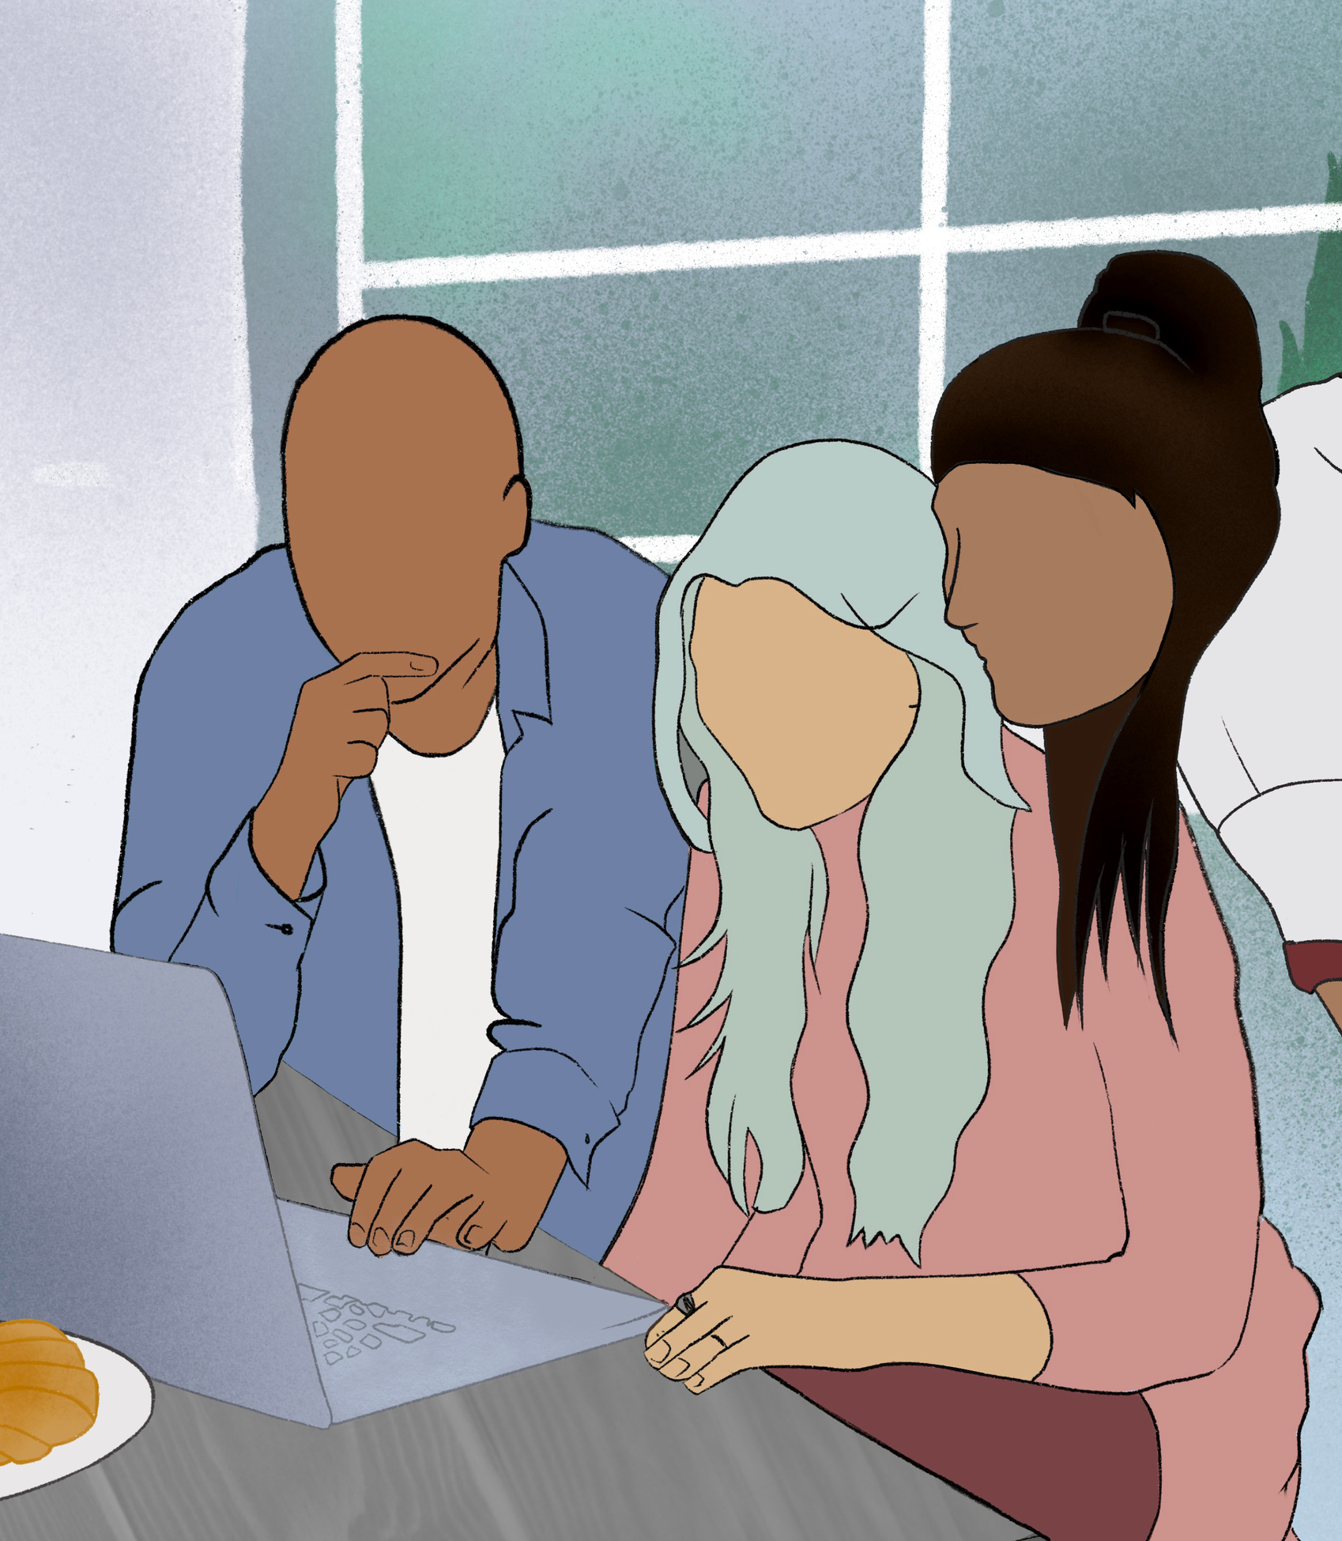
Workshop - afternoon discussions
The afternoon discussion cover two funding types:
Large Scale Grants £ 10,000,000
Large Scale Commercialization of Council owned land
Building on the City of Nature Alliance model of working in a more coordinated way we considered what a bigger, better, more joined up approach to finance could allow us to access.
Two groups:
1. “What would we need to consider if we went for a Heritage Lottery £ 10,000,000 joint bid over five years to deliver the Future Park Standard (as delivered in the pilot) across all wards?”
2. “What are the opportunities to use commercialization to deliver the River Cole vision of a high-quality local nature reserve integrated into the local environment?”

Slide 11

Feedback from afternoon sessions – Group 1.
Group 1.
Even with a model approach (Future Park Standard), delivery is still very complex.
Do we know what is needed in the other wards? Balsall Heath and Nechells have proved to be very different wards.
Can we take an even more holistic approach i.e. One Planet: The One Planet Living Framework - 10 Powerful One Planet Principles for a Sustainable Future OnePlanet
Even with funding – would it be just too big to manage all those projects at one time?
Where would all the people come from to deliver – brings in the skills and training gap questions.
Don’t forget connecting people to other places, supporting travel to bigger landscapes, Sutton Park and beyond – Doorstep to Landscapes (Natural England) Could there be funding for bus passes for example? It can't all be on the doorstep. – But doesn’t help ecosystem services if it’s not in situ.
As more organisations become involved coordination becomes harder.
Building Partnerships for Nature’s Recovery (publishing.service.gov.uk)

Slide 12


Feedback from afternoon sessions – Group 2.
Group 2.
Biodiversity Net Gain could provide potential for investment in the natural environment not sufficient to do everything that needs to be done.
How do you develop other commercial or investment opportunities on a site that isn’t heavily used so doesn’t currently have a large audience.
Some sites may lend themselves to a long-term development and expansion of community offer starting for example with mobile catering but leading to static catering / cafes in time.
Questioned if more potential to attract a destination style (visitor attraction) provision such as a high ropes course that has a wide draw beyond Birmingham. As a hook to bring in more investment to be able to expend what is offered to both residents and visitors.
The sites that make up the Country Parks also serve as local parks for residents. We need to consider the secondary impacts in terms of increased traffic and need for better transport links.
It will need a whole development plan looking at the area holistically, while making the most of what the individual sites and communities offer.
Need to involve stakeholders from the beginning, groups, involved organisations and other BCC officers (i.e. transportation) already exist.

Slide 13

Summary Points
This is only the start of this strategic planning part of the development of the City of Nature Alliance.
The feedback from the finance workshop will feed into the Volunteer and Communication workshop to build a fuller picture and help create a dynamic online resource to support the members of the Alliance in their individual objectives and the delivery of the City of Nature Plan.
At the end of October 2024 there will be a final workshop to bring all the work together and present the full report from the Commonwealth Games Legacy Project.
Working together can help to create a more diverse and perhaps more ambitious funding model for the delivery of the City of Nature Plan.
Even when we all work together there is a lot to do and there are still challenges to overcome which may be financial, environmental or social and it will take good communication and strong relationships to take this forward during this time of change.
The finance framework will be complex, but it needs to be – there is no “silver bullet” but we can try to ensure we make full use of all the tools and opportunities available to us.

