Slide 1


City of Nature Alliance Pilot Project
Finance Workshop – Dawberry Fields Park
Reptile Project Crowd Funding Case Study

Slide 2
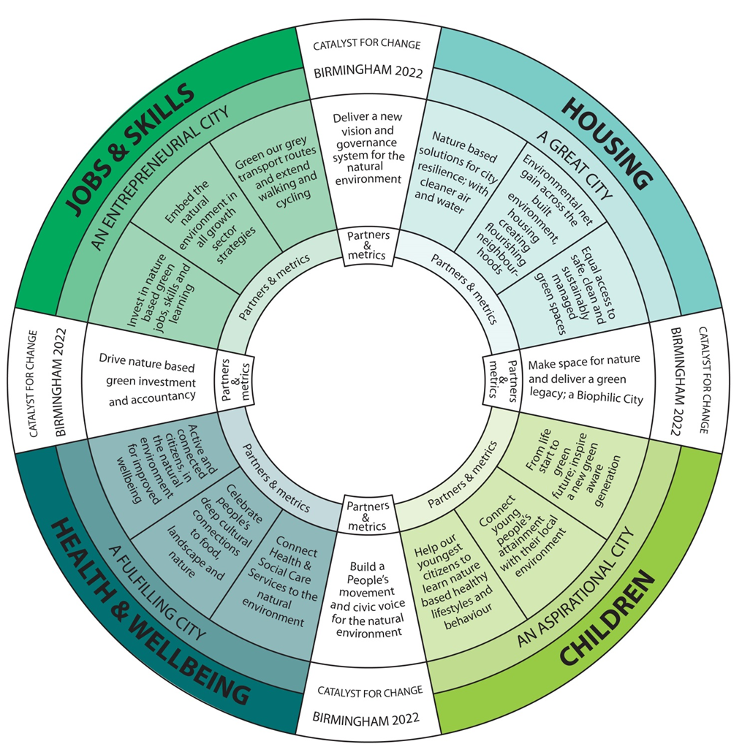
Naturally Birmingham Project aims.
This wheel diagram represents the original vision for Naturally Birmingham, at the time of the bid in 2019.
The city set itself 5 strategic outcomes around Jobs & skills, Housing and the built environment, the future of children, health & wellbeing, and maximising the benefits from hosting the 2022 Games. All the proposed actions listed were derived from the 2018-2022 Council Plan.
The city had an ambition to be “An Aspirational City” that focused on children being encouraged to believe they could aspire to be anything they wanted to be and supported to achieve their ambitions.
The project believed that nature connectedness and access to quality green spaces for learning, play and health would give children experiences and skills that would help them to do this.

Slide 3

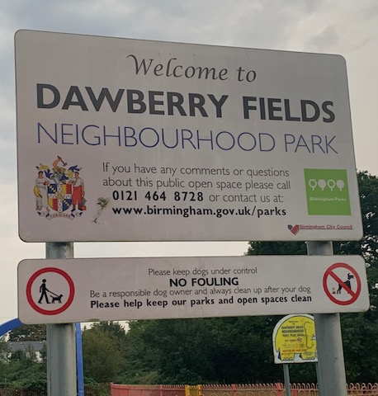
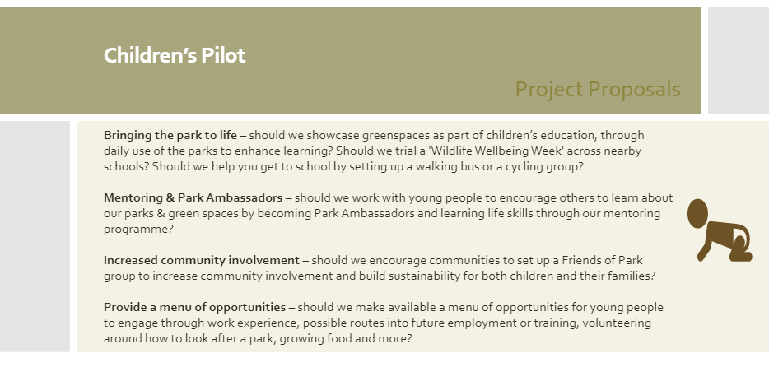
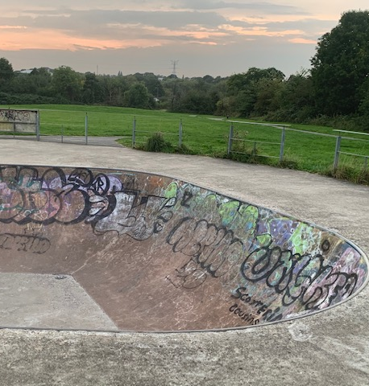
Children’s Pilot – Dawberry Fields Park
Notes:
Objectives
Bringing the park to Life –
Mentoring
Ambassador
Community Involvement
Provide a menu of opportunities
Aims
Promoting how people engage with their parks in order to maximise public benefit
cross-sector partnerships that bring together knowledge and expertise embedding new skills
enabling new funders and investors;
Protecting and enhancing public green - delivering a fair, quality and free service to all
Goals
Making green spaces a key part of children’s education incl. vulnerable children and CIC
Embed green space into children and young people’s lives
Dawberry Fields – Brandwood is the pilot site for the Naturally Birmingham Future Parks project. The project has 4 pilots – Children’s, Health and Wellbeing, Jobs and Skills and housing.
The children’s pilot has been working with mentors to incorporate green spaces within their sessions, this could include visiting park, going for a walk or sitting in a garden either whilst having sessions or having time to reflect - promoting their health and wellbeing. We have been embedding green space training and ideas with mentors to engage with young people in safe green spaces building confidence in mentors to enable them to take sessions outdoors.
We have also been Engaging with Early Years settings as a key part of children’s education and play encouraging healthy living and skills i.e. growing seeds learning about nature and outdoor play . Promoting green space, nature and the environment to schools, nurseries, and early years settings
Encouraging young people to connect with nature through fun family events helping children to learn about the environment and green space. – Park stars – Nature trails. Outdoor activities.
Ensuring this offer is available to all children and young people

Slide 4
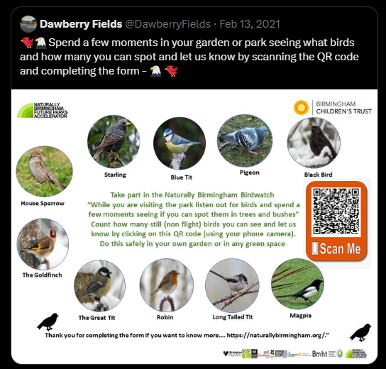
Nature needs to be there to connect to
The children’s pilot proposals were put to the community around Dawberry Fields Park.
There was a strong feeling from the community that there wasn’t enough “nature” in Dawberry Fields Park for young people to engage with.
Although not one of the most diverse sites Dawberry Fields Park had more to offer than most people visiting the site realised so we set out to do three things:
Raise awareness of nature on the site.
Actively connect people with nature on site.
Increase the biodiversity of the site.
We started by doing what we could within the budget we had for the Naturally Birmingham Project, but we wanted to explore how we could find funding to increase the amount of biodiversity.

Slide 5
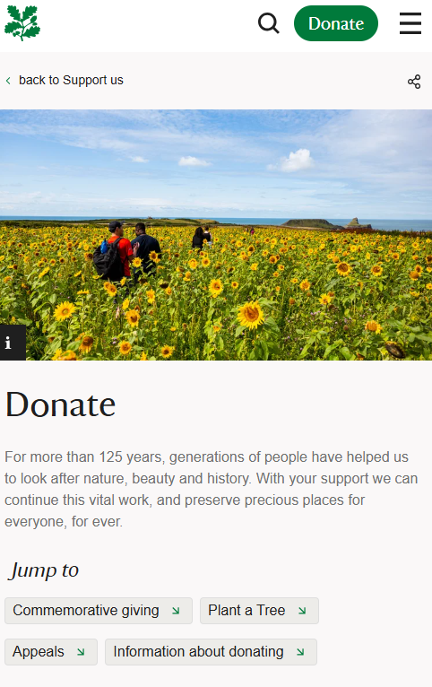
Public money – Donations and appeals for specific reasons
We knew that many charities need to ask the public for money because they rely on public generosity to carry out their important work helping those in need. But public generosity can never be taken for granted. The public have trust in charities to raise money in a considerate and responsible way and to use it effectively. However, the council does not normally ask the public for donations. We knew we had to be very specific about why we needed to raise funds and why BCC couldn't afford to do the work. We also knew we needed to find a partner charity to deliver the project with BCC as the landowner.
The government guidance for raising funds sets out 6 principles:
plan effectively
supervise fundraisers
protect your (and your partners) reputation, money and other assets
follow fundraising laws and regulation
follow recognised standards for fundraising
be open and accountable
Charities often run appeals for specific purposes or projects. If you are planning to do that, think carefully about how you word that appeal.
Donations to an appeal for a specific purpose (or purposes) must be used only for that purpose (or purposes).
For us this was donations to an appeal to restore reptile habitats in Dawberry Fields Park, so it could only be used for that purpose.
If you cannot use the donations received for that purpose, or you raise more than you need, you cannot immediately use the funds for something else. You must follow a legal process first.
Because we were raising funds for a specific purpose, we needed to ensure we planned the project well so that we met all the charity regulations and described the work fully so we could ensure that we could show funds were spent on the approved purpose.

Slide 6

Testing Crowd Funding for collecting donations.
Crowdfunding is the practice of funding a project or venture by raising money from many people, typically via the internet. We can think of crowdfunding simply as online donations, but it is really a lot more than shaking a virtual collections tin.
Crowdfunding is a form of crowdsourcing and alternative finance. In 2015, over US$34 billion was raised worldwide by crowdfunding.
This modern crowdfunding model is generally based on three types of actors:
The project initiator who proposes the idea or project to be funded. (BCC and Wildlife Trust Partnership)
Individuals or groups who support the idea. (Community and reptile enthusiasts)
A moderating organization (the "platform") that brings the parties together to launch the idea. (Just Giving)
Crowdfunding has been used to fund a wide range of for-profit entrepreneurial ventures.
Although charities can use crowdfunding just to ask for donations, the real power of crowdfunding platforms is to attract people who think your idea is great and want to support it, they want to be involved with it and would probably expect more than just dropping a coin in a tin and never hearing anything personally about the project in future. Most supporters will want to see what their investment has resulted in. Or may even expect some kind of return or unique experience. This is important to be aware of.
Here is one example of a crowdfunding platform for information only: https://youtu.be/bERs-GlCyjo

Slide 7
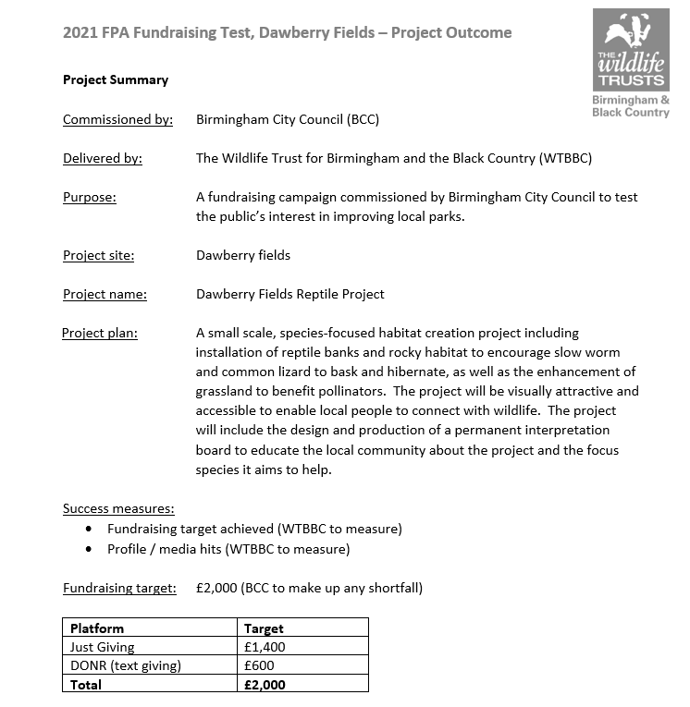
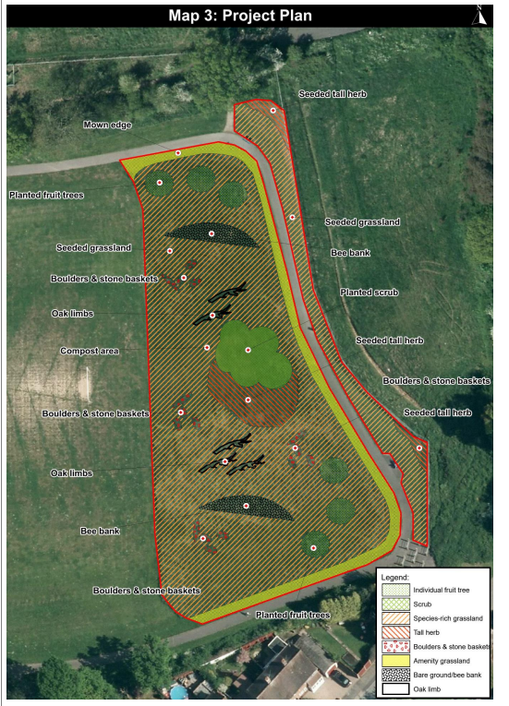
Planning the project – Reptile Restoration

Slide 8
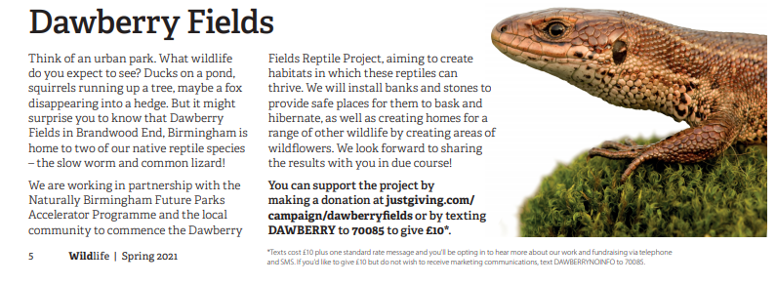
Finding supporters rather than funders!

Slide 9
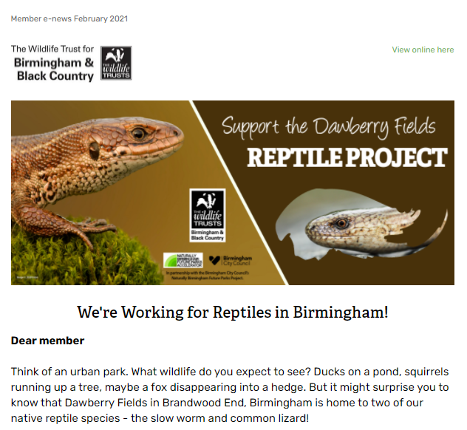
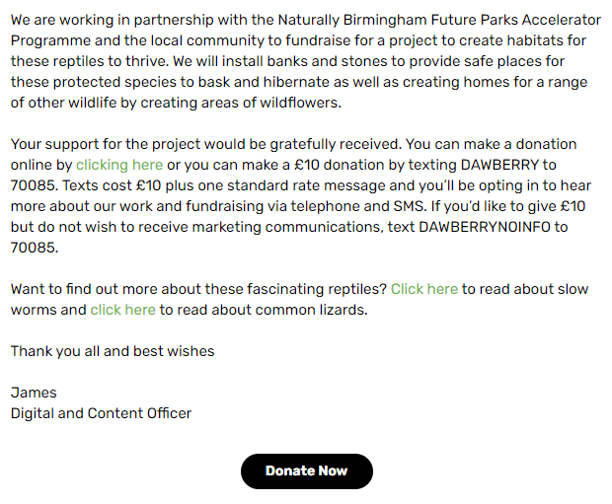
Asking existing supporters to support a specific campaign

Slide 10
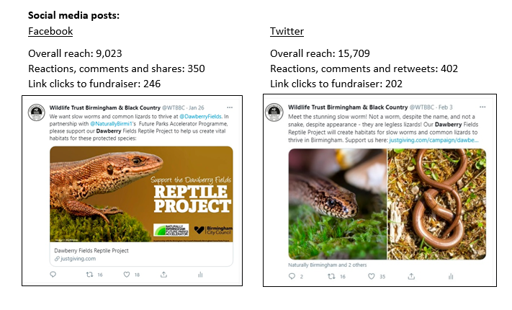
Using Social Media to spread the campaign widely

Slide 11
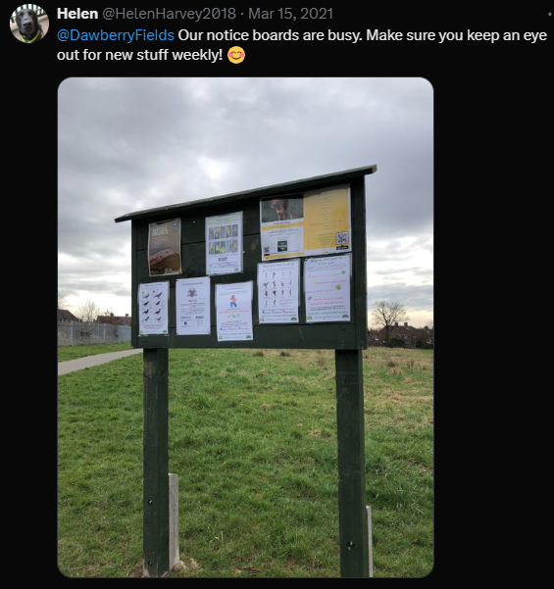
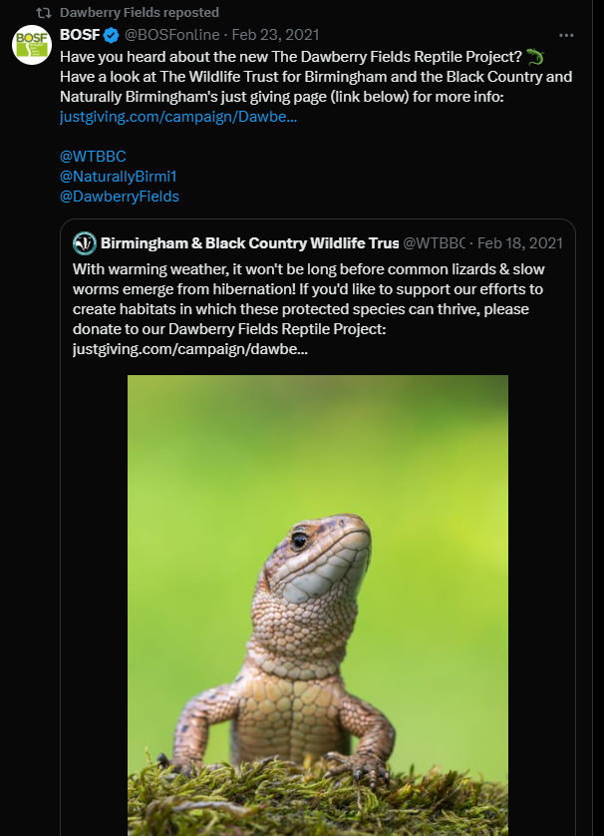
Asking other partners (like BOSF) to help share to their supporters

Slide 12
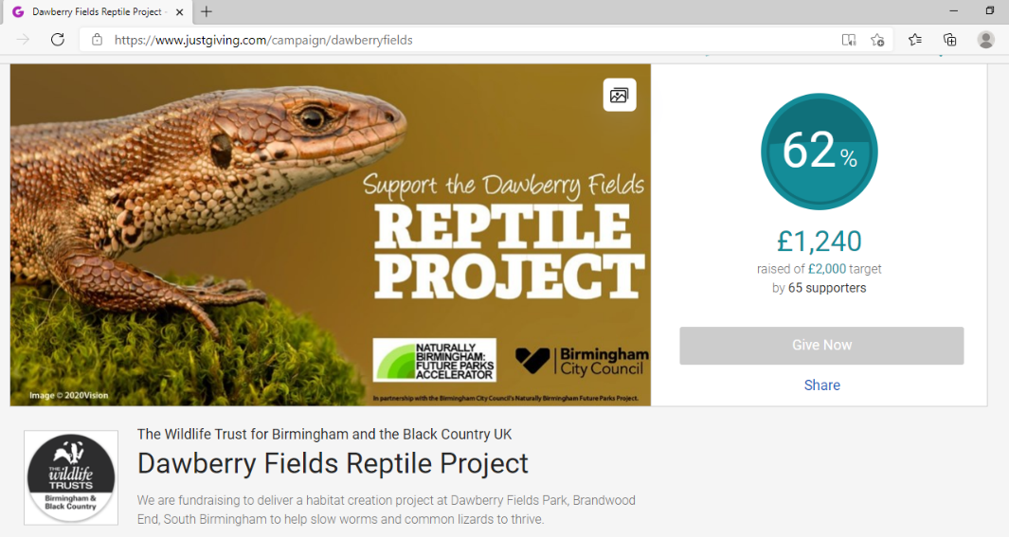
Keeping everyone updated

Slide 13
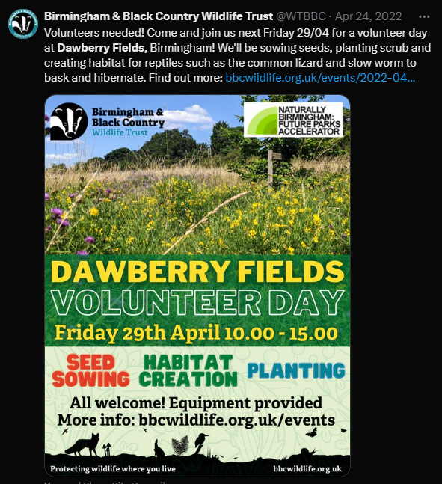
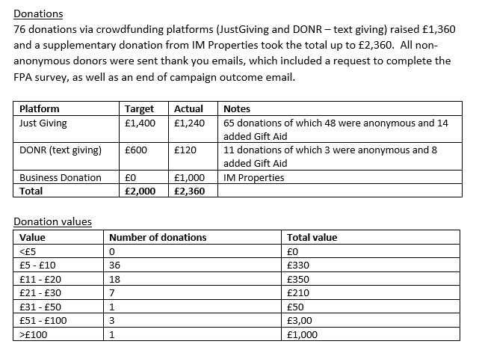
Success and delivery

Slide 14
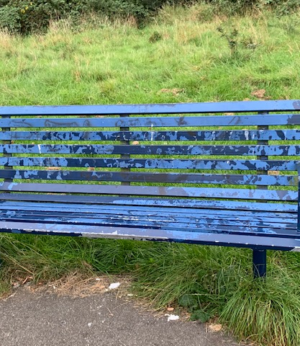
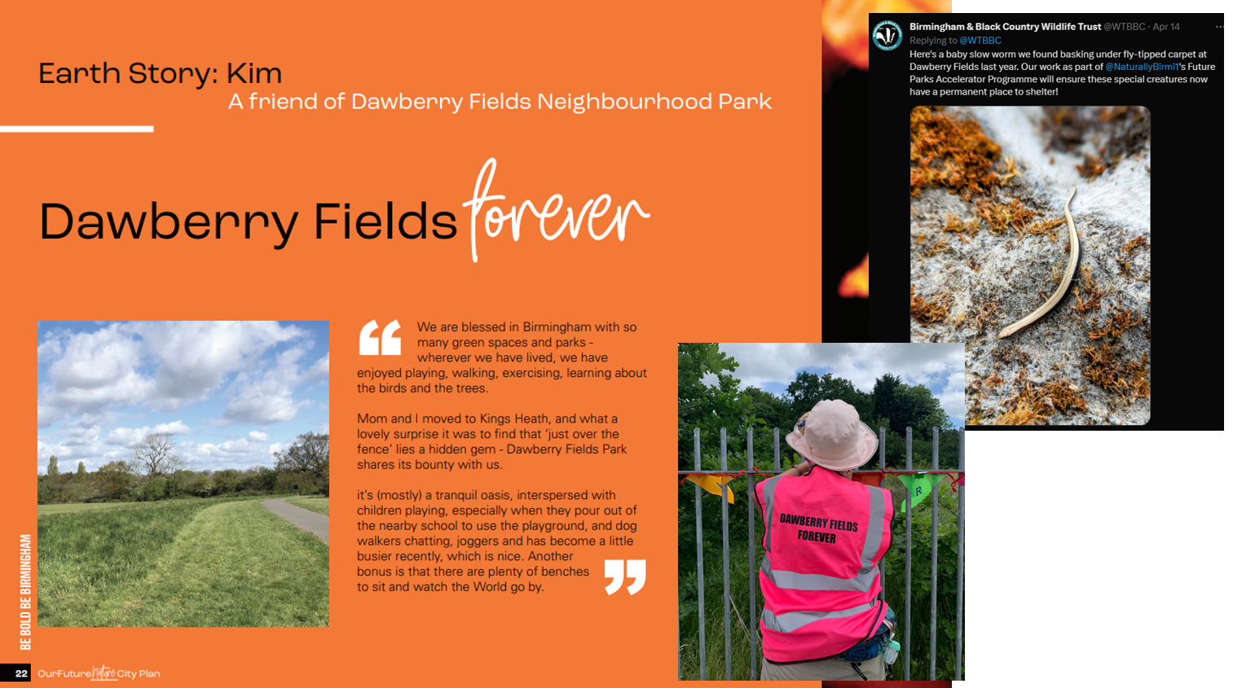
Just the beginning – Dawberry Fields forever

