Slide 1




City of Nature Alliance Pilot Project
Finance Workshop – Biodiversity Net Gain

Slide 2
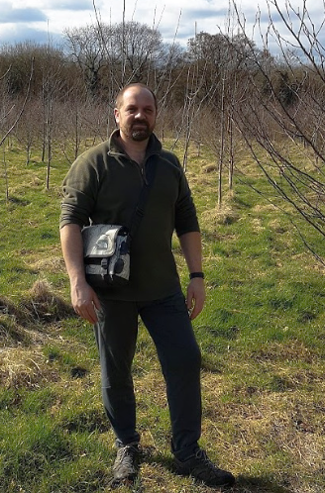
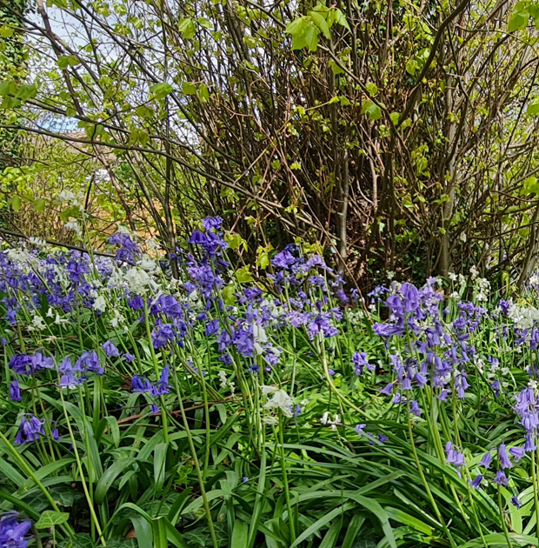


Simon Needle
Urban Nature and Forestry Lead Officer
Birmingham City Council

Slide 3
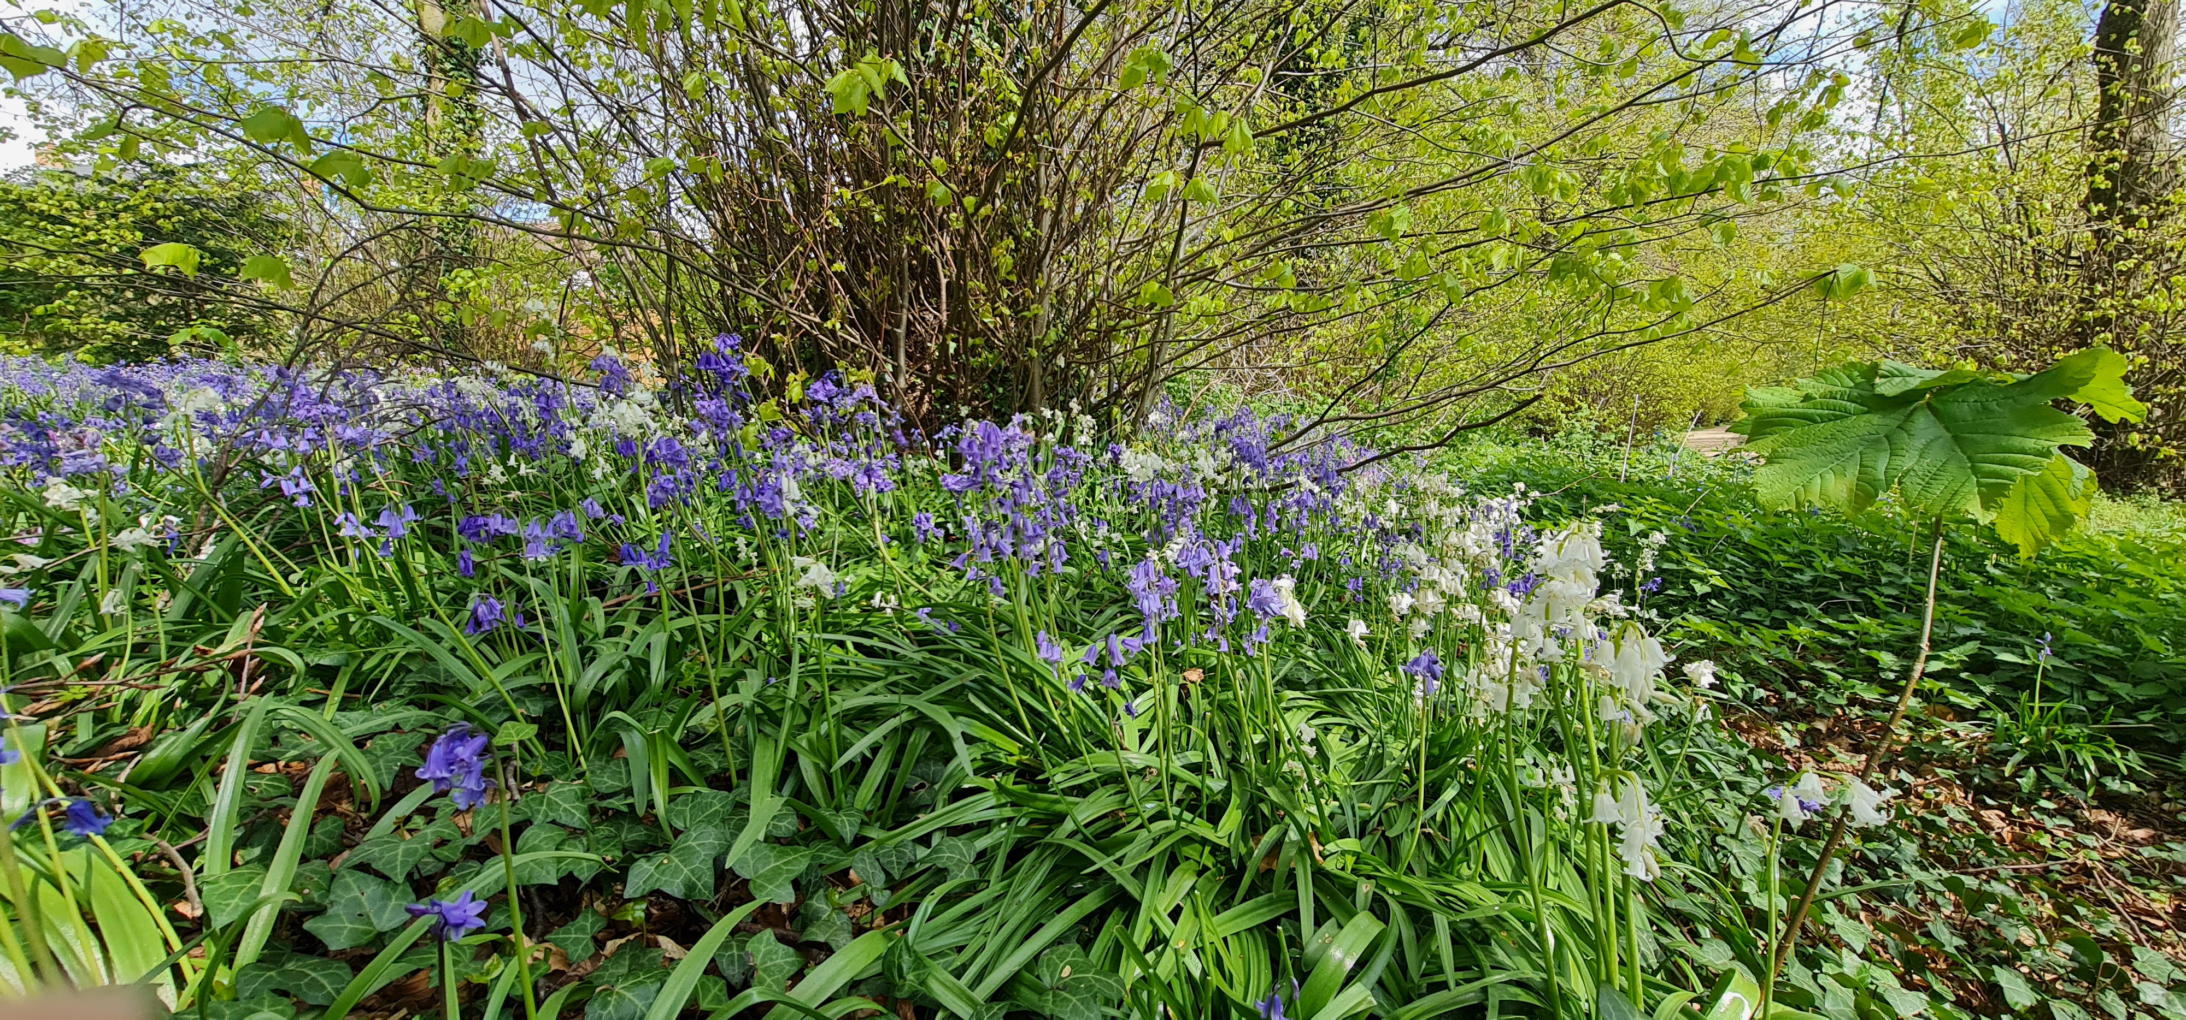

Slide 4

Statutory Legislation and Planning Policy in relation to Biodiversity

Slide 5
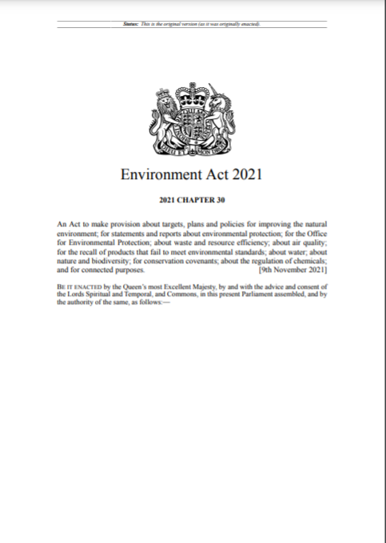
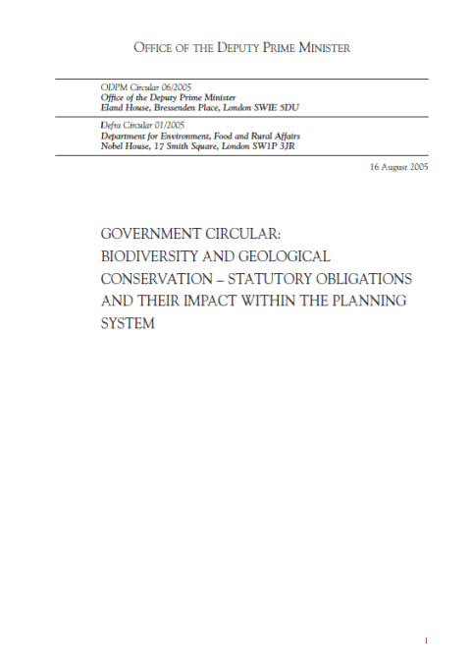

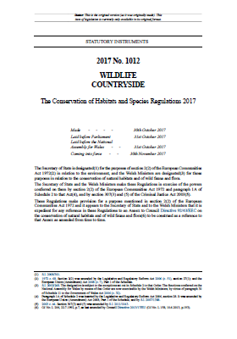
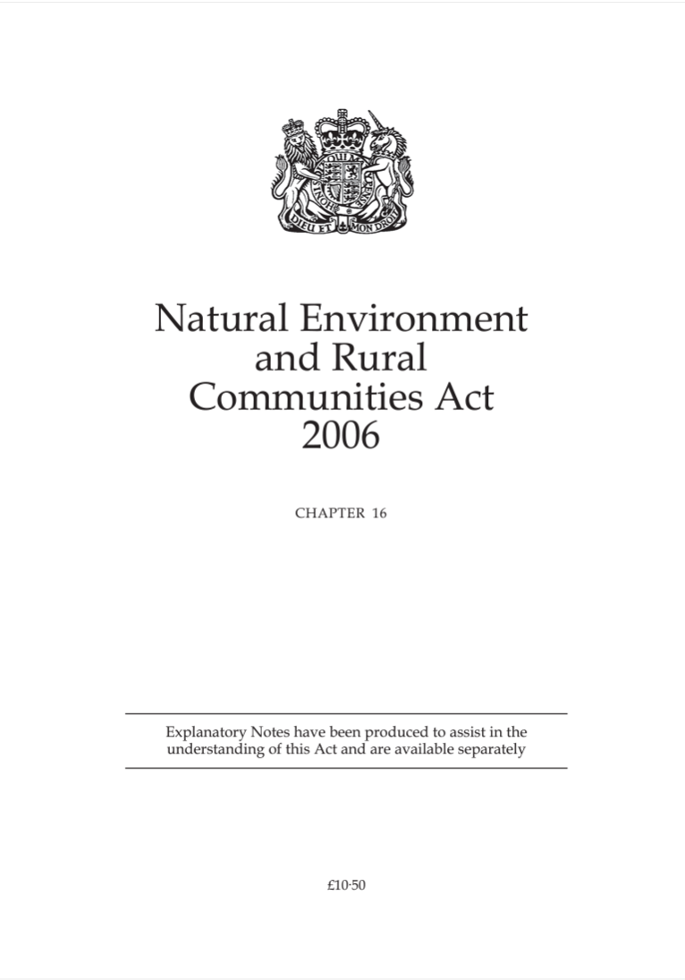
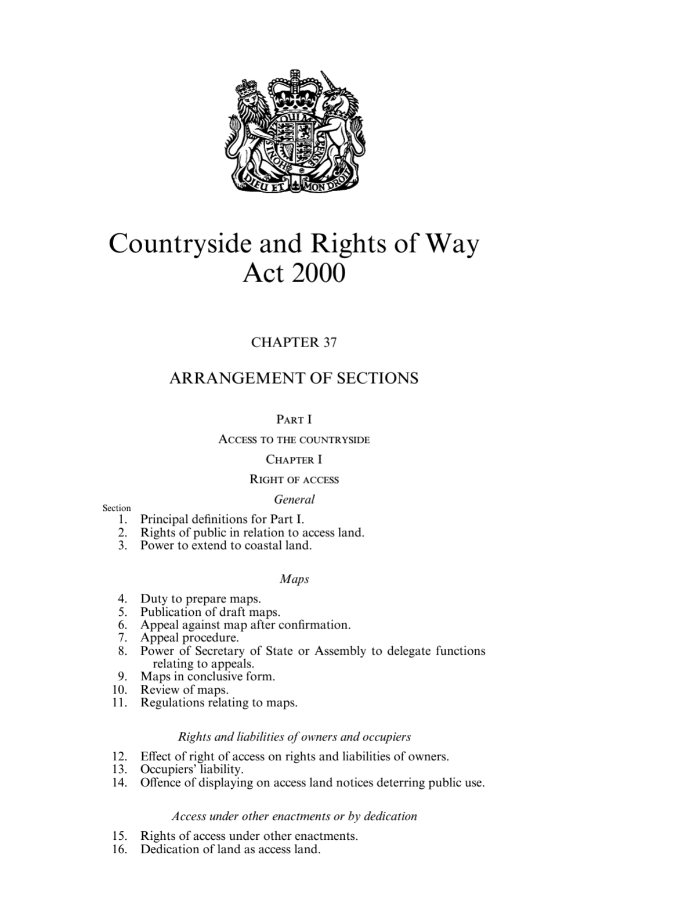
Legislation and policy overview

Slide 6
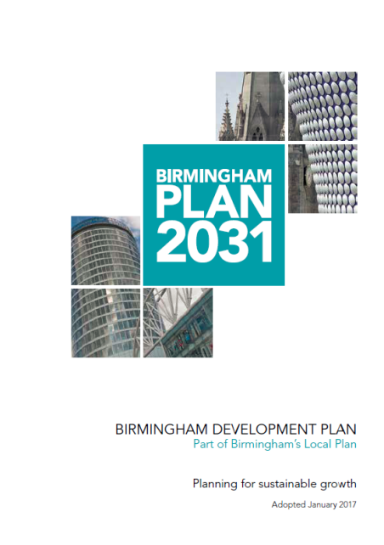
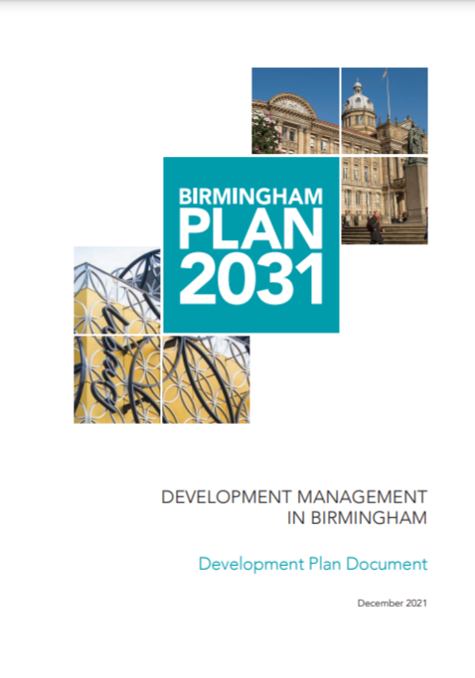
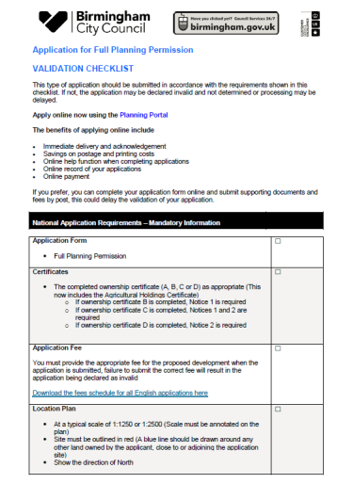
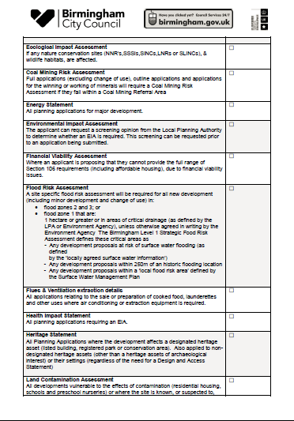
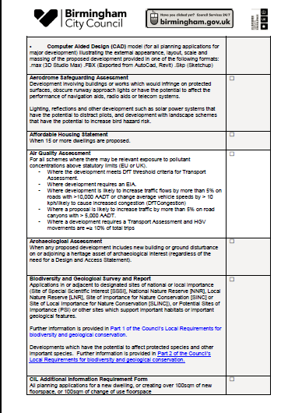
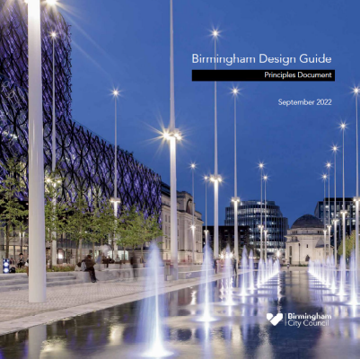
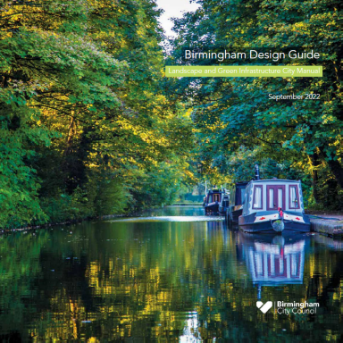
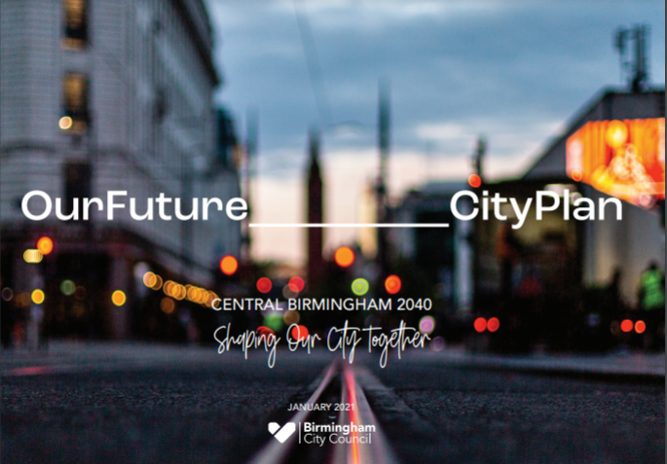
Local planning policy and process

Slide 7
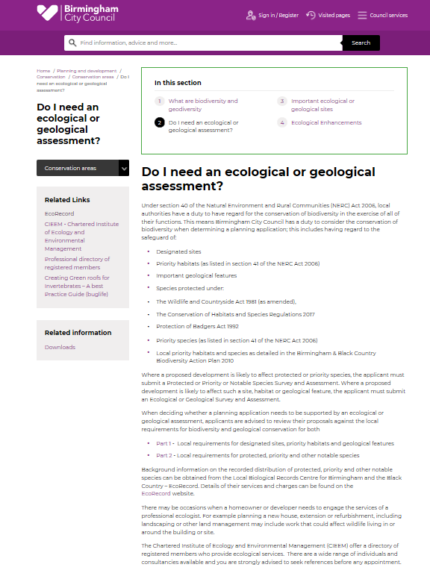
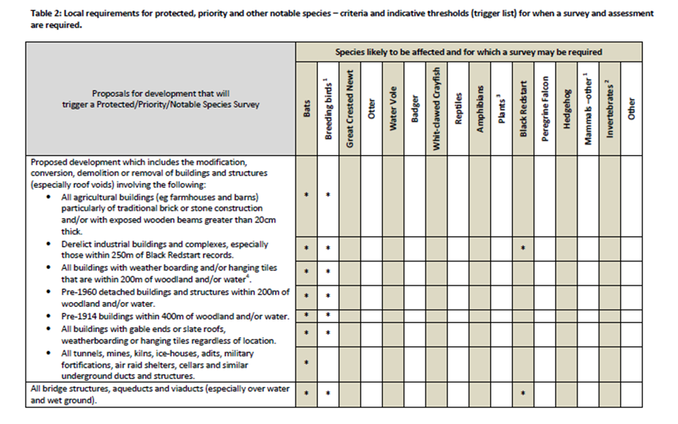
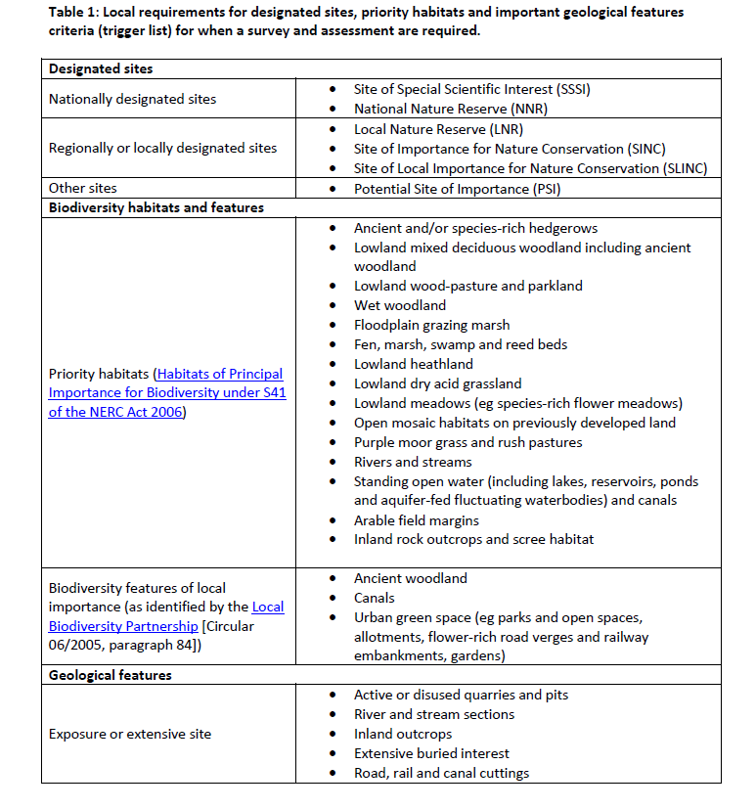
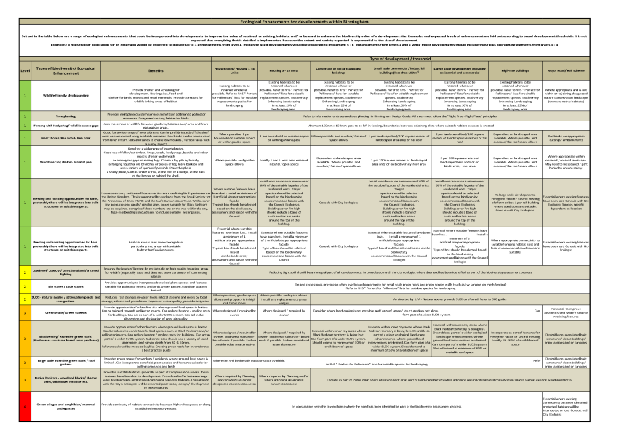

Slide 8
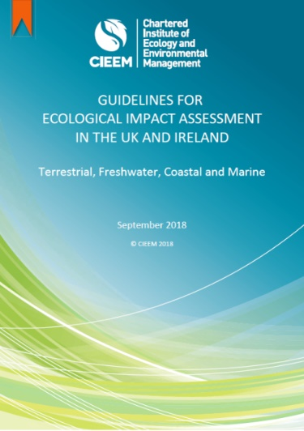
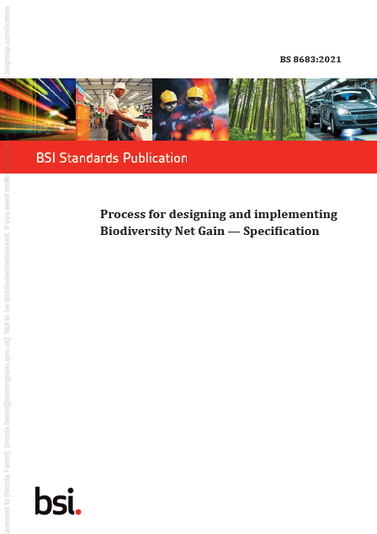
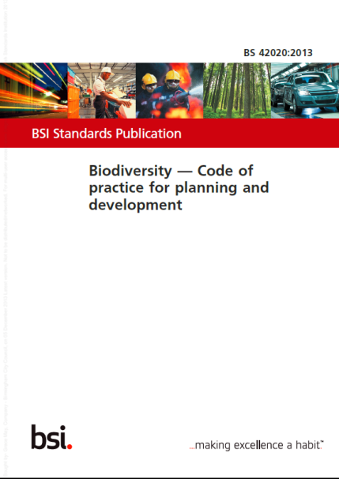
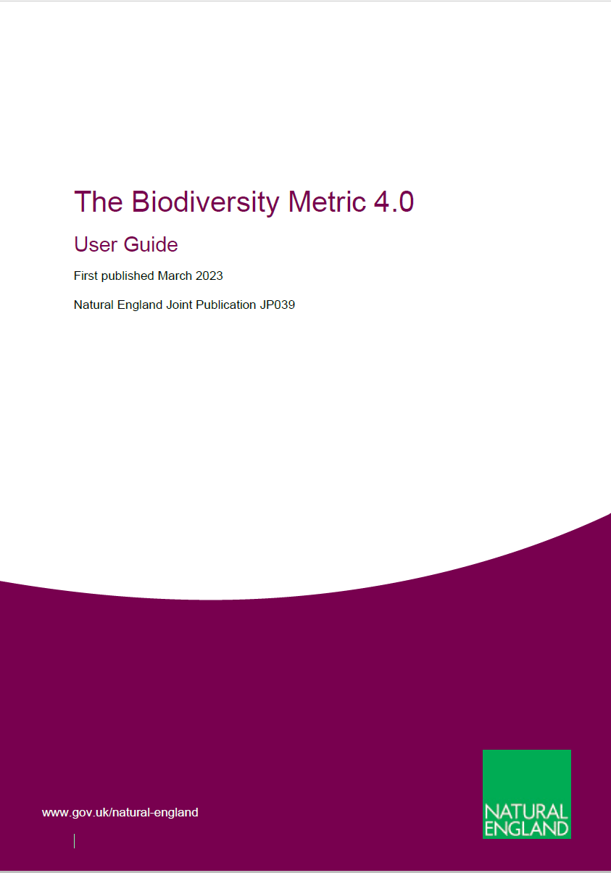
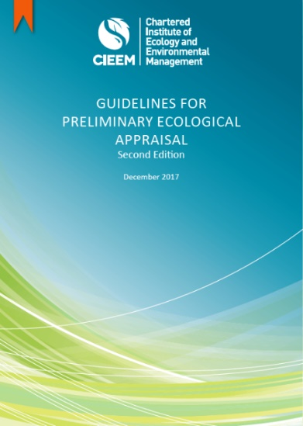
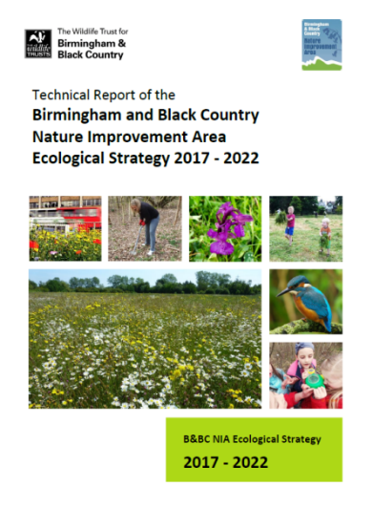
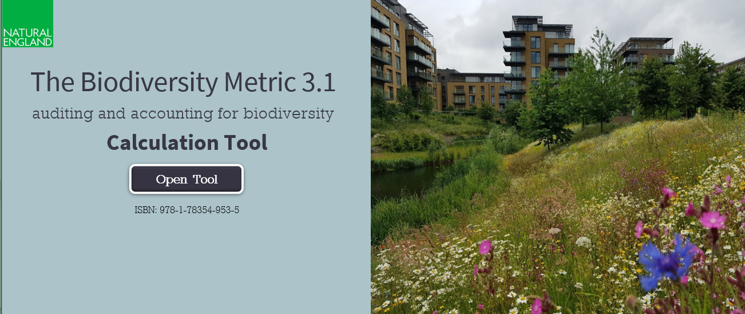
Biodiversity policy and good practice guidance

Slide 9

The Environment Act 2021 and New Duties
Biodiversity Net Gain and NERC Act.

Slide 10
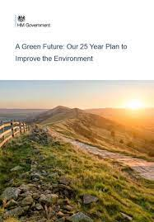
New Duties - Background & Policy Context
Lawton Report ‘Make Space for Nature’ (2010) - ‘Bigger, Better, More Joined up’
25 Year Environment Plan (2018) -
‘Be the first generation to leave the environment in a better state than we found it’. Develop a Nature Recovery Network
Agriculture Act (2020) – public money for public goods
Environment Act (2021) – species and habitat targets, mandatory 10% BNG for developments
30 by 30 Pledge (2020) – protect 30% of land/sea by 2030
Environment Improvement Plan February 2023
Third National Adaptation Plan (NAP3)
Notes:
The UK governments 25 Year Environment Plan sets out what the UK will do to improve the environment, within a generation. By 204, the ambition is to achieve high quality, accessible, natural spaces with increased biodiversity close to where people live and work,; with a focus around the equal distribution of environmental benefits and resources to all.

Slide 11
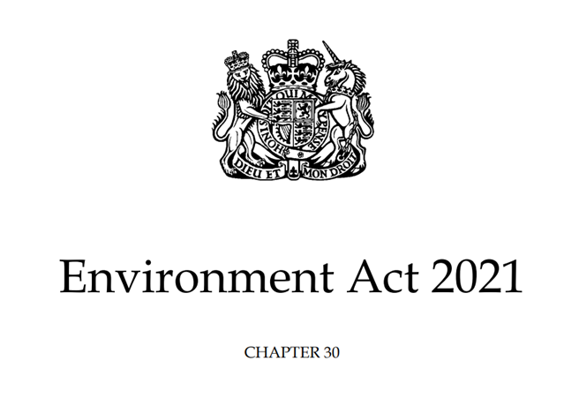
Environment Act New Duties
All planning permissions granted in England (with a few exemptions) must deliver at least 10% biodiversity net gain from February 2024 (majors) 2nd April (minors) (S98-101).
Enhanced duty for LAs to conserve and enhance biodiversity (S102) and report on their actions (S103) in place January 2023.
LPAs will need to comply with the above duty and have regard to the Local Nature Recovery Strategy in local planning policy and decisions (S102).
Responsible authorities appointed by the Secretary of State (S105) to lead the Local Nature Recovery Strategy (LNRS), working with a broad range of stakeholders.

Slide 12
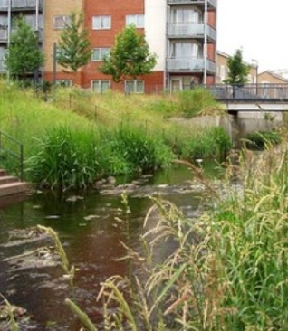
Biodiversity Net Gain (BNG) and Nature Recovery – what are they?
Net gain is an approach to development that aims to leave the natural environment in a measurably better state than it was beforehand.
Nature recovery is about stepping beyond conservation into active restoration of the natural world and halting the decline in species abundance by 2030.
Notes:
Creating more better joined up wildlife rich places (a NRN) that will help recover species and restore ecosystem services to provide places that are more effective in functioning to provide benefits for us

Slide 13
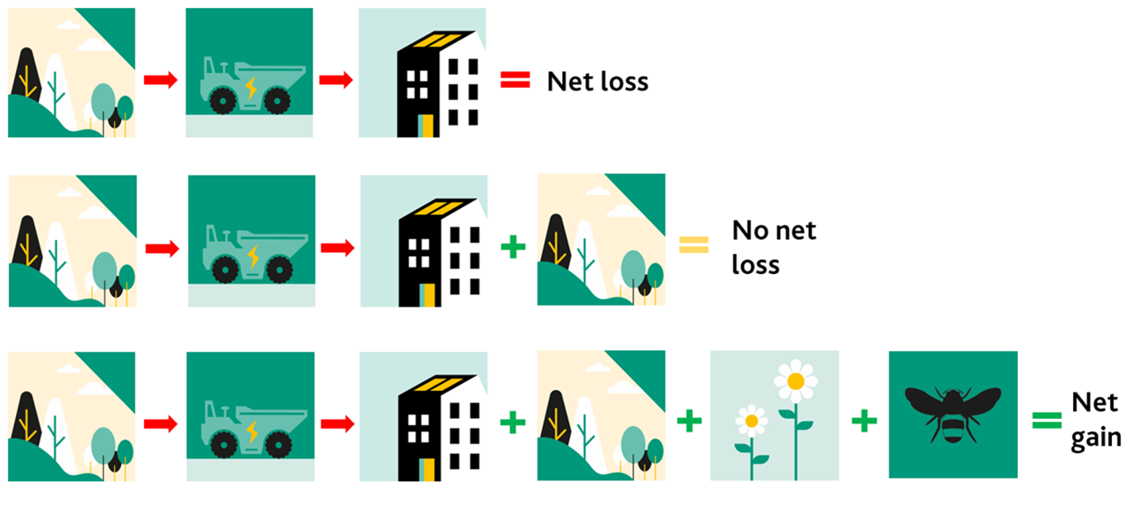
BNG and Habitat Units

Slide 14
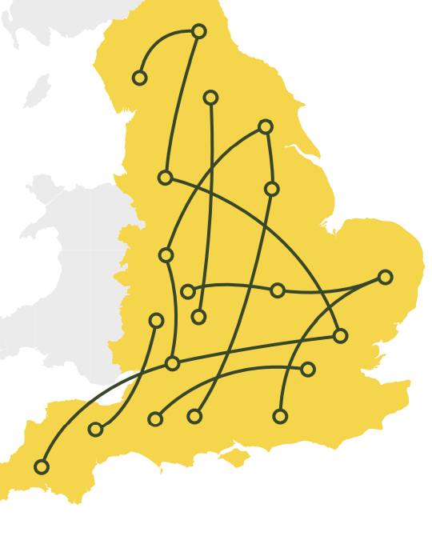
What is the Nature Recovery Network?
The Nature Recovery Network (NRN):
A national network of wildlife-rich places (made up of many local networks)
It will expand, improve and connect across towns, cities, countryside and coast
Assist recovery of nature across England at scale
Tackles crises of biodiversity loss and climate change and improve public health and wellbeing
There will be a Local Nature Recovery Network covering the WMCA area which includes Birmingham.
Notes:
The Nature Recovery Network is the biggest nature restoration project in our nation’s history. It will be a national network of wildlife-rich places. The aim is to expand, improve and connect these places across our cities, towns, countryside and coast. The Nature Recovery Network is a major commitment in the government’s 25 Year Environment Plan, enacted by the Environment Act 2021.

Slide 15
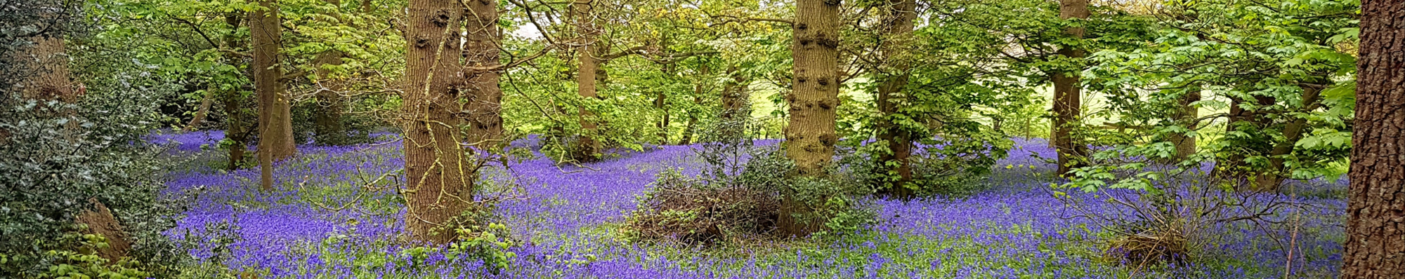
Delivery of Biodiversity Net Gain, management and monitoring
It is expected that the delivery of BNG will be primarily be or via:
On site creation (within a development boundary)
Off site as close to site as possible and in a strategically identified location (as defined by the LNRS)
Off site as close as possible but in an opportunity area
Off site elsewhere (but ideally within the LNRS area)
Purchase Statutory Biodiversity Credit from the Government.
Habitat created as mitigation (including any net gain) will need to have management secured and funded for a minimum of 30 years.
Sites (such as parks) where off-site net gain is delivered must be registered on the governments database.
Regular monitoring of habitats – for both on and off-site delivery – is required and the LPA is tasked with reporting on this (to government) as part of the net gain process.

Slide 16

Local Nature Recovery Network
(Birmingham)

Slide 17
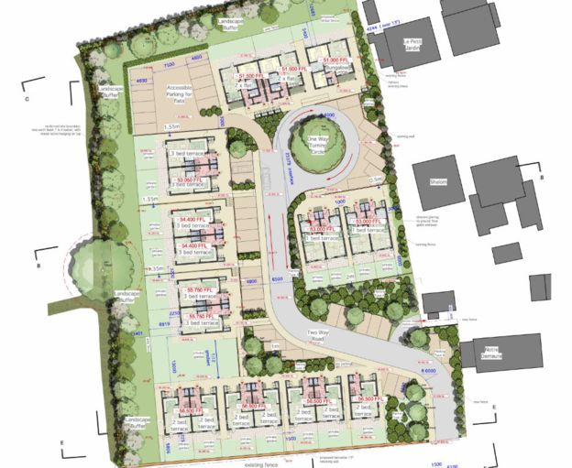
What is the local authority role in BNG and nature recovery?
Planning decisions and Local Plan policies
Setting strategy, linking to overarching council strategy and objectives:
  Local Nature Recovery Strategy
  Climate emergency
  Place making & infrastructure
  Natural capital and ecosystem services
Embedding and joining up across council services, including estates
Mapping, evidence and data
Working in partnership
Securing funding
Delivering nature recovery on the ground
Engage local communities, farmers and landowners

Slide 18
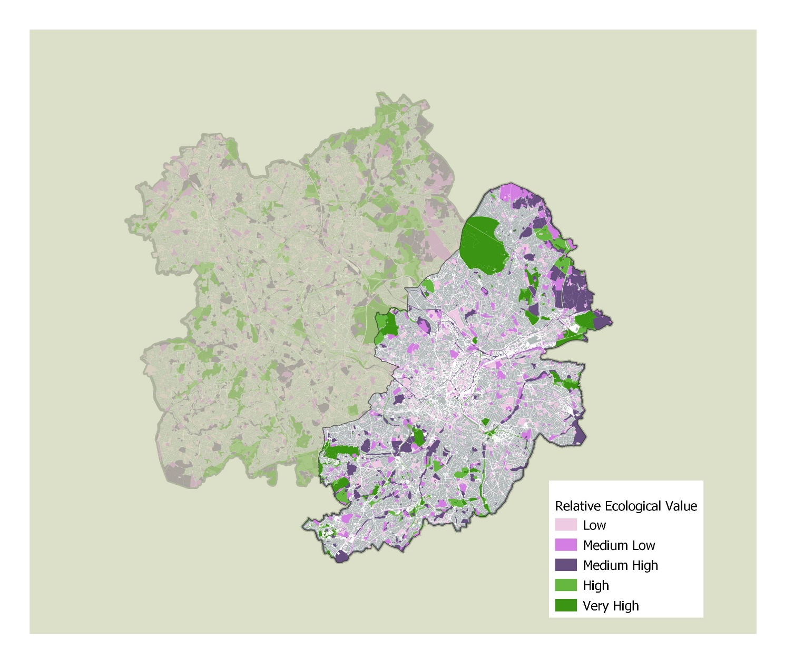

Slide 19
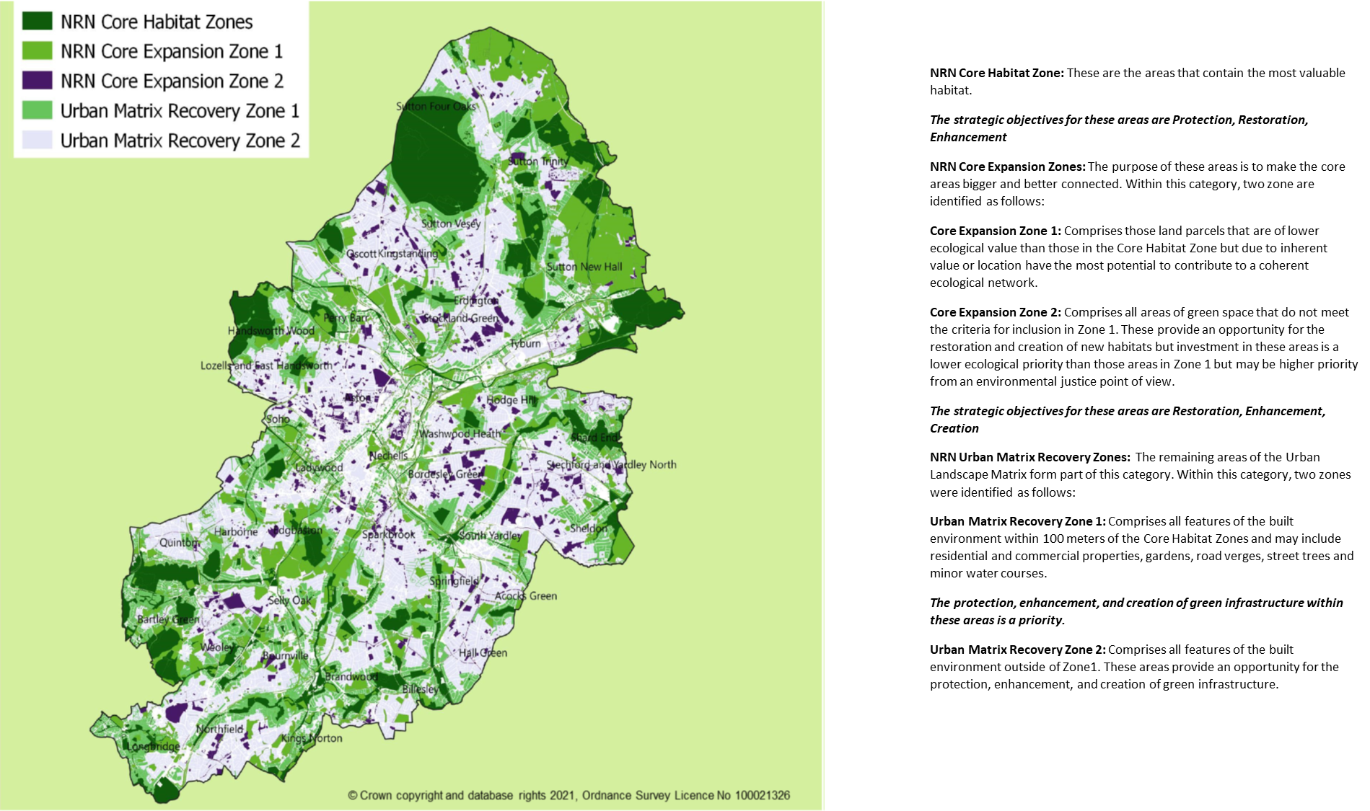
NRN Core Habitat Zone: These are the areas that contain the most valuable habitat.
The strategic objectives for these areas are Protection, Restoration, Enhancement
NRN Core Expansion Zones: The purpose of these areas is to make the core areas bigger and better connected. Within this category, two zone are identified as follows:
Core Expansion Zone 1: Comprises those land parcels that are of lower ecological value than those in the Core Habitat Zone but due to inherent value or location have the most potential to contribute to a coherent ecological network.
Core Expansion Zone 2: Comprises all areas of green space that do not meet the criteria for inclusion in Zone 1. These provide an opportunity for the restoration and creation of new habitats but investment in these areas is a lower ecological priority than those areas in Zone 1 but may be higher priority from an environmental justice point of view.
The strategic objectives for these areas are Restoration, Enhancement, Creation
NRN Urban Matrix Recovery Zones: The remaining areas of the Urban Landscape Matrix form part of this category. Within this category, two zones were identified as follows:
Urban Matrix Recovery Zone 1: Comprises all features of the built environment within 100 meters of the Core Habitat Zones and may include residential and commercial properties, gardens, road verges, street trees and minor water courses.
The protection, enhancement, and creation of green infrastructure within these areas is a priority.
Urban Matrix Recovery Zone 2: Comprises all features of the built environment outside of Zone1. These areas provide an opportunity for the protection, enhancement, and creation of green infrastructure.

Slide 20
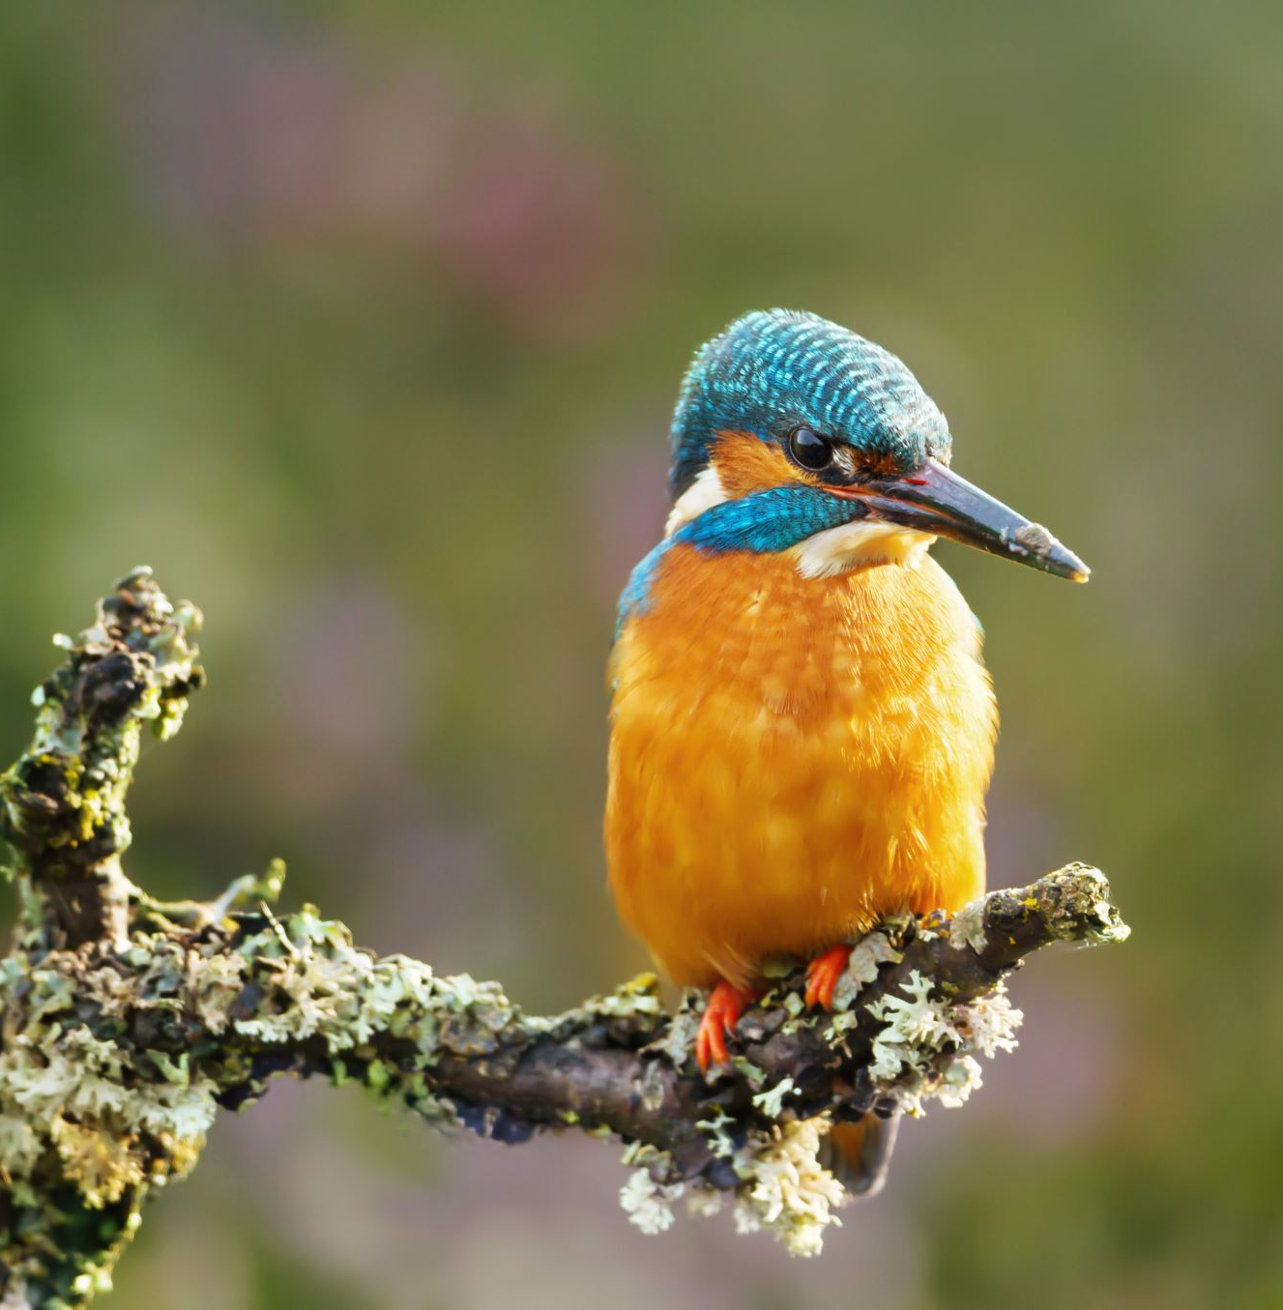
How are habitats recorded and habitat value established?

Slide 21

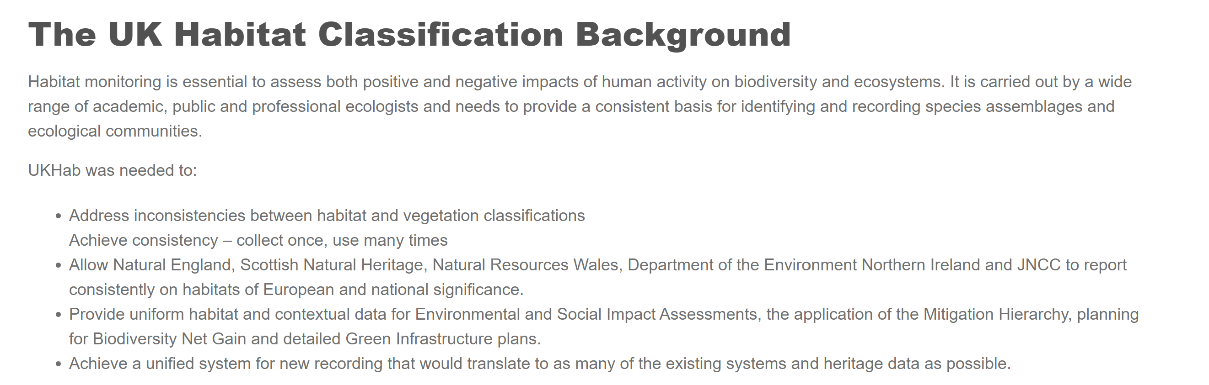

Slide 22
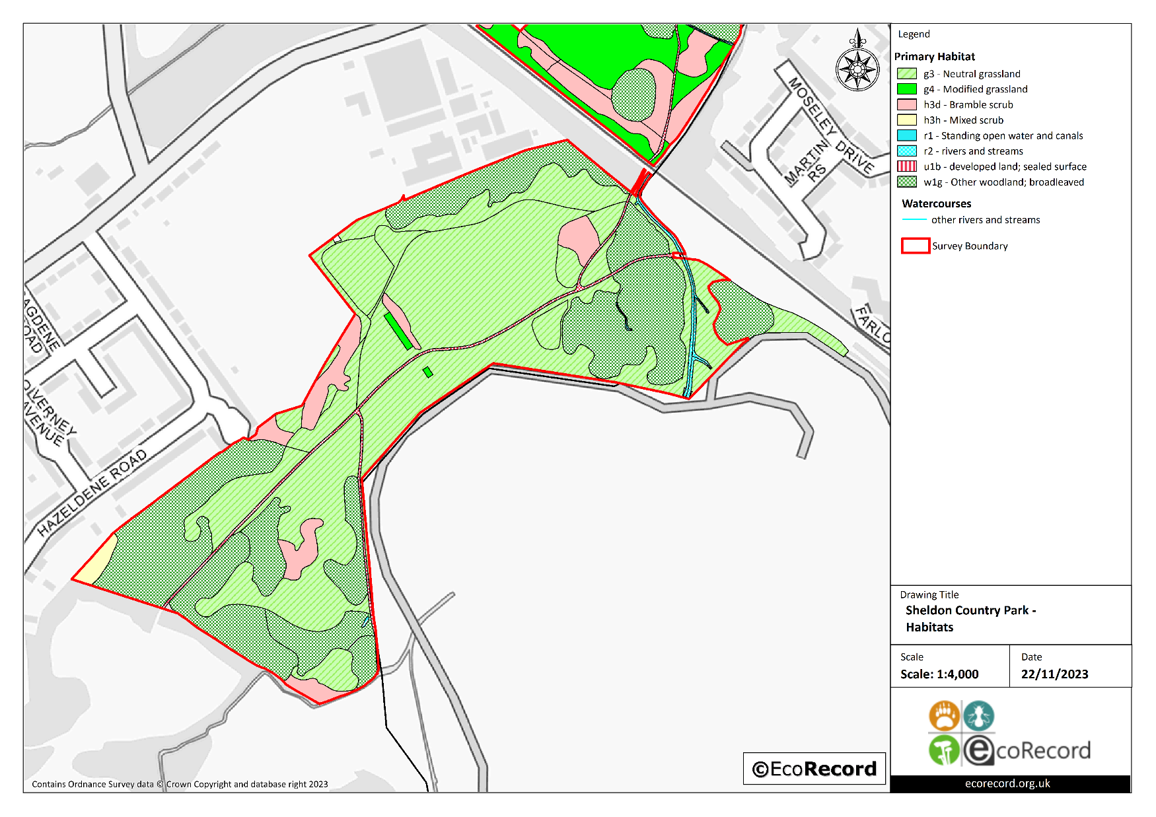

Slide 23
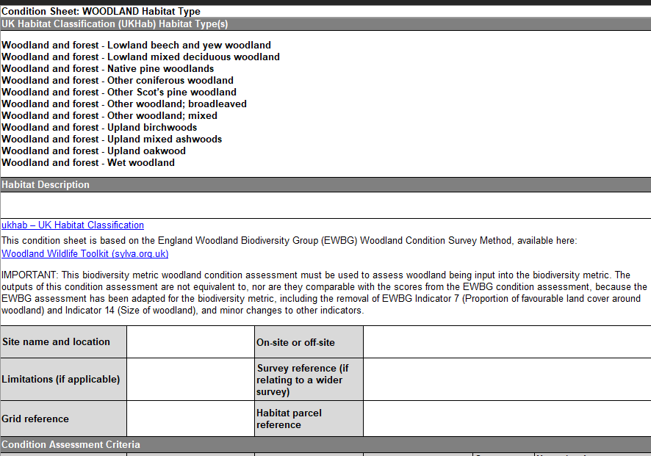

Slide 24
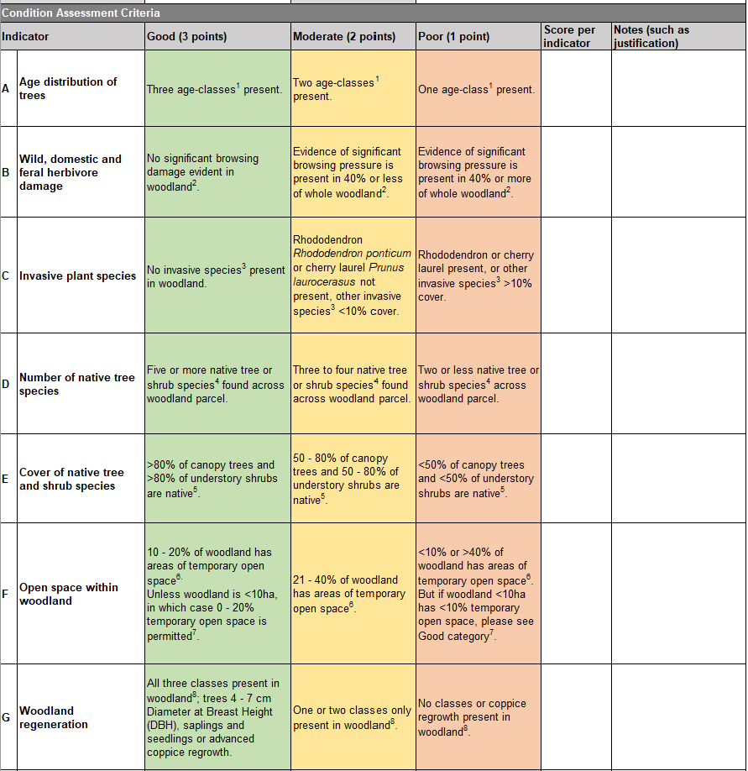
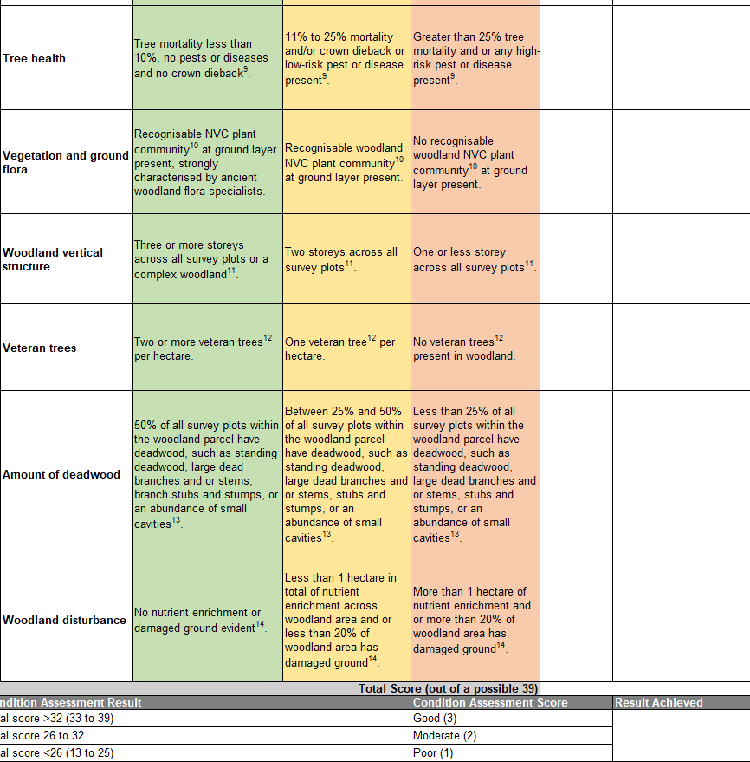

Slide 25
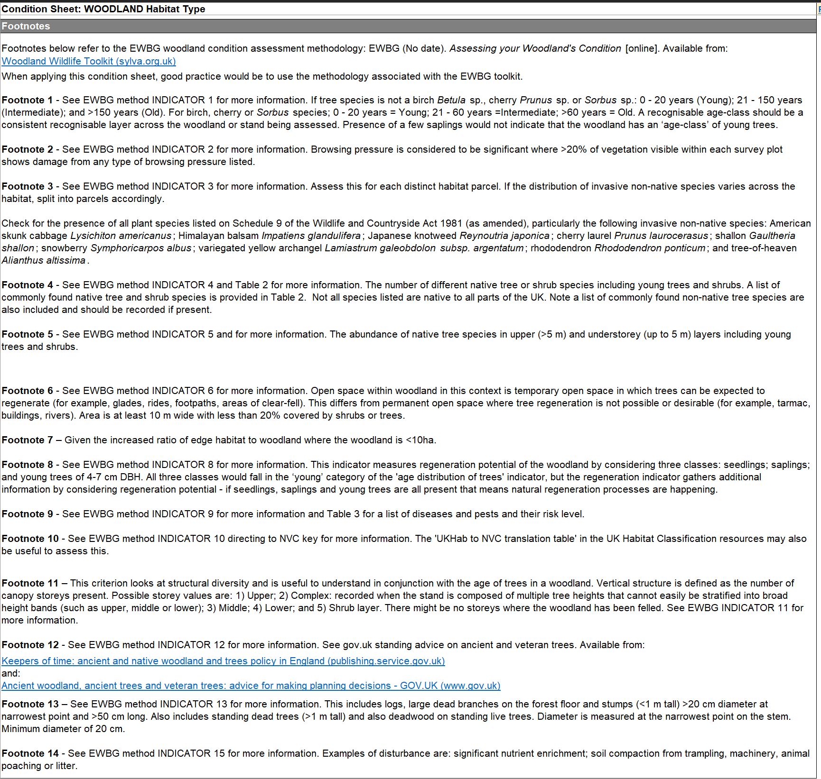

Slide 26
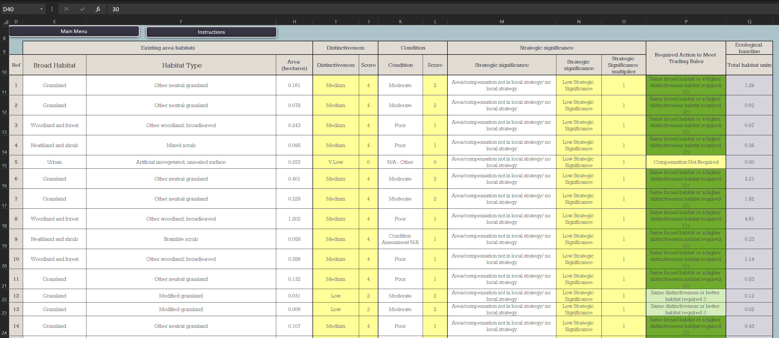
Statutory Metrics spreadsheet

Slide 27
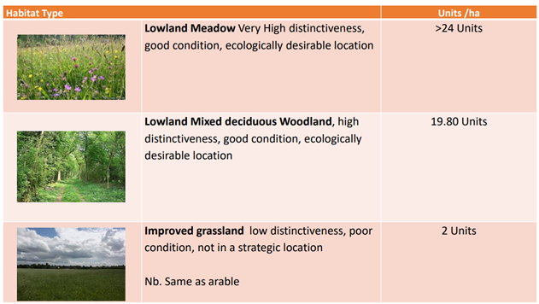
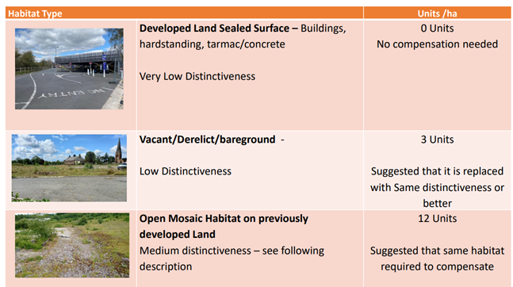
What is a Habitat Unit and what does it look like?
Habitat Units are a measure of a habitat, they can be areas such as grassland and woodland or linear features such as hedges and streams. They are also defined by their quality. This would generally be Poor, Moderate or Good
Plus their distinctiveness and ecological location status.
Hard to replace or scarce habitats score higher value for a smaller area than easy to replicate common habitats
This means that that the number of habitat units that are found on a site will vary based on the above.
In terms of replacement habitat, a poor quality habitat can be mitigated for by a smaller area of moderate or good quality habitat (created or improved)
Additional “credit” is given for delivery in strategically important locations.

Slide 28

What does this mean for friends of/ volunteer and community groups working in parks and open spaces?

Slide 29
While Birmingham’s parks offer the biggest opportunity for benefiting from net gain it is recognised that open spaces have multiple uses such as sporting provision or other recreational activities.
It is not the intention to revert all parks or open space to natural habitat but to ensure that the most appropriate uses and opportunities can be realised in a complimentary manner.

Slide 30
Considerations
Sites within strategic locations will need site specific management plans.
Changes in the site such as new habitat/ feature creation will need to be directed by habitat mapping, condition assessment and the Local Nature Recovery Strategy.
Before any changes can occur, baseline habitat mapping and condition values must be established.
The above may constrain proposals for “other uses” or interventions/ activities that don’t align with the Nature Recovery Plan.
The Future Parks Standard must also be considered, and this has a biodiversity element which is informed by the above.
Where a site is already registered for net gain delivery any identified areas MUST be managed to maintain the desired condition or above – BCC will need to ensure this as financial penalties/ costs will be incurred to rectify to standard. Similar to higher level stewardship that already applies on some sites such as Lickey and Sutton.
Opportunities
Sites that have appropriate management plans will provide a clear plan of potential habitat management/ enhancement or creation opportunities – and therefore form an annual work programme.
Where the work of the city/ friends' groups has enabled an uplift of biodiversity value this has the potential to be matched against developments where financial sums have been secured through planning for net gain and future maintenance.
Where sites have the potential to generate habitat units through creation / enhancement – these can be offered for off-setting of development impacts
The minimum 30-year maintenance sums can be used to support the work of local groups where they have contributed to elements of net gain delivery. (could cover tools and training; and support from ranger service/ parks GM staff).
BNG sums can also fund tasks such as litter picking or creation/ maintenance of features such as access points and routes where these contribute to the protection of the habitat.
Drawing in income supplements existing parks budgets and would allow re allocation to other parks in need which have limited potential to attract net gain sums.

