Slide 1




City of Nature Alliance Pilot Project
Finance Workshop

Slide 2



City of Nature Alliance Pilot Project
Workshop Facilitator
Debbie Needle
Community Facilitator
For the city’s Urban Nature Development Project
(Part of the City of Nature Programme)

Slide 3
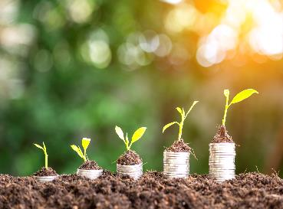
Funding the delivery of the City of Nature Plan actions
In this presentation we will look at:
The City of Nature Plan Overview.
What are the Valued City actions.
What are Ecosystem Services.
What are Nature Based Solutions.
What is Natural Capital and why did we choose to use this approach.

Slide 4
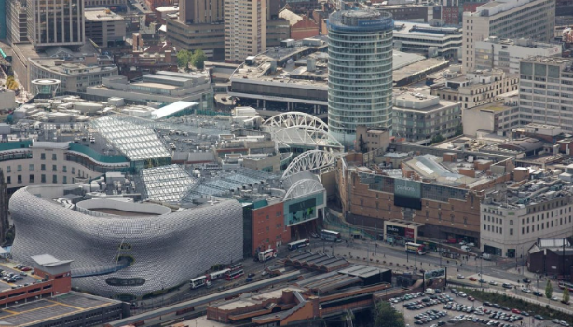
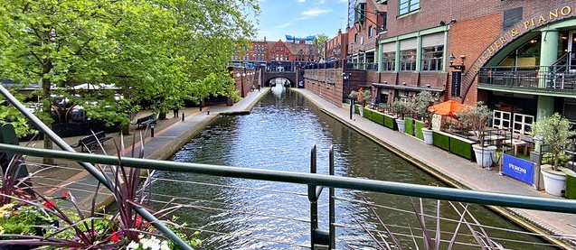
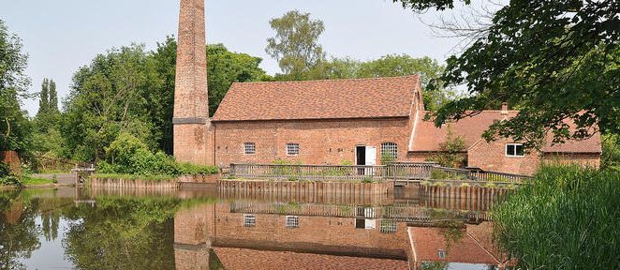
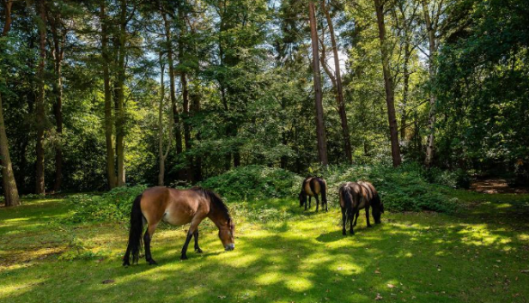
Birmingham
Notes:
When we think about Birmingham what images come into our minds?
All these images are in Birmingham. The city centre (very grey, not much green just one tree if you look closely), Brindley Place canals, Sarehole Mill Museum and ponies in Sutton Park LNR.

Slide 5
25-year Plan for a City of Nature – The long game
Over thirty years ago, at the Rio Summit in 1992, the world formally recognised how important the environment, biodiversity and sustainability would be as a new framework for 21st century living. Sustainability has three pillars, economical, ecological and social. Without all three being balanced, it will not work.
Over the intervening 30 years Birmingham has undergone a significant transformation rebuilding its city centre and creating a vibrant economy. (Economic and Social)
In 2019 we started out by deciding that over the next 30 years Birmingham would deliver its plan for the design, management and use of green infrastructure by creating a city of nature. (Ecological) This will help to create the balance for a sustainable city.
Notes:
Over thirty years ago, at the Rio Summit in 1992, the world formally recognised how important the environment, biodiversity and sustainability would be as a new framework for 21st century living. Sustainability has three pillars, economical, ecological and social. Without all three being balanced, it will not work.
Over the intervening 30 years Birmingham has undergone a significant transformation rebuilding its city centre and creating a vibrant economy. (Economic and Social)
In 2019 we started out by deciding that over the next 30 years Birmingham would deliver its plan for the design, management and use of green infrastructure by creating a city of nature. (Ecological) This will help to create the balance for a sustainable city.

Slide 6

From a vision to delivering a City of Nature
2018 - Our Future City Plan (OFCP) 2040 ‘Shaping This City Together’
This “vision document” introduced a new approach to strategy and plan making based on a shared and inclusive vision for Birmingham’s central region.
2019 - The Naturally Birmingham Project
This was the name of Birmingham’s Future Park Accelerator (FPA) Project funded by Heritage Lottery and supported by the National Trust, which took two years to develop a plan for the whole city building on the original OFCP vision for just the central region of Birmingham.
2022 - The City of Nature 25-year Plan
In February 2022, the City of Nature Plan was agreed and adopted by Birmingham City Council as the Green Infrastructure Strategy. This documents the why, what, when and who of how the vision would get delivered across the whole city.
2023 - The City of Nature Programme and City of Nature Alliance of organisations Pilot.
This was about increasing knowledge about exactly what needs to happen, what it will cost and what else we still need to know, for the plan to be delivered.
2024 - The Urban Nature Development Project, Urban Forest Accelerator and Green Champions Programme
This is the first implementation of the City of Nature Plan across multiple wards.
Notes:
There are lots of different plan, policy and project names that we use when talking about the City of Nature.
We started in 2018 with a vision for a more balanced sustainable plan for Birmingham. This became the Our Future City Plan (OFCP) 2040 ‘Shaping This City Together’
This vision document introduced a new approach to strategy and plan making based on a shared and inclusive vision for Birmingham’s central region.
In 2019 The councils Green City Manager – Nick Grayson but together a bid to apply for funding from the Future Park Accelerator (FPA) Project. He called the Birmingham Project – Naturally Birmingham. The project was funded by Heritage Lottery and supported by National Trust, which took two years to develop a plan for the whole city building on the original OFCP vision for just the central region of Birmingham. This project would take two years to build on the vision for central Birmingham and make it deliverable for the whole city.
In February 2022, the City of Nature Plan was agreed and adopted by Birmingham City Council as the Green Infrastructure Strategy. This documents the why, what, when and who of how the vision would get delivered across the whole city.
In 2023 - The City of Nature Programme and City of Nature Alliance of organisations pilot was developed. This project was about increasing knowledge about exactly what needs to happen at site level, what it will cost and what else we still need to know, for the actions in the plan to be delivered on the ground.
2024 - The Urban Nature Development Project, Urban Forest Accelerator and Green Champions Programme
This is the first implementation of the City of Nature Plan across multiple wards.

Slide 7
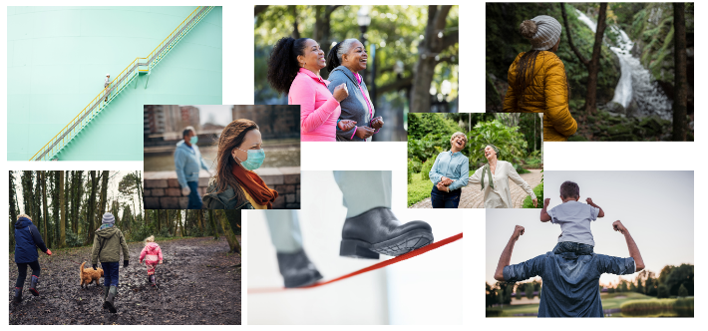
The start.
5 priorities for Birmingham.
Health, Housing, Children, Employment & Environment
Notes:
At the start of the Naturally Birmingham project, we looked at the councils' priorities for the city: Health, Housing, Children and Young People and Jobs and Skills.
We added the environment to this list of priorities and set about showing why the environment was so important, in fact vital, to tackling the other 4 existing priorities.

Slide 8
The Journey to the 5 Themes
Focusing on : Funding, Involvement & Communication
Notes:
Eventually we would develop five themes for the basis of the City of Nature, but we started by thinking about funding (money), involving people at every stage and communicating about this.

Slide 9

The 5 Themes
And delivery
Delivered
Valued
Involved
Green
Healthy
Fair
A city that is: Fair, Healthy, Green, Involved & Valued
Notes:
After many iterations we landed on five themes that made up a city of nature.
A city would need to deliver green infrastructure and services that are Fair, Healthy, Green, Involved and Valued – and – these would need to be delivered.
Without delivery it would remain just a plan rather than a transformation process.
All the themes are interrelated and interdependent. You will see this translate in each section.

Slide 10




Environmental justice is at the heart of what a fair city would look like.
It is defined as the fair treatment and meaningful involvement of all people regardless of race, colour, national origin, or income, with respect to the development, implementation and enforcement of environmental laws, regulations, and policies.
Measuring Environmental Justice in Birmingham The Birmingham Future Parks Accelerator Project has looked at how other cities around the world have responded to this issue of unequal access to green space; and is the first UK local authority to develop a measurement tool for Environmental Justice; based on the existing Indices of Multiple Deprivation.
The Environmental Justice score measures:
• Access to a green space (2 hectares or larger) within 1,000m.
• Flood Risk.
• Urban Heat Island effect.
• Health inequalities (through Excess Years of Life Lost).
• Indices of Multiple Deprivation.
Birmingham City Council Geospatial Team developed a new map that shows where in the city all these compound issues are being felt most acutely. This then provides a very useful new baseline from which to develop an evidence-based approach to levelling-up Fair City outcomes We will make sure every citizen has access to good quality green space wherever they live and that there is fair access to training and green jobs and our workforce reflects our diverse communities.
To do this we need:
• Good quality green spaces close to where people live, through the adoption of the Birmingham Future Parks Standard process (F1).
• To Identify up to 400 more public green spaces (F2).
• Green spaces that are managed to ensure they are appealing to our diverse communities (F3).
• Green spaces that are accessible for those with additional needs and those who may need support (F4).
• A training and employment showcase of opportunities in the ‘green sector’ (F5).
• A green space workforce more reflective of Birmingham’s diverse communities (F6).
• A children and young people strategy with City of Nature as part of that (F7).
Notes:
A Fair City – is one that has Environmental justice is at the heart.
Environmental Justice is defined as the fair treatment and meaningful involvement of all people regardless of race, colour, national origin, or income, with respect to the development, implementation and enforcement of environmental laws, regulations, and policies.
Measuring Environmental Justice in Birmingham The Birmingham Future Parks Accelerator Project has looked at how other cities around the world have responded to this issue of unequal access to green space; and is the first UK local authority to develop a measurement tool for Environmental Justice; based on the existing Indices of Multiple Deprivation.

Slide 11
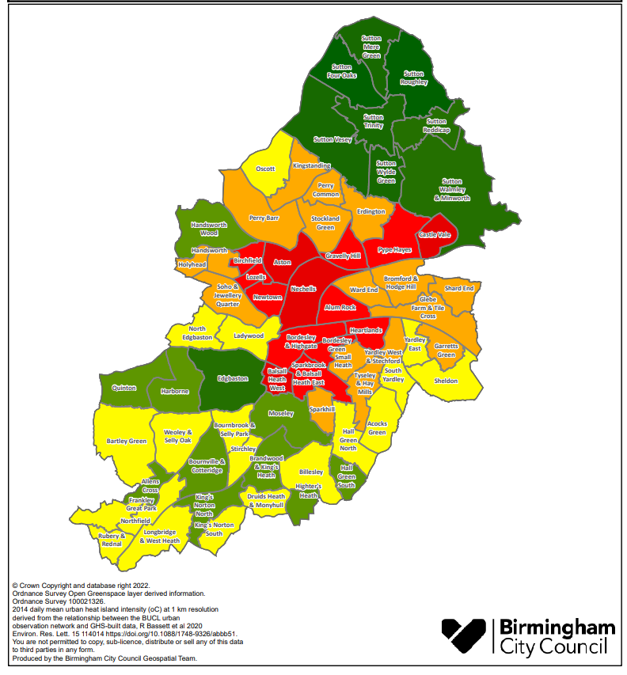
Delivering Environmental Justice
Starting with Birmingham’s priority “Red Wards”:
Castle Vale
Pype Hays
Gravelly Hill
Nechells
Bordesley and Highgate
Balsall Heath West
Achieving:
Levelling Up environmental justice
Climate Change Adaptation
Nature Recovery
Notes:
First 12 months: 2022 -2023 We trialled this approach first in 5 open spaces in Bordesley and Highgate Ward to ensure it is working well before taking it elsewhere.
First five years: 2022 to 2027
We are using the findings from the Bordesley and Highgate pilot to bring together council departments and community organisations to focus upon the green spaces in another 5 wards:
• Balsall Heath West.
• Nechells.
• Gravelly Hill.
• Pype Hayes.
• Castle Vale.
3 of these wards - Balsall Heath West, Nechells and Castle Vale are in the top 5 areas of most need of environmental justice; the other two are geographical neighbours making a central north-south spine of the city.
Years 6 to 10: 2028 - 2032 This will be followed by 8 more red wards:
• Alum Rock.
• Aston.
• Birchfield.
Bordesley Green.
• Heartlands.
• Lozells.
• Newtown.
• Sparkbrook and Balsall Heath East
Within the 25 years of the plan: by 2047 All our parks and green spaces will meet the Birmingham Future Parks Standard, with the 35 highest scoring wards forming a vital part of the city’s nature recovery network and therefore it’s response and resilience to climate change; ensuring our whole parks network moves from red to green. But the City of Nature outcomes don’t stop with the Birmingham Fair Parks Standard Audit process.
The City of Nature plan supports all green spaces throughout the 25 years to reach their full potential through the involvement of the local community to access resources that Birmingham City Council alone can no longer provide. For example, there is already substantive work planned along the South and East of Birmingham as part of the East Birmingham Inclusive Growth Strategy.
The Cole Valley is a key green corridor running through East and South Birmingham. It is identified within the Council’s Route to Zero and East Birmingham programmes as a focus for the improvement of the natural environment and as an active travel artery.
The Environment Agency has published a Vision for the Cole Valley Catchment in partnership with the Council and other stakeholders and this provides a useful starting point for planning the delivery of improvements to blue and green infrastructure.

Slide 12



The value of parks, green spaces and nature is not just defined by numbers.
The health benefits of green spaces have been intuitively known by communities for a long period of time. In recent years there has been an explosion of evidence which comprehensively supports the idea that green spaces are integral for both our physical and mental health.
Green space has been demonstrated to improve physical health in the following ways:
• Studies have shown that for children and young people access to green space helps regulate emotional and behavioural activity, specifically inattention and hyperactivity; encourages prosocial behaviour; and is the most significant factor to influence the reduction in childhood obesity.
• For adults, access to green space brings significant benefits in terms of reducing the likelihood of cardiovascular diseases, type two diabetes, hip fractures, bowel, and breast cancers. Older adults also benefit from reduction in levels of obesity, numbers of fractures and reduced death from cardiovascular diseases.
• Access to green space can also bring significant benefits in terms of mental health with evidence suggesting higher levels of life satisfaction; lower levels of self-reported stress; and lower levels of anxiety and depression.
To do this we need:
• Nature connectedness - whereby citizens understand the benefits of using green space and having contact with nature for physical and mental health (H1).
• Safe and attractive routes for walking and cycling (H2).
• An increased number of parks offering health and wellbeing services and green social prescribing (H3).
• To work with fitness providers to offer health and wellbeing activities in parks and other green spaces (H4).
• Support to citizens living in council housing to make communal gardens where they live (H5).
• To establish at least one Community Growing Space in every ward (I7).
Notes:
The value of parks, green spaces and nature is not just defined by numbers.
The health benefits of green spaces have been intuitively known by communities for a long period of time. In recent years there has been an explosion of evidence which comprehensively supports the idea that green spaces are integral for both our physical and mental health.
Green space has been demonstrated to improve physical health in the following ways:
• Studies have shown that for children and young people access to green space helps regulate emotional and behavioural activity, specifically inattention and hyperactivity; encourages prosocial behaviour; and is the most significant factor to influence the reduction in childhood obesity.
• For adults, access to green space brings significant benefits in terms of reducing the likelihood of cardiovascular diseases, type two diabetes, hip fractures, bowel, and breast cancers.
Older adults also benefit from reduction in levels of obesity, numbers of fractures and reduced death from cardiovascular diseases.
• Access to green space can also bring significant benefits in terms of mental health with evidence suggesting higher levels of life satisfaction; lower levels of self-reported stress; and lower levels of anxiety and depression.
Healthy City outcomes: We will make sure every citizen in Birmingham can access green spaces to improve their health and wellbeing as part of the foundations of a good life.

Slide 13

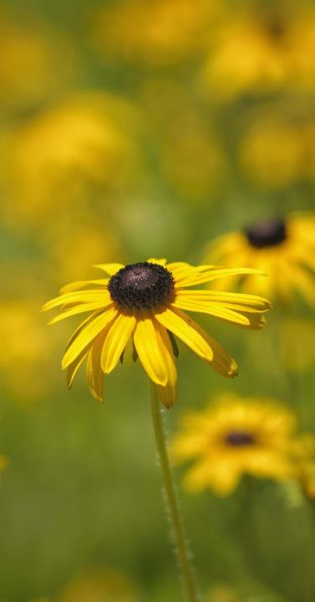
Where nature is recognised as integral to wider decision and plan making; and where green spaces, nature and the environment are protected, maintained, and sustainably managed.
The City of Nature Plan will address one of the themes prioritised in England’s 25 Year Environment Plan:
“Support the delivery of the national Nature Recovery Network, with its focus on enhancing landscapes; improving connectivity between wildlife rich places; climate resilience; protection of existing natural environments and supporting access to nature for health and well-being.”
To do this we need:
The restoration of green spaces, nature, and the environment (G4).
A complete change in how we build all our public realm, providing improved connectivity and supporting the restoration and viability of urban areas (G1).
Green corridors that are easier to find and use, helping citizens to use them for active travel and so improve air quality (G2).
An enhanced network of green space and green infrastructure that are safe, clean, sustainably managed and meet the Birmingham Future Parks Standard (G3).
Greener development bringing natural landscapes or features into every place and neighbourhood (G5).
Opportunities to help citizens make better use of green space outside of their home for food growing or communal gardens (G6).
The Nature Recovery Network, stretching right across the city and linking with all our West Midlands neighbours, forming part of the West Midlands National Park (G7).
An increase to the tree canopy coverage across the city to 25%, through the Birmingham Urban Forest Master Plan (G8).
A change to the city’s governance structures that oversee the city’s natural environment across the full 25-year term (G9).
Notes:
A Green City is one where nature is recognised as integral to wider decision and plan making; and where green spaces, nature and the environment are protected, maintained, and sustainably managed.
The City of Nature Plan will address one of the themes prioritised England’s 25 Year Environment Plan: “Support the delivery of the national Nature Recovery Network, with its focus on enhancing landscapes; improving connectivity between wildlife rich places; climate resilience; protection of existing natural environments and supporting access to nature for health and well-being.”

Slide 14



Involving citizens throughout the delivery of actions in the City of Nature plan will mean that there is a greater understanding of the challenges the city faces and ensure local people have a voice in how their area is run. In the most deprived areas of England, people tend to have the poorest health and significantly less green space than wealthier areas.
Involving Council officers, other than just those in Street Scene, and their network of citizens from their associated service areas such as Planning, Public Health, Highways, Neighbourhoods and Jobs and Skills will result in the delivery of appropriate housing, better health outcomes, places for children to learn and play and a sense of pride of our citizens in their local area and in Birmingham as a whole.
The number of people who spend little or no time in natural spaces is too high.
Recent data from the Monitor of Engagement with the Natural Environment survey tells us that some 12% of children do not visit the natural environment each year. Playing and learning outside is a fundamental part of childhood, and helps children grow up healthy. Some children are lucky enough to have a family garden; others will not, and it is important that we find other ways to give them better access to the great outdoors. We know that regular contact with green spaces, such as the local park, lake, or playground, can have a beneficial impact on children’s physical and mental health.
To do this we need:
A City of Nature Alliance, made up of charities and community organisations, to provide a new civic voice and engagement mechanism (I6).
New and more flexible ways for the citizens to participate and to get involved in volunteering in green spaces; and become Green Champions (I5).
Support to children and young people to learn, play and explore the wonders of nature as part of their education and acting as Young Green Champions (I3).
New City of Nature pages on Birmingham City Council’s website to bring our green spaces to people at home, helping them to connect to nature wherever they are (I1).
Opportunities in green spaces to explore and celebrate art and culture, for example: work with libraries to organise book clubs in parks (I4).
Notes:
The City of Nature Plan was Co-created with as many people as possible for the project, the process tried to support involvement rather than just engagement or consultation.
Continuing to involve citizens throughout the delivery of actions in the City of Nature plan will mean that there is a greater understanding of the challenges the city faces and ensure local people have a voice in how their area is run. In the most deprived areas of England, people tend to have the poorest health and significantly less green space than wealthier areas.
Involving Council officers, other than just those in Street Scene, and their network of citizens from their associated service areas such as Planning, Public Health, Highways, Neighbourhoods and Jobs and Skills will result in the delivery of appropriate housing, better health outcomes, places for children to learn and play and a sense of pride of our citizens in their local area and in Birmingham as a whole.
The number of people who spend little or no time in natural spaces is too high.
Recent data from the Monitor of Engagement with the Natural Environment survey tells us that some 12% of children do not visit the natural environment each year. Playing and learning outside is a fundamental part of childhood, and helps children grow up healthy. Some children are lucky enough to have a family garden; others will not, and it is important that we find other ways to give them better access to the great outdoors. We know that regular contact with green spaces, such as the local park, lake, or playground, can have a beneficial impact on children’s physical and mental health.

Slide 15

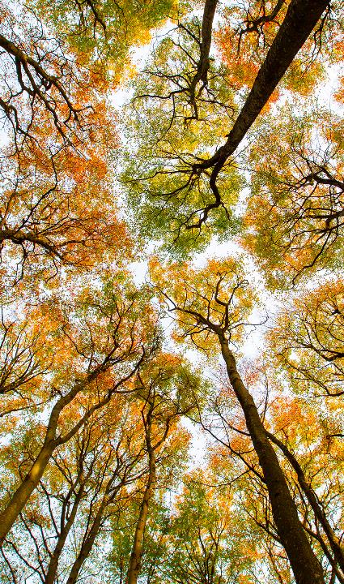



One of the greatest challenges facing the long-term maintenance and recovery of the natural environment and parks and green spaces, is the issue of funding.
The 2016-17 Parliamentary Inquiry ‘The Future of Public Parks’ found that the value of parks and green spaces was well documented but not well understood; so not fully protected in policy. The inquiry found that as a non-statutory service they have often been seen as non-essential services and have suffered disproportionately with budgets reductions imposed following the 2008 global financial crisis and subsequent austerity measures.
Historically the economic model adopted by all cities has been a linear one resulting in the maintenance of parks being registered as nothing but a cost; with their value not being captured. The City of Nature plan moves away from that model towards a circular economy one, that better fits how the city will need to meet its twin challenges of levelling-up and climate change.
In addition, the city will develop a Sustainable Finance Framework with external green investors allowing for the long-term investment into the city’s blue and green infrastructure.
This will help the city realise the true value of the natural environment as captured in the latest Natural Capital Account which valued the city’s future potential green estate as £14.93 billion after 25 years.
Notes:
The City of Nature plan depends on everyone understanding the value of the connections within nature. We are part of those connections.
One of the greatest challenges facing the long-term maintenance and recovery of the natural environment and parks and green spaces, is the issue of funding.
The 2016-17 Parliamentary Inquiry ‘The Future of Public Parks’ found that the value of parks and green spaces was well documented but not well understood; so not fully protected in policy.
The inquiry found that as a non-statutory service parks and green spaces have often been seen as non-essential services and have suffered disproportionately with budgets reductions imposed following the 2008 global financial crisis and subsequent austerity measures. In most recent times this has slowed but not stopped.
Historically the economic model adopted by all cities has been a linear one resulting in the maintenance of parks being registered as nothing but a cost; with their value not being captured.
The City of Nature plan moves away from that model towards a circular economy one, that better fits how the city will need to meet its twin challenges of levelling-up and climate change.
In addition, the city will develop a Sustainable Finance Framework with external green investors allowing for the long-term investment into the city’s blue and green infrastructure.
This will help the city realise the true value of the natural environment as captured in the latest Natural Capital Account which values the city’s future (after 25 years) potential green estate (if all the actions in the City of Nature Plan were delivered) as £14.93 billion.

Slide 16

The Urban Nature Development Project and Urban Forest Accelerator Project
BCC needed to make the City of Nature Plan both deliverable and sustainable and the National Trust wanted to be able to expand, develop and share the work started in the Future Parks Accelerator Project.
Although much had already been achieved for Birmingham through the work done in the Future Parks Accelerator Project, there was still a lot of work to do to ensure the detail, data and mechanisms, both operational and the governance for the delivery of the plan are in place.
The first two projects in the City of Nature Programme are:
The Urban Nature Development Project
The Urban Forest Accelerator (Birmingham Pilot) in response to the then government's “Trees Call for Action”
Both projects are supported by the National Trust and funded by the National Lottery Heritage fund.
Notes:
BCC needed to make the City of Nature Plan both deliverable and sustainable and the National Trust wanted to be able to expand, develop and share the work started in the Future Parks Accelerator Project.
Although much had already been achieved for Birmingham through the work done in the Future Parks Accelerator Project, there was still a lot of work to do to ensure the detail, data and mechanisms, both operational and the governance for the delivery of the plan are in place.
The first two projects in the City of Nature Programme are:
The Urban Nature Development Project
The Urban Forest Accelerator (Birmingham Pilot) in response to the then government's “Trees Call for Action”
Both projects are supported by the National Trust and funded by the National Lottery Heritage fund.

Slide 17
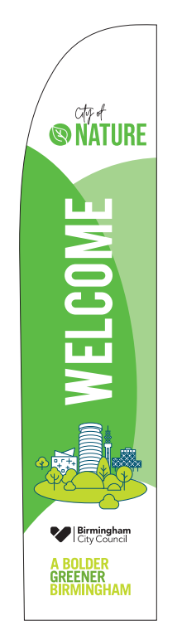
The Future Parks Standard - Improving existing parks
UND - Focusing on Nature on Your Doorstep / Nature Connection for Health
We are improving existing parks so people in most need can benefit from their green spaces and nature on their doorstep.
To do this we are establishing mechanisms to:
Convene a City of Nature BCC Operations Group
Support a City of Nature Alliance partnership to enhance working with communities.
Activate five ‘red’ wards (identified through the environmental justice map) using the “Birmingham Future Park Standard” method to manage assets and deliver services.
Develop a Green Champions model for eco volunteers.
Identifying and testing a programme of nature-based health interventions and growing a range of online information and opportunities to involve new audiences.
Trialling a Social Impact Assessment app to monitor and report on this work.
Identifying key sources of parks related income to fund this work in the future.
Notes:
We want to establish a capacity and capability building mechanism for people in most need to be able to benefit from the enjoyment of the natural world by becoming involved with their green spaces and nature on their doorstep.
We are improving existing parks so people in most need can benefit from their green spaces and nature on their doorstep.
To do this we are establishing mechanisms to:
Convene a City of Nature BCC Operations Group
Support a City of Nature Alliance partnership to enhance working with communities.
Activate five ‘red’ wards (identified through the environmental justice map) using the “Birmingham Future Park Standard” method to manage assets and deliver services.
Develop a Green Champions model for eco volunteers.
Identifying and testing a programme of nature-based health interventions and growing a range of online information and opportunities to involve new audiences.
Trialling a Social Impact Assessment app to monitor and report on this work.
Identifying key sources of parks related income to fund this work in the future.

Slide 18
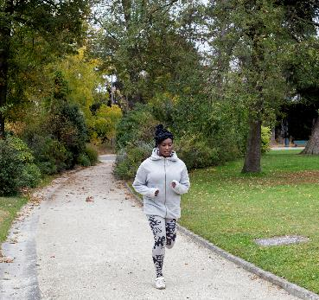
Master Planning - New parks and green spaces
Produce a pipeline of projects for the East Birmingham Inclusive Growth geography by:
Developing a green infrastructure (GI) master plan that will:
Identify improvement options for all existing green space, starting with East Birmingham.
Identify all future opportunity sites & linkages across East Birmingham.
Develop costed investment proposals for nominated sites, across a range of typologies, with recommended financial resources.
Inform the City’s local development plan, wider GI master planning and sustainable investment strategies.
Notes:
Produce a pipeline of projects for the East Birmingham Inclusive Growth geography by:
Developing a green infrastructure (GI) master plan that will:
Identify improvement options for all existing green space, starting with East Birmingham.
Identify all future opportunity sites & linkages across East Birmingham.
Develop costed investment proposals for nominated sites, across a range of typologies, with recommended financial resources.
Inform the City’s local development plan, wider GI master planning and sustainable investment strategies.

Slide 19

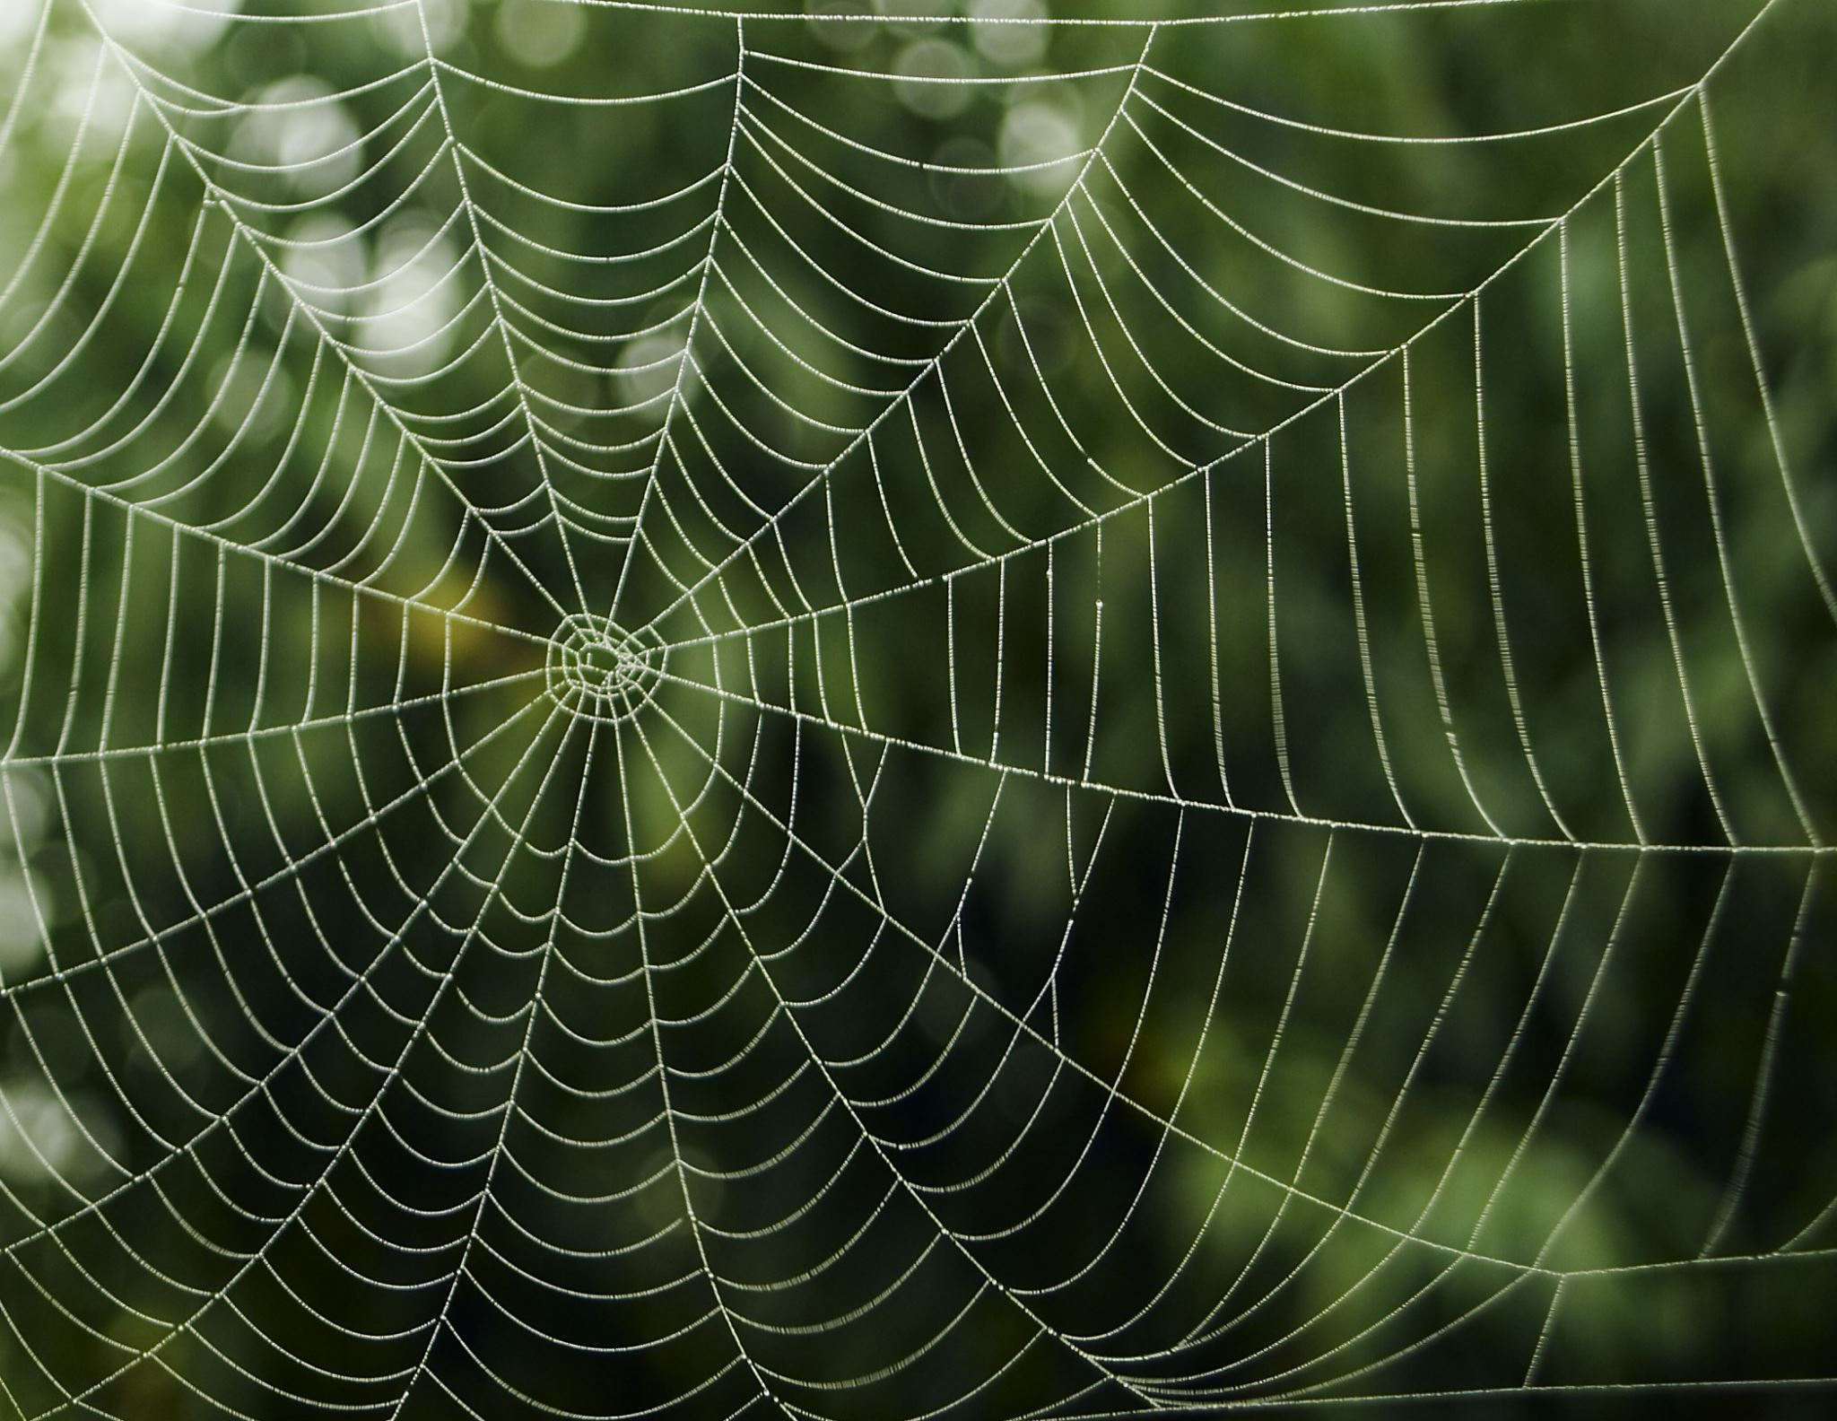
Nature Recovery Network
The requirement for Local Nature Recovery Strategies (LNRS) across the whole of England were set out in the Environment Act 2021. The LNRS Regs came into force on 13th April 2023 with the WMCA being appointed as Responsible Authority for delivering the stratergy for the West Midlands region in June 2023.
What is the LNRS?
Local nature recovery strategies are a system of spatial strategies for nature and environmental improvement required by law under the Act.
Each strategy must:
agree priorities for nature’s recovery;
map the most valuable existing areas for nature; and
map specific proposals for creating or improving habitat for nature and wider environmental goals (adopting Nature Based Solutions).
Together, the strategies will cover the whole of England with no gaps and no overlaps.
The main purpose of the strategies is to identify locations to create or improve habitat most likely to provide the greatest benefit for nature and the wider environment.
Urban Nature Development Project
Create a schedule of Birmingham City Council sites that could successfully benefit from future Biodiversity Net Gain credits and embedded maintenance payments through identification of BCC owned sites against the 25-year nature recovery vision map developed through FPA.
Notes:
The requirement for Local Nature Recovery Strategies (LNRS) across the whole of England were set out in the Environment Act 2021. The LNRS Regs came into force on 13th April 2023 with the WMCA being appointed as Responsible Authority for delivering the stratergy for the West Midlands region in June 2023.
What is the LNRS?
Local nature recovery strategies are a system of spatial strategies for nature and environmental improvement required by law under the Act.
Each strategy must:
agree priorities for nature’s recovery;
map the most valuable existing areas for nature; and
map specific proposals for creating or improving habitat for nature and wider environmental goals (adopting Nature Based Solutions).
Together, the strategies will cover the whole of England with no gaps and no overlaps.
The main purpose of the strategies is to identify locations to create or improve habitat most likely to provide the greatest benefit for nature and the wider environment.
Urban Nature Development Project
Create a schedule of Birmingham City Council sites that could successfully benefit from future Biodiversity Net Gain credits and embedded maintenance payments through identification of BCC owned sites against the 25-year nature recovery vision map developed through FPA.

Slide 20
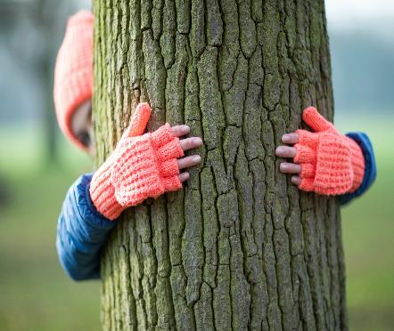
Growing Birmingham’s Urban Forest and Urban Foresters
The Urban Forest Accelerator (UFA) project is a joint project between the National Trust, Birmingham Treepeople CIO and Birmingham City Council. It contributes to the vision of the England Trees Action Plan (ETAP) and will deliver against multiple objectives from it.
Its objectives are:
Connecting people with trees and woodlands
Making trees and woodlands part of the green economy
Protecting and improving our trees and woodlands
Expanding and connecting our trees and woodlands
As a local authority we have stated a clear commitment to Net Zero and as part of that a commitment to future tree planting and protection. This will take those reoccurring resources of money, volunteers and communication alongside building skills for a future green workforce.
Notes:
The Urban Forest Accelerator (UFA) project is a joint project between the National Trust, Birmingham Treepeople CIO and Birmingham City Council. It contributes to the vision of the England Trees Action Plan (ETAP) and will deliver against multiple objectives from it.
Its objectives are:
Connecting people with trees and woodlands
Making trees and woodlands part of the green economy
Protecting and improving our trees and woodlands
Expanding and connecting our trees and woodlands
As a local authority we have stated a clear commitment to Net Zero and as part of that a commitment to future tree planting and protection. This will take those reoccurring resources of money, volunteers and communication alongside building skills for a future green workforce.

Slide 21

BCC Housing
BCC Route to Zero Team
BCC Street Scene (Including Parks)
BCC Commonwealth Games Legacy
BCC Adult Education
Birmingham Children’s Trust
BCC Public Health
At the start of the FPA project there was already fantastic work being done in Birmingham by individuals, groups and organisations, but we wanted to bring all of those together with all BCC Departments to continue the collaborate of developing the plan into a collaboration to deliver the plan at ward level. We would look for gaps and make the most of the strengths by sharing knowledge and skills.
This collaboration is known as the: City of Nature Alliance
Core third sector members of the Alliance were:
Birmingham Open Spaces forum
The Birmingham and Black Country Wildlife Trust
The Active Wellbeing Society
The Birmingham Children's Trust
Charities Birmingham Tree People (previously the BTFL project), Legacy WM and Patchwork Meadow and local entrepreneurs like Learning Journey and the Parakeet have joined these and the wider City of Nature Alliance that helps to shape the delivery of the City Nature Programme includes National organisations like the RSPB, The National Trust, Natural England, The Canals and Rivers Trust and it is growing all the time.
City of Nature Alliance
Birmingham Open Spaces Forum
The Active Wellbeing Society
Legacy WM
Learning Journeys
Birmingham and Black Country Wildlife Trust
Neighbourhood Networks
Birmingham Tree People
Notes:
At the start of the FPA project there was already fantastic work being done in Birmingham by individuals, groups and organisations, but we wanted to bring all of those together with all BCC Departments to continue the collaborate of developing the plan into a collaboration to deliver the plan at ward level. We would look for gaps and make the most of the strengths by sharing knowledge and skills.
This collaboration is known as the: City of Nature Alliance
Core third sector members of the Alliance were:
Birmingham Open Spaces forum
The Birmingham and Black Country Wildlife Trust
The Active Wellbeing Society
The Birmingham Children's Trust
Charities Birmingham Tree People (previously the BTFL project), Legacy WM and Patchwork Meadow and local entrepreneurs like Learning Journey and the Parakeet have joined these and the wider City of Nature Alliance that helps to shape the delivery of the City Nature Programme includes National organisations like the RSPB, The National Trust, Natural England, The Canals and Rivers Trust and it is growing all the time.

Slide 22
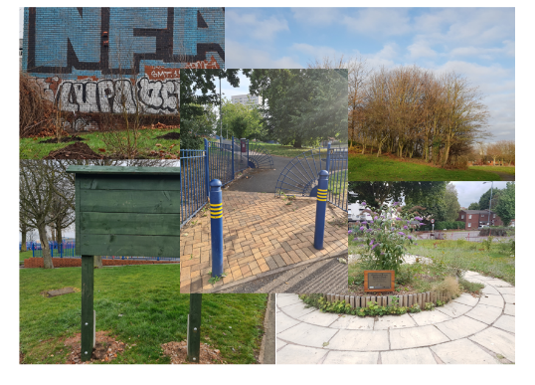
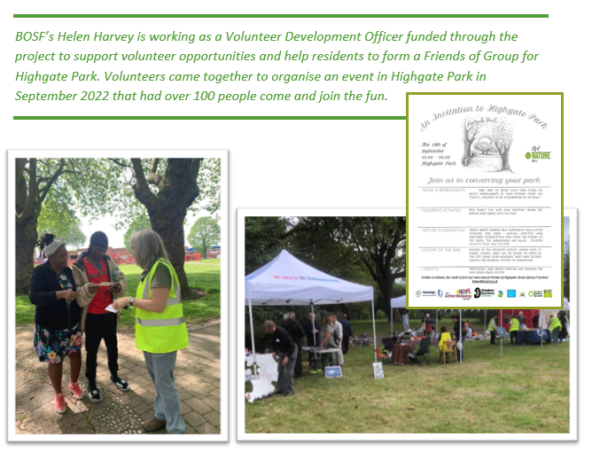

The City of Nature Alliance Ward Pilot – Improving 5 Existing Parks
Bordesley and Highgate pilot project - managing parks and greenspaces differently following the City of Nature Plan – How much did that cost £150,000 +?
Notes:
In 2023 the council’s Urban Nature Development Project (funded by the Heritage Lottery) commenced the City of Nature Alliance Pilot applying the Future Park Standard to activate five parks in one red ward which was Bordesley and Highgate.
The Bordesley and Highgate pilot project looked at managing parks and greenspaces differently following the City of Nature Plan. The work of the Alliance organisations was funded with £ 150,000 from the Commonwealth Games Legacy fund.
But do we know how much it really cost to run the pilot? What if we added in volunteer time, organisational support, use of equipment that had already been purchased etc.
We need to be able understand the true cost of things and the true value of them.

Slide 23
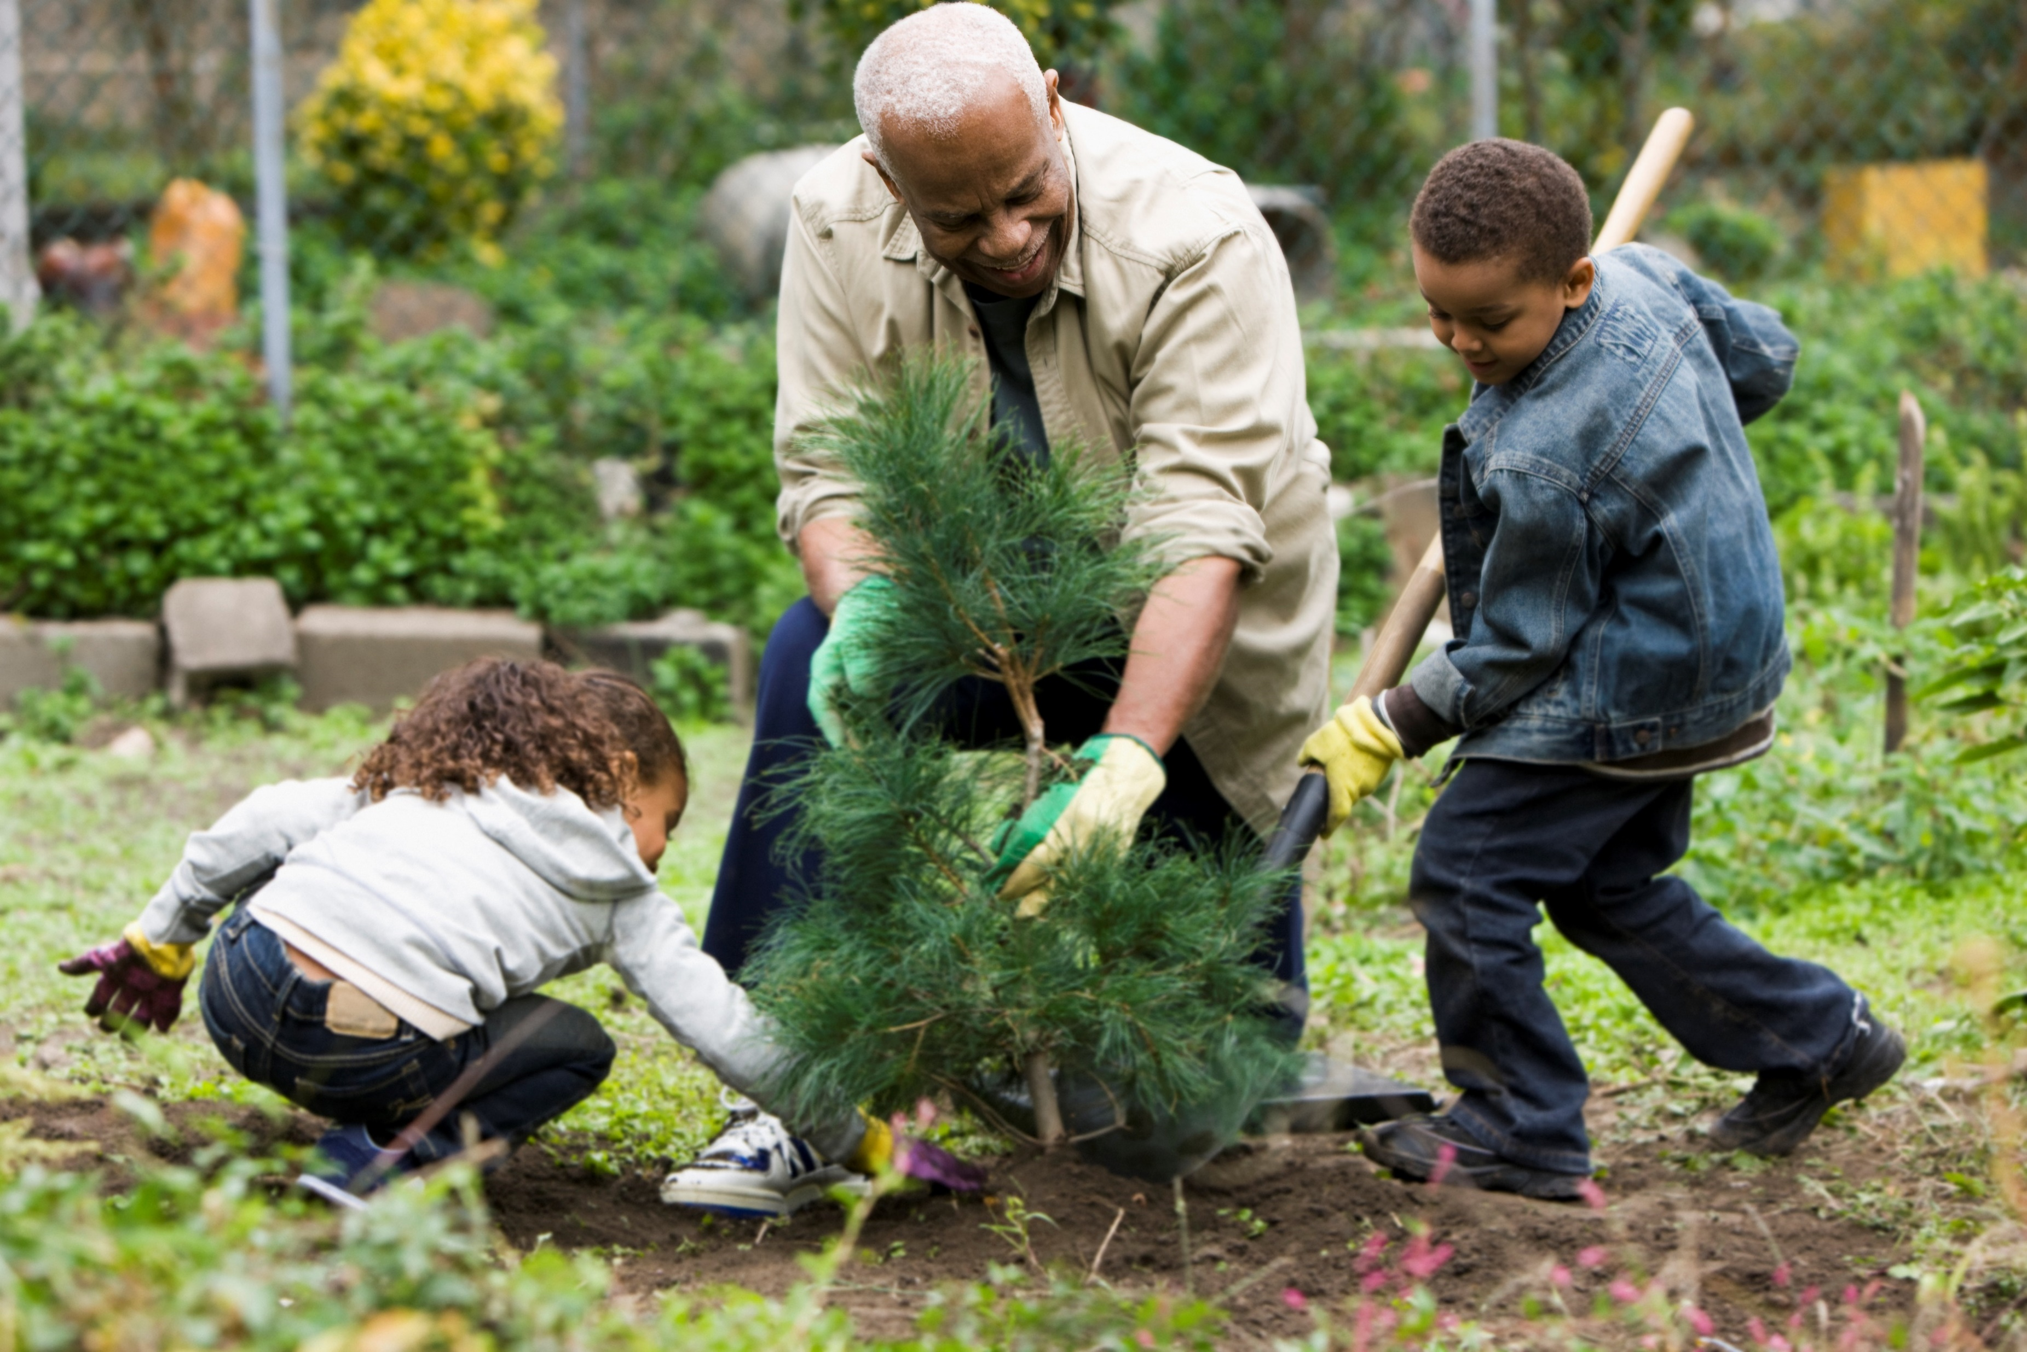
Needs, Nature,
Human Services, benefits, cost and funding
Do we really need to provide interventions?
Notes:
The prevalence of mental ill-health is on the rise in the UK with an estimated one in four people experiencing a ‘significant’ mental health problem in any one year.
With the prescription of anti-depressants at record levels and a huge demand for Cognitive Behaviour Therapy and other psychological therapies, health and social care commissioners are examining and commissioning different options for cost effective services for mental health.
At the same time there is increasing recognition of the importance of nature and place as a determinant of individuals’ mental health.
Nature-based interventions are operating throughout the UK, working with a wide range of vulnerable groups helping to positively benefit health and wellbeing outcomes.
These nature-based interventions (also called green care and ecotherapy) could be part of a new solution for mental health care. However, increasing awareness and access to these interventions is challenging given the number of organisations delivering nature-based projects and services, the variety of terms and language used to describe their activity and benefits and the variation in delivery models which all use different impact measures.
To add to that challenge, we are using the term intervention not only for human health care but also for nature health care. Nature must be in good health for it to help us care for human health. Where nature has been seriously depleted to ”below the red line” we will need to intervene to restore it before it can start to heal itself and us.
The City of Nature Plan has looked at what people need, how can nature help, what human services are needed to meet the need (so what are the benefits from the services), what is the cost, how do we find the funding.

Slide 24
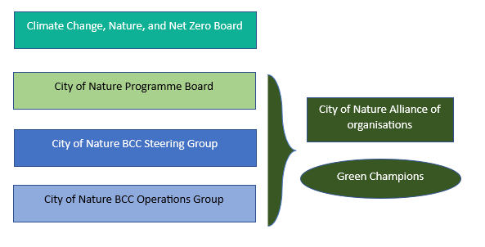

Governance for a City of Nature
The Climate Change, Nature, and Net Zero Board overseas all the work being delivered for the Environment Portfolio.
The City of Nature Programme Board ensure the delivery of projects are on track.
The City of Nature Steering Group - advises the delivery of the programme.
The City of Nature BCC Operations Group – supports delivery.
The City of Nature Alliance – plays a part in all City of Nature levels.
Green Champions can include anyone involved at any level and / or interested citizens.
Notes:
Governance and Finance
How do we ensure that when we look at what people need, how nature can help, what human services are needed to meet the need (so what are the benefits from the services), what is the cost, how do we find the funding and how we ensure the original need is being met in the most nature friendly and cost-effective way possible.
Birmingham participated as a case study city in a 5-year national research study - Liveable Cities (2012- 2017) which looked at the world’s most liveable cities to understand the critical ingredients needed to be successful as a green sustainable city.
One of its main findings was that successful cities were clear about how they linked municipal governance, with municipal planning and municipal finance.
These lessons have been built into the City of Nature Plan http://liveablecities.org.uk/
Strong and inclusive leadership will be key to the success of the City of Nature Plan.
To ensure the long-term governance and management of Birmingham’s natural environment a series of new bodies and groups have been formed to connect agendas and outcomes; with the benefits that the natural environment can bring to the improved performance of the city.
The core aims and ethos of the plan need to be considered when any decisions relating to Birmingham green spaces are being taken.
These new bodies are:
• The City of Nature Board: chaired by Cabinet Member for Parks and Street Scene.
• The City of Nature Steering Group: chaired by Assistant Director for Development who will bring together other Assistant Directors from across the council.
• The City of Nature Operations Group: chaired by Principal Planning Officer who will bring together operational officers from across the council.
• The Birmingham City of Nature Alliance: facilitated by the City of Nature Officer who will bring together representatives from external organisations.
The City of Nature Alliance will hold the Council accountable for the delivery of this plan

Slide 25
Valuing Nature

Slide 26

Achieving Valued City outcomes
These are the actions from the City of Nature plan that have been identified as vital to creating a city that understands and recognises the value of its natural assets and the people that help maintain them.
Sharing information that demonstrates the wider environmental, social, and economic value of green space through a Natural Capital Account
Using Biodiversity Net Gain and the planning and development process to improve access to good quality green spaces.
Developing a diversity of funding streams for green infrastructure from:
  supporting communities to crowdfund and secure grants,
  through to large scale business contributions.
Increasing council income for green infrastructure management through commercial activity.
Adding social value actions for green infrastructure through the council procurement process.
Education, Skills and Volunteering. Looking at people’s stories, skills and experience as an asset with value when considering how green infrastructure interventions are funded.
We will take these one at a time starting with understanding Natural Capital Accounts in this presentation.
Notes:
These are the actions from the City of Nature plan that have been identified as vital to creating a city that understands and recognises the value of its natural assets and the people that help maintain them.
Sharing information that demonstrates the wider environmental, social, and economic value of green space through a Natural Capital Account
Using Biodiversity Net Gain and the planning and development process to improve access to good quality green spaces.
Developing a diversity of funding streams for green infrastructure from:
supporting communities to crowdfund and secure grants,
through to large scale business contributions.
Increasing council income for green infrastructure management through commercial activity.
Adding social value actions for green infrastructure through the council procurement process.
• Education and Skills commissioning done through a green lens (V6)
We will take these one at a time starting with understanding Natural Capital Accounts

Slide 27
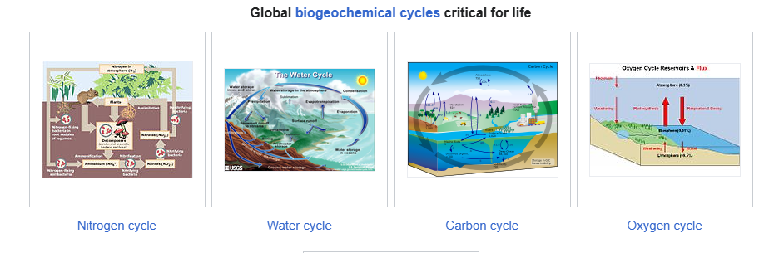
Global Cycles - Natural systems working at the global level.
Sometimes it can be hard to relate these powerful natural processes at a local level, but these global process have an impact on all of us through food production, climate change (increase in temperatures and flooding etc) and biodiversity loss.
We will need to adapt locally to the negative impacts the changes to these systems are producing - this will have a cost.
We in the UK / Birmingham can’t affect these global systems very much by our own actions, but we do still contribute to changes to them, we need to reduce this - this will have a cost.
To help we need to understand the changes we need to make to our environment and the way we all live – this will have a cost
To implement and promote these changes will need human interventions and these interventions come with a financial cost.
We have often said “parks (nature) need people, people need parks (nature)” however those people need funding, even volunteers.
However, all these costs are substantially less than if we do nothing (or carrying on doing the same things).
Therefor this cost is an investment to improve the lives we live and the lives of future generations by healing our environment - our planet.
Notes:
There are global processes operating all the time keeping us alive: The nitrogen cycle, water cycle, carbon cycle and oxygen cycle are vital to life, but can all be affected by human actions.
Sometimes it can be hard to relate these powerful natural processes at a local level, but these global process have an impact on all of us through food production, climate ( and climate change increase in temperatures and flooding etc) and biodiversity and therefor biodiversity loss.
We will need to adapt locally to the negative impacts the changes to these systems are producing - this will have a cost.
We in the UK / Birmingham can’t affect these global systems very much by our own actions, but we do still contribute to changes to them, we need to reduce this - this will have a cost.
To help we need to understand the changes we need to make to our environment and the way we all live – this will have a cost
To implement and promote these changes will need human interventions and these interventions come with a financial cost.
We have often said “parks (nature) need people, people need parks (nature)” however those people need funding, even volunteers.
However, all these costs are substantially less than if we do nothing or carrying on doing the same things.
This is investing to improve the lives we live and the lives of future generations by healing our environment our planet.

Slide 28
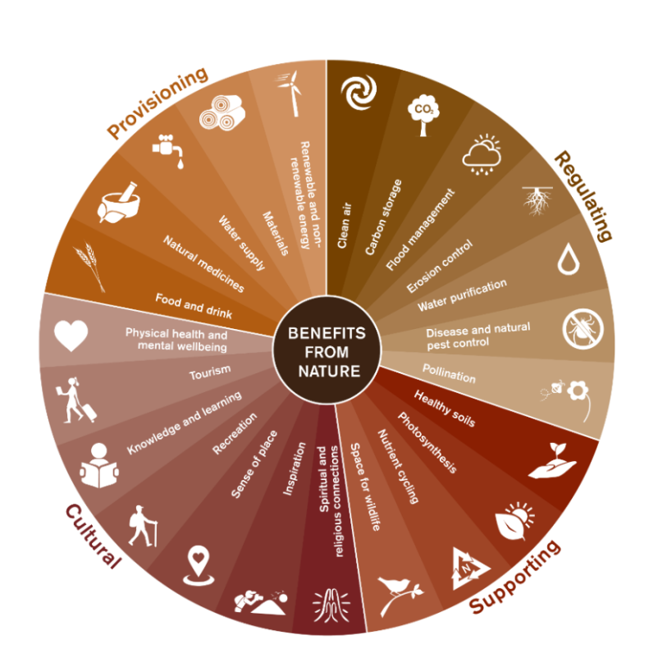
Eco Systems and Eco System Services
Eco systems work at a more “local” geographical level but still include living parts like plants and animals and non-living factors like air, water and minerals and all the interactions taking place.
Sometimes we call all these our “natural environment” or even just “nature”.
Nature is essential for human life, it provides us with water, clean air and food, raw materials (for medicines, industry and buildings) and renewable energy.
We may be aware that many of our crops rely on insect pollination, but we are not so aware of the complex geological and biological processes that create the soil that plants grow in. We rely all these nature-based products to survive as humans.
We also know there is more to life than surviving. Enjoying parks, landscapes and wildlife improves our health and well-being and helps us to thrive.
All these products and their benefits to us are known together as ecosystem services and depend on a healthy balanced natural environment to work well.
The vast number of services provided by ecosystems can be categorised into more manageable groups of provisional; regulating; cultural; and supporting services.
The services provided by ecosystems lead to benefits received by humans in the form of security, goods and materials, health and wellbeing these benefits can be calculated as a financial value.
Notes:
Eco systems work at a more “local” geographical level but still include living parts like plants and animals and non-living factors like air, water and minerals and all the interactions taking place.
Sometimes we call all these our “natural environment” or even just “nature”.
Nature is essential for human life, it provides us with water, clean air and food, raw materials (for medicines, industry and buildings) and renewable energy.
We may be aware that many of our crops rely on insect pollination, but we are not so aware of the complex geological and biological processes that create the soil that plants grow in. We rely all these nature-based products to survive as humans.
We also know there is more to life than surviving. Enjoying parks, landscapes and wildlife improves our health and well-being and helps us to thrive.
All these products and their benefits to us are known together as ecosystem services and depend on a healthy balanced natural environment to work well.
The vast number of services provided by ecosystems can be categorised into more manageable groups of provisional; regulating; cultural; and supporting services.
The services provided by ecosystems lead to benefits received by humans in the form of security, goods and materials, health and wellbeing these benefits can be calculated as a financial value.

Slide 29
Nature Based Solutions (NBS)
The International Union for Conservation of Nature (IUCN) defines Nature Based Solution (NBS) as:
Human “Actions to protect, sustainably manage, and restore natural or modified ecosystems, that address *societal challenges effectively and adaptively, simultaneously providing human well-being and biodiversity benefits".
*Societal challenges of relevance here include climate change, food security, disaster risk reduction, water security.
In other words: "Nature-based solutions are interventions that use natural functions of healthy ecosystems to protect the environment but also provide numerous economic and social benefits.“ They are used both in the context of climate change mitigation and adaptation.
Instead of “Doctor heal thy self” this is “Nature heal thy self”. It is using nature to heal nature, a street raingarden to manage urban flooding.
The European Commission's definition of NBS states that these solutions are: “Inspired and supported by nature, which are cost-effective, simultaneously provide environmental, social and economic benefits and help build resilience. Such solutions bring more, and more diverse, nature and natural features and processes into cities, landscapes, and seascapes, through locally adapted, resource-efficient and systemic interventions".
There is also an exponential effect, once you introduce nature-based systems (e.g. trees), they can organically increase their benefits over time. A tree can in the right environment not only grow in size but also create more trees to replace it when it can no longer function.
In 2020, the EC definition was updated to further emphasise that "Nature-based solutions must benefit biodiversity and support the delivery of a range of ecosystem services."
The term ecosystem-based adaptation (EbA) is a subset of nature-based solutions and "aims to maintain and increase the resilience and reduce the vulnerability of ecosystems and people in the face of the adverse effects of climate change".
Notes:
The International Union for Conservation of Nature (IUCN) defines Nature Based Solution (NBS) as:
Human “Actions to protect, sustainably manage, and restore natural or modified ecosystems, that address *societal challenges effectively and adaptively, simultaneously providing human well-being and biodiversity benefits".
*Societal challenges of relevance here include climate change, food security, disaster risk reduction, water security.
In other words: "Nature-based solutions are interventions that use natural functions of healthy ecosystems to protect the environment but also provide numerous economic and social benefits.“ They are used both in the context of climate change mitigation and adaptation.
Instead of “Doctor heal thy self” this is “Nature heal thy self”. It is using nature to heal nature, a street raingarden to manage urban flooding.
The European Commission's definition of NBS states that these solutions are: “Inspired and supported by nature, which are cost-effective, simultaneously provide environmental, social and economic benefits and help build resilience. Such solutions bring more, and more diverse, nature and natural features and processes into cities, landscapes, and seascapes, through locally adapted, resource-efficient and systemic interventions".
There is also an exponential effect, once you introduce nature-based systems (e.g. trees), they can organically increase their benefits over time. A tree can in the right environment not only grow in size but also create more trees to replace it when it can no longer function.
In 2020, the EC definition was updated to further emphasise that "Nature-based solutions must benefit biodiversity and support the delivery of a range of ecosystem services."
The term ecosystem-based adaptation (EbA) is a subset of nature-based solutions and "aims to maintain and increase the resilience and reduce the vulnerability of ecosystems and people in the face of the adverse effects of climate change".

Slide 30
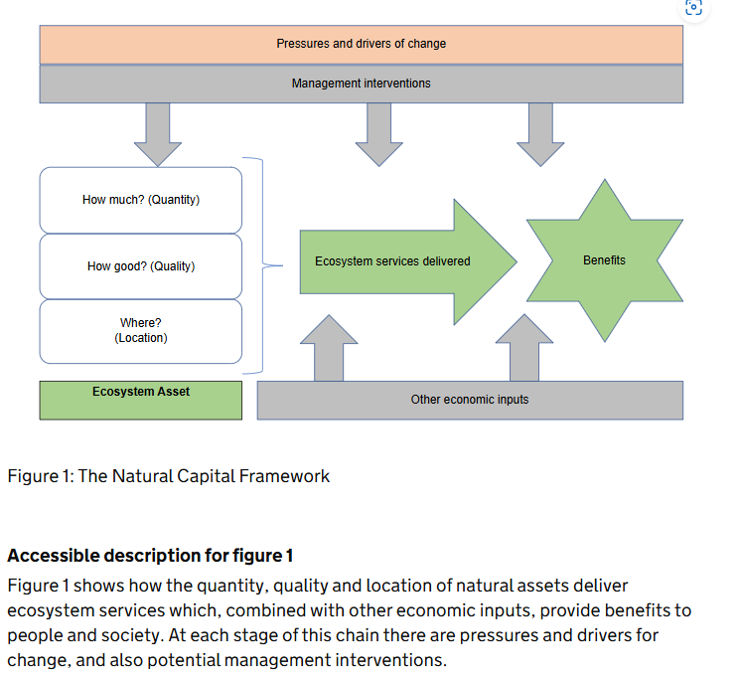
Natural Capital Assets
Natural capital includes elements such as forests, fisheries, rivers, biodiversity, land and minerals. Natural capital includes both the living and non-living aspects of these elements.
Stocks of natural capital provide flows of ‘ecosystem’ services. These services, often in combination with other forms of capital (human, produced and social) produce a wide range of benefits.
Ecosystem services have “use values” that involve interaction with the resource, these can have a market value (minerals, timber, freshwater) or non-market value (such as outdoor recreation, landscape amenity).
They also include non-use values, such as the value people place on knowing about the existence of habitats or species, they may never interact with such as dolphins or elephants. There is enjoyment in just knowing these things exist.
The ability of natural assets to provide goods and services is determined by their quality, quantity and location. These in turn can be affected by background pressures, management practices and drivers of demand.
Notes:
Natural capital includes elements such as forests, fisheries, rivers, biodiversity, land and minerals. Natural capital includes both the living and non-living aspects of these elements.
Stocks of natural capital provide flows of ‘ecosystem’ services. These services, often in combination with other forms of capital (human, produced and social) produce a wide range of benefits.
Ecosystem services have “use values” that involve interaction with the resource, these can have a market value (minerals, timber, freshwater) or non-market value (such as outdoor recreation, landscape amenity).
They also include non-use values, such as the value people place on knowing about the existence of habitats or species, they may never interact with such as dolphins or elephants. There is enjoyment in just knowing these things exist.
The ability of natural assets to provide goods and services is determined by their quality, quantity and location. These in turn can be affected by background pressures, management practices and drivers of demand.
This understanding ties us back to the provision of green spaces across the city, they need to be good quality (Future Park Standard) they need to be the right quantity (enough for everyone to use without decreasing the quality) and they need to be in the right location (Master Planning) to provide the benefits where they are needed. Then how we continue to manage these assets will make a difference to their quality.

Slide 31
Why take the Natural Capital Approach
Taking a natural capital approach develops our traditional understanding of how the economy works - in which traditionally recognised kinds of capital provide flows of benefit to households and firms.
Natural capital does form part of our “wealth”, alongside traditional assets such as infrastructure, skills, buildings and technology. This framing helps us to account for its contribution to the economy, and the range of social and economic benefits and opportunities that come from investment in those assets. Pressures on nature result in costs to the economy.
Understanding nature as a set of assets that benefit people and society in all kinds of ways can support better decision-making. This helps us to give the best public value given that there are scarce resources and trade-offs between objectives. It reduces the risk of the value of the natural environment being ignored in decision making.
Natural capital has become a standard analytical approach to thinking about nature, following the seminal UK National Ecosystem Assessment (2011 and 2014) and the work of the Natural Capital Committee. It offers a balanced focus on natural assets in ecological terms (their quantity, condition and sustainability) and the social and economic benefits that derive from those assets. It also enables different disciplines to adopt a shared framework and understanding in both research and practical initiatives.
However, it is recognised that natural capital as a conceptual approach and language may not resonate with all groups or be relevant for all purposes. It is also recognised that sometimes natural capital assets can overlap with cultural and heritage assets.
It is important for us to be aware of the existence of natural capital assets it’s systems, benefits and value but not to explicitly use this language if it is not felt appropriate for the audience.
Notes:
Taking a natural capital approach develops our traditional understanding of how the economy works - in which only traditionally recognised kinds of capital are seen to provide flows of benefit to households and firms.
The natural capital approach recognises that natural capital also form part of our “wealth”, alongside traditional assets such as infrastructure, skills, buildings and technology.
This framing helps us to account for its contribution to the economy, and the range of social and economic benefits and opportunities that come from investment in those assets.
Pressures on nature result in costs to the economy.
Understanding nature as a set of assets that benefit people and society in all kinds of ways can support better decision-making. This helps us to give the best public value given that there are scarce resources and trade-offs between objectives. It reduces the risk of the value of the natural environment being ignored in decision making.
Natural capital has become a standard analytical approach to thinking about nature, following the seminal UK National Ecosystem Assessment (2011 and 2014) and the work of the Natural Capital Committee. It offers a balanced focus on natural assets in ecological terms (their quantity, condition and sustainability) and the social and economic benefits that derive from those assets. It also enables different disciplines to adopt a shared framework and understanding in both research and practical initiatives.
However, it is recognised that natural capital as a conceptual approach and language may not resonate with all groups or be relevant for all purposes. It is also recognised that sometimes natural capital assets can overlap with cultural and heritage assets.
It is important for us to be aware of the existence of natural capital assets it’s systems, benefits and value but not to explicitly use this language if it is not felt appropriate for the audience.

Slide 32
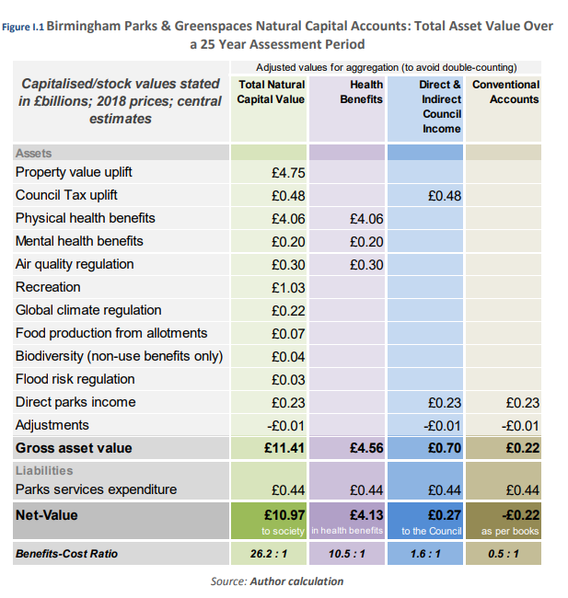
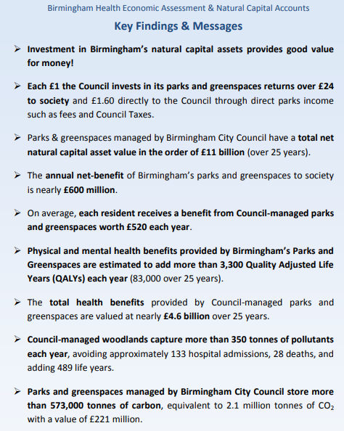
Natural Capital Accounts
Notes:
Birmingham Health Economic Assessment & Natural Capital Accounts - July 2019
Key Findings & Messages
Investment in Birmingham’s natural capital assets provides good value for money! ➢ Each £1 the Council invests in its parks and greenspaces returns over £24 to society and £1.60 directly to the Council through direct parks income such as fees and Council Taxes.
Parks & greenspaces managed by Birmingham City Council have a total net natural capital asset value in the order of £11 billion (over 25 years).
The annual net-benefit of Birmingham’s parks and greenspaces to society is nearly £600 million.
On average, each resident receives a benefit from Council-managed parks and greenspaces worth £520 each year.
Physical and mental health benefits provided by Birmingham’s Parks and Greenspaces are estimated to add more than 3,300 Quality Adjusted Life Years (QALYs) each year (83,000 over 25 years).
The total health benefits provided by Council-managed parks and greenspaces are valued at nearly £4.6 billion over 25 years.
Council-managed woodlands capture more than 350 tonnes of pollutants each year, avoiding approximately 133 hospital admissions, 28 deaths, and adding 489 life years.
Parks and greenspaces managed by Birmingham City Council store more than 573,000 tonnes of carbon, equivalent to 2.1 million tonnes of CO2 with a value of £221 million.

Slide 33

Ecosystem Services – So aren’t these provided for free by nature?
Yes, benefit can follow directly from ecosystem services without further capital or human input, however:
For some ecosystem services, additional inputs are required to realise benefits. Although much cheaper than providing the whole service through human action alone, additional inputs must be funded.
Remember: The ability of natural capital assets to provide goods and services is determined by their quality, quantity and location. Ensuring these factors are met can require funding.
These in turn can be affected by background pressures, management practices and drivers of demand. Good management requires funding.
If they are broken or damaged through our actions, we will have to mend them for them to provide the most benefits –there will be an added cost to do this.
The better the health of the environment, the better the health of natural capital, the better the ecosystem services run without intervention - the less financial cost to the benefits they deliver.
But the benefits are not delivered for free by nature in most urban environments. Most urban environments will require interventions to realise their true value.
Notes:
Ecosystem Services – So aren’t these provided for free by nature?
Yes, benefit can follow directly from the ecosystem service without further capital or human input, however:
For some ecosystem services, additional inputs are required to realise benefits. Although much cheaper than providing the whole service through human action alone, additional inputs must be funded.
Remember: The ability of natural capital assets to provide goods and services is determined by their quality, quantity and location.
These in turn can be affected by background pressures, management practices and drivers of demand.
If we break them or damage them, we will have to mend them for them to provide the most benefits –there will be a cost to do this.
But the benefits are not delivered for free by nature in most urban environments. Most urban environments will require interventions to realise their true value.

Slide 34
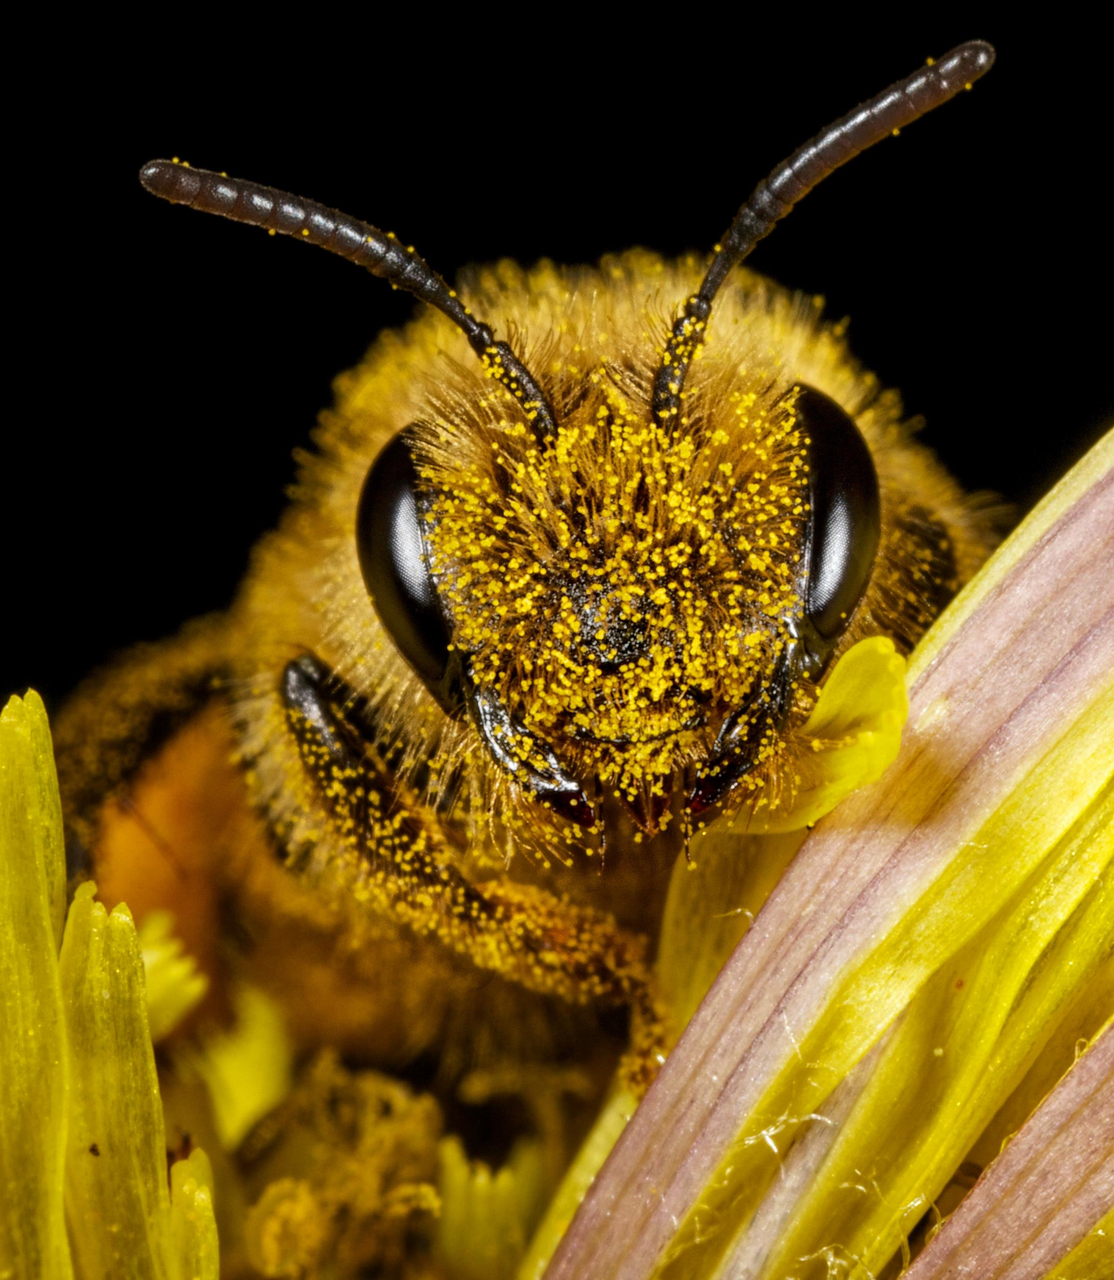
Nature our most important partner
Next – Biodiversity Net Gain
Notes:
Nature our most important partner
There are some amazing partners delivering the City of Nature Plan, but we mustn't forget that nature is also our partner, and we need to make sure that just like us it has what it needs to be a capable partner.
The stronger the relationship, the better we know each other, the greater the return.
The new City of Nature Alliance model needs to have a space for nature.

Slide 35

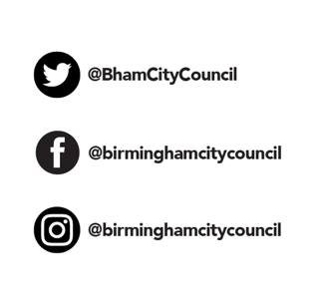
Debbie Needle,
Community Facilitator
City of Nature Projects
Email:
Cityofnature@birmingham.gov.uk
Website:
https://naturallybirmingham.org/

