Slide 1

The BIG 3
Health and Wellbeing benefits of
GREEN SPACE
A Health and wellbeing guide to:
assist link workers in their mission to create excellent social prescribing services.

Slide 2


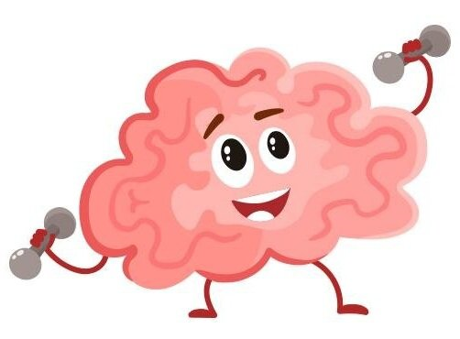
The BIG 3
1. Physical Wellbeing
3. Social cohesion
2. Mental Wellbeing

Slide 3

How well do you know your patient?
Social prescriptions only work if people believe in them.
Here are a few ways to help understand your patients, explore their:
1. Ideas about nature
2. Concerns about nature and the therapy
3. Expectations of what can be done with the therapy

Slide 4
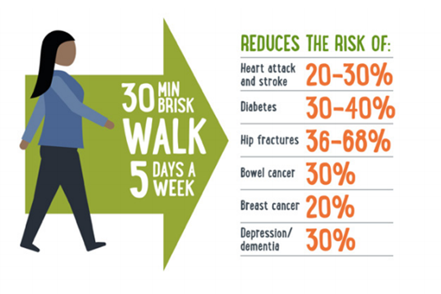
Physical wellbeing
People often think that being “physically active” is about doing vigorous exercise.
It isn’t! A brisk walk is good enough for YOU to enjoy all these benefits.
How many of the benefits listed opposite did you know about?
As a challenge, ask you clients to list what they think the physical benefits of green space are!

Slide 5


Physical wellbeing
Getting outside increases your chances of boosting your bodies levels of vitamin D!
But remember to always wear sun screen to block out those harmful rays!
Z
Z
Z
Natural light helps regulate your bodies internal clock (circadian rhythm) and therefore provides you with a restorative, replenishing, and rejuvenating sleep!

Slide 6
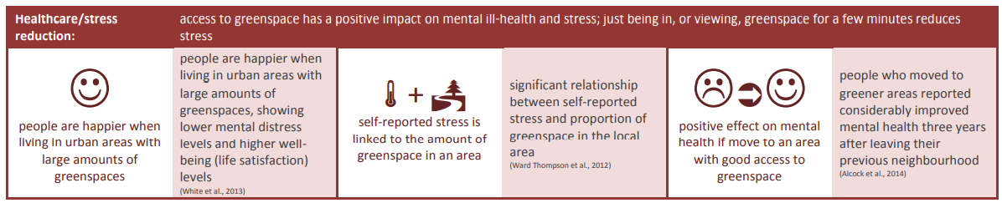
Mental Wellbeing
Questions to ask your clients:
1) When was the last time you were in a green space?
2) How did being in a green space make you feel?
3) Do you know how green space benefits your mental health?

Slide 7





How to connect to nature, and improve your mental health…
Nature connectedness is the key idea behind utilising green space to improve your mental health.
It is all about connecting to the world around you and taking a moment to appreciate it.
Touch!…
What can you touch?
How do you feel about what you touch?
Taste!…
What can you taste?
How do you feel about what you taste?
Look!…
What can you see?
How do you feel about what you see?
Listen!…
What can you hear?
How do you feel about what you hear?
Smell!…
What can you smell?
How do you feel about what you smell?

Slide 8
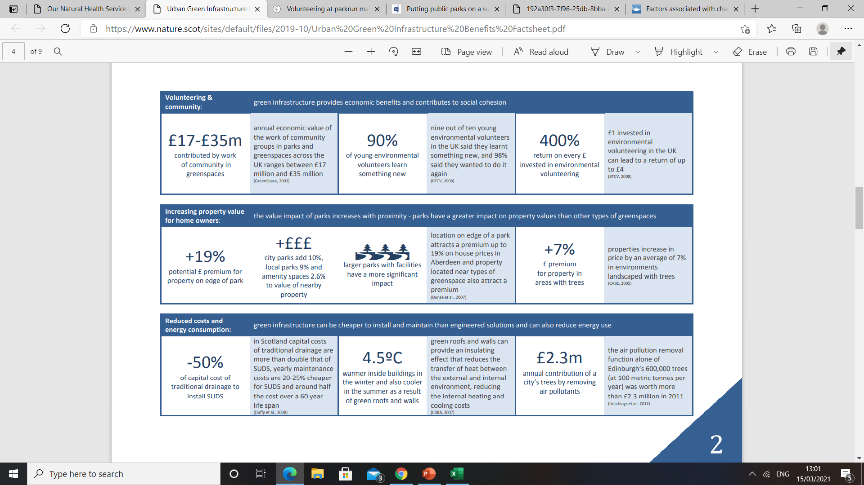
Social Cohesion
Make sure you tell your clients that:
1) Birmingham has 591 green spaces and 7000 allotments!
2) Green spaces are the new community centres!
3) Green spaces are for EVERYONE!

Slide 9


Social Cohesion
So are we, but getting outdoors will help us all combat this!
Are you worried about:
. Fly tipping?
. Environmental hazards?
. Anti-social behaviour?
The more we use green spaces the more we:
. Help understanding of the benefits
. Help preserve natural beauty
. Help people come together
During COVID green spaces have become the new community centres

Slide 10
Case Study | What can we learn?
A 50-year-old patient with a learning disability was referred to the Link Worker. He was struggling with his mental health, was inactive and obese. He has been socially isolated and needed some social help. | He is a complex patient who has lots of different needs. There are lots of patients like this.
He was refereed to a link worker January during his visit to the GP for his vaccination. | The services are there we just need to raise awareness about them!
He now receives support twice a week including engaging with a walking and gardening group. Initially he was hesitant to engage into any of the activities he was offered. After attending his first sessions he is now enjoying both the walks and gardening sessions. | There can be a transformational benefit for our patients. This is because social prescribing helps patients with their physical, mental and social health.
At his most recent walking session he spoke about his improvement in his self-esteem. He told the group that he has never enjoyed gardening before but now enjoys the activity and is interested in learning more about it. | Social prescribing can help people learn new skills.
His mum, who has always supported and encouraged him, stated she felt proud said she also wants to visit the gardening site with him to join in. | The snowball effect when one person feels change everyone can start to feel the benefit!
CONCLUSION: The work YOU do CHANGES lives.

Slide 11
Case Study | What can we learn?
A 24-year-old male has received 3 face to face Link Worker support sessions based in 3 greenspaces: at Calshot Park, Great Barr, and Witton Lakes. Prior to being referred, he was homeless and struggled with depression. | Patients have complex social, mental and physical needs.
Within a week of engaging with LW: . He now lives in supported living accommodation. . He was also signposted to a local engineer organization that and now works there with a full-time job as an apprentice. . He was also referred to access food support from two Aston based Masjid food banks. . Having mentioned his mother’s struggle with substance misuse, he was also signposted to the Council’s substance misused support provider which he was able to access for his mother. | We can be the hub that signposts patients to the correct spokes so that they can get their needs fulfilled.
He reported to the Link Worker saying, "you've put my life back on track mate". | You can and are changing peoples lives.
He was referred to our prescription scheme and was delighted to receive a free bike to get to work. He cycles to work with it daily. He is now motivated to be more physically active and would like to get involved in volunteering work to support other young people. | People with lived experiences of the benefits of green spaces and green social prescribing are likely to become green champions and help others do so!
CONCLUSION: The work YOU do CHANGES lives.

Slide 12
Sometimes its about the signs, sometimes its about a little bit more…
Have any of these things changed?:
But remember, green social prescribing is also about happiness:
Engagement
Mental health: Forgetfulness, difficulty concentrating, worrying, rumination, not enjoying life, difficulty with decision making
Physical health: Poor sleep, restlessness, fitness, pain
Social health: social isolation, loneliness, not engaging, poor social function
Positive emotions
Happiness
Relationships
Achievement
Meaning
Notes:
Use Alex as an example in the strategy work and shock at last 3
Causally explain each of the last 3

Slide 13
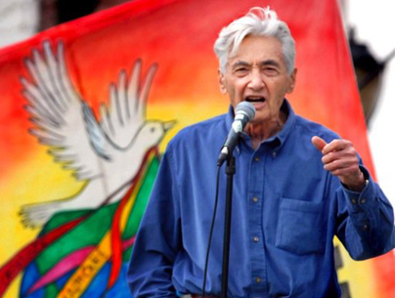

The climate emergency
The climate emergency requires us all to make changes in our lives.
We don’t have to engage in grand, heroic actions to participate in the process of change. Small acts, when multiplied by millions of people, can transform the world.
Howard Zinn
By educating and empowering our patients in green spaces, we can convey the severity of the existential crisis we face as a species and encourage them to start with small acts for their health and the health of the planet.

Slide 14
WHERE TO START…
Organisation | What they do | Where you can find them
Birmingham City Council | You can locate YOUR local park! | https://www.birmingham.gov.uk/findapark
BOSF (Birmingham open spaces forum) | A wide range of volunteering opportunities in green spaces! | https://bosf.org.uk/
THRIVE | Social prescribing through gardening! | https://www.thrive.org.uk/how-we-help/regional-centres-and-programmes/birmingham

